Slide 1
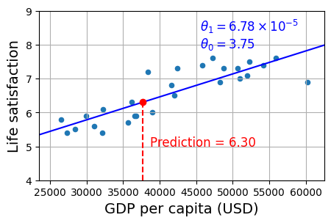
The Machine Learning Landscape
David Meredith
Aalborg University
dave@create.aau.dk

Slide 2
Sources for this lecture
Preface and Chapter 1 of
Géron, A. (2023). Hands-On Machine Learning with Scikit-Learn, Keras & TensorFlow. (Third edition). O’Reilly. Available at
https://www.amazon.de/-/en/Aur%C3%A9lien-G%C3%A9ron/dp/1098125975/
https://www.saxo.com/dk/hands-on-machine-learning-with-scikit-learn-keras-and-tensorflow_bog_9781098125974
https://factumbooks.dk/?search_string=hands-on+machine+learning+with+scikit-learn

Slide 3
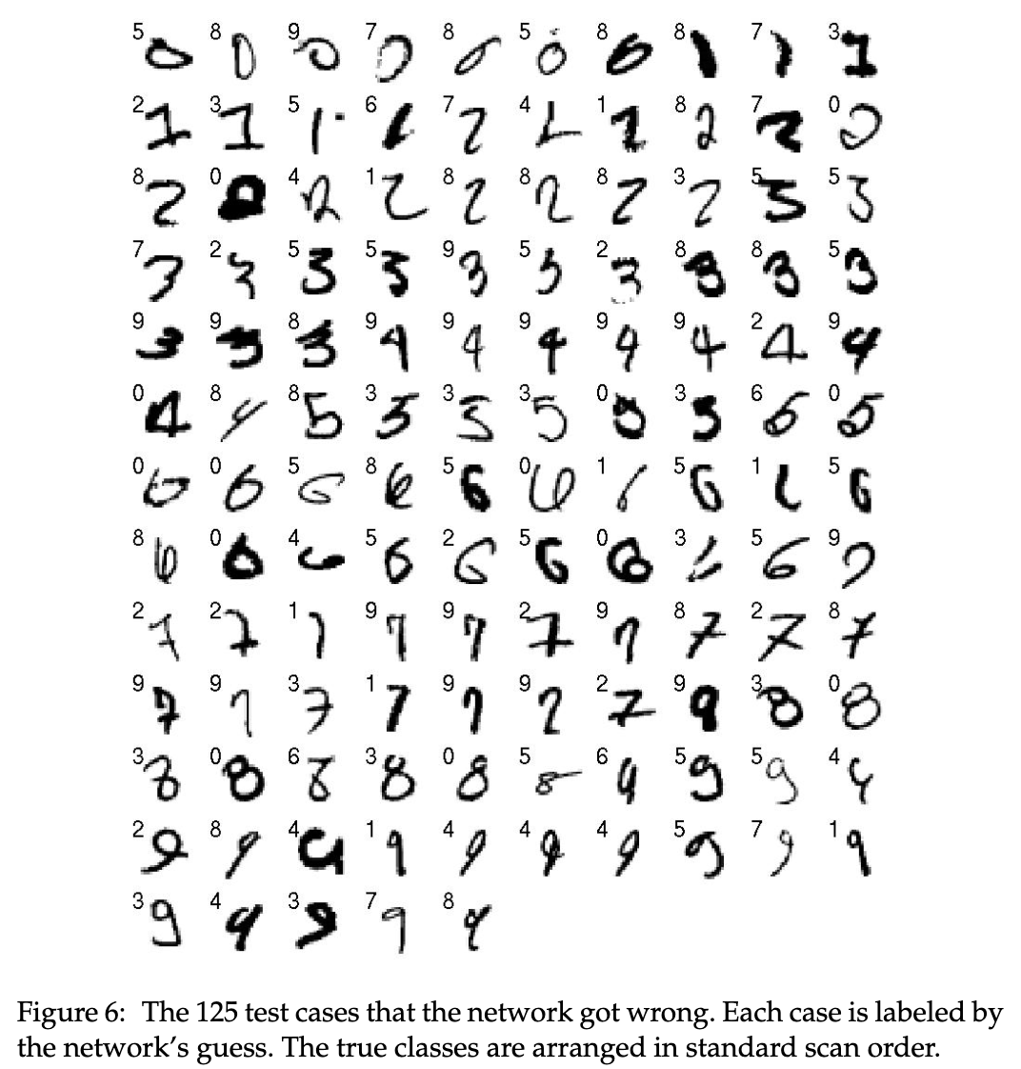
The Machine Learning Tsunami
In 2006, Hinton, Osindero and Teh published a paper* describing how to train a deep neural network that could recognize handwritten digits with state-of-the-art accuracy (>98% at the time)
They called this novel network training technique, deep learning
A “deep” neural network (i.e., one with more than one layer) is a learning model inspired by the architecture of the cerebral cortex which has been shown to consist of a stack of layers of neurons, each one representing concepts that are more and more abstract
From Hinton et al. (2006, p. 1542)
* https://www.cs.toronto.edu/~hinton/absps/ncfast.pdf

Slide 4
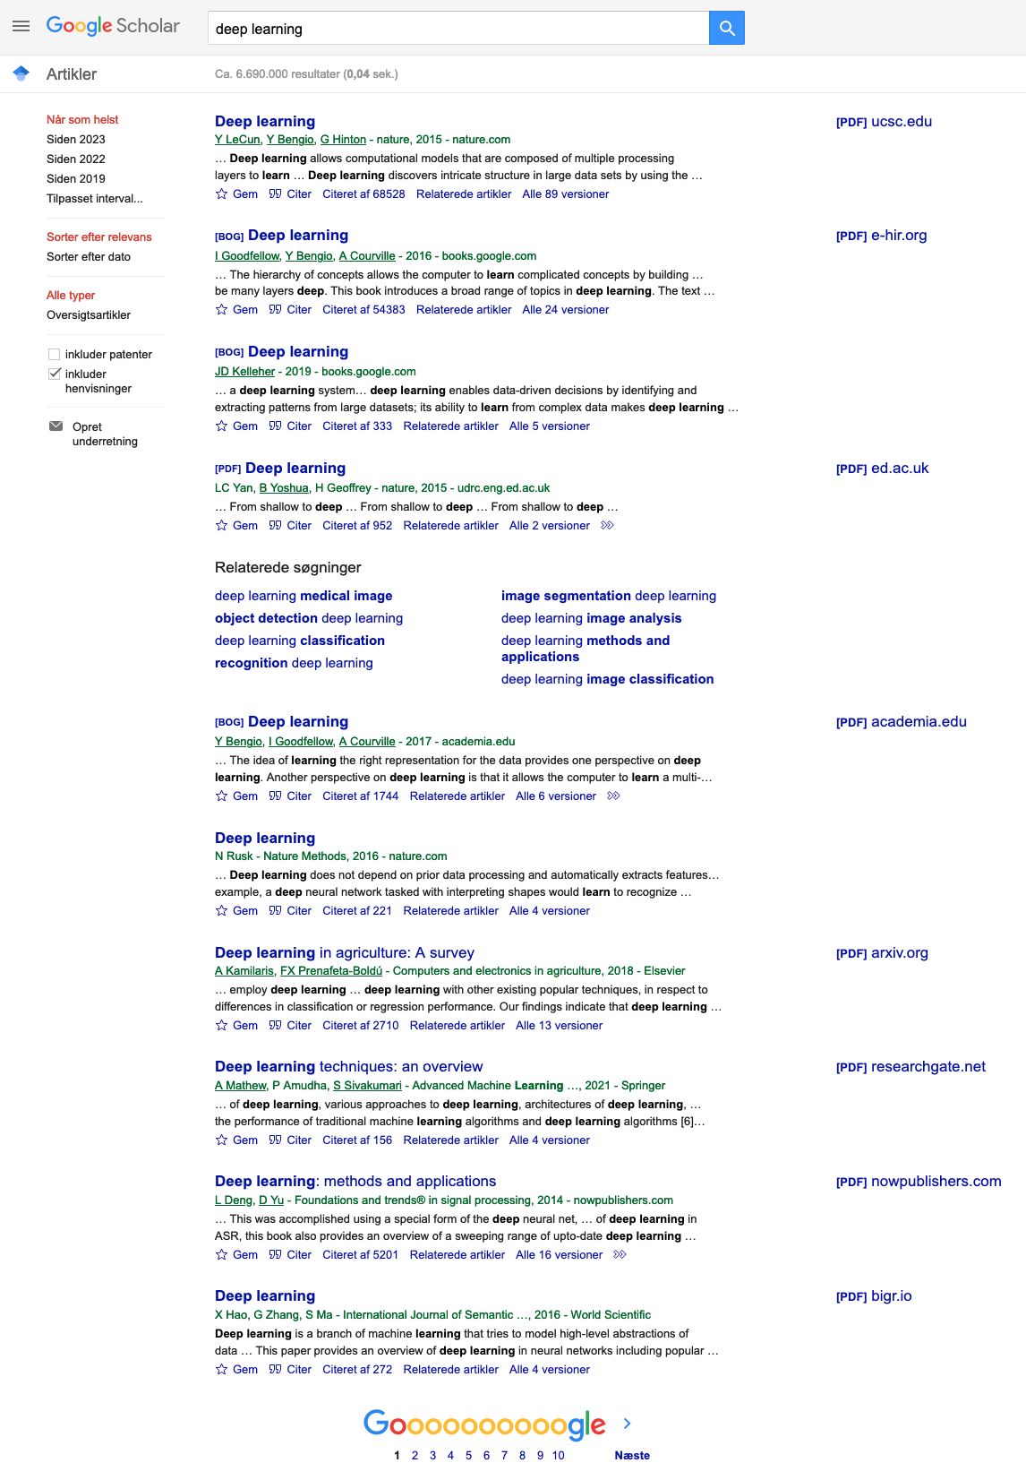
The Machine Learning Tsunami
Before Hinton et al.’s paper, it had been widely considered that training a deep neural network was impossible and most researchers had abandoned the idea
The success of Hinton et al.’s method revived interest in artificial neural networks and led to a tidal wave of projects that showed that deep learning could be used to achieve results well beyond the SOTA in many ML tasks (provided one had enough computing power and data...)
Since then, ML models have become ubiquitous, being present in a huge variety of products and services

Slide 5

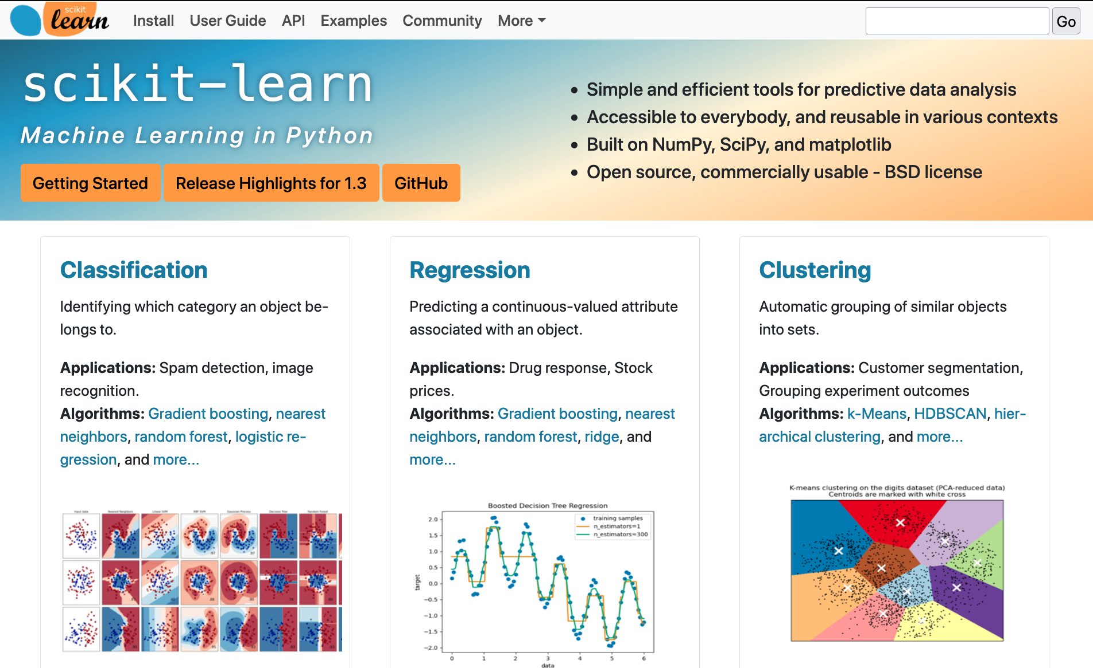
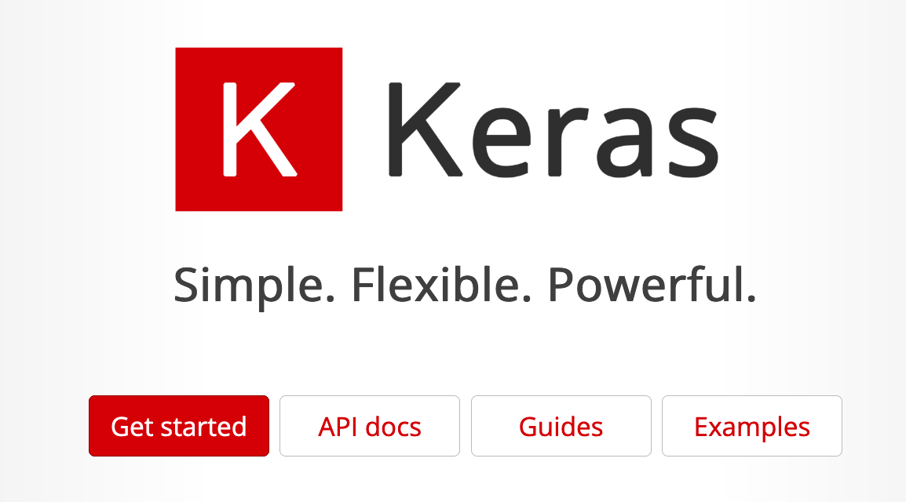

Objective and approach
So naturally you are keen to incorporate machine learning into your projects, and this course aims to provide you with the knowledge and skills that will empower you to do so
We will assume you know next to nothing about machine learning
However, you should have a good basic familiarity with Python
e.g., by having completed The Python Tutorial (https://docs.python.org/3/tutorial/index.html)
You hopefully should get this from the Python workshops
We will cover a wide range of ML techniques, ranging from simple linear regression to deep learning networks
We will make extensive use of the following three Python ML frameworks:
Scikit-Learn (https://scikit-learn.org) provides implementations of many ML algorithms through an easy-to-use API
TensorFlow (https://tensorflow.org) is a library for distributed numerical computation that makes it possible to parallelise ML processes over many processors
Keras (https://keras.io) is a high-level deep learning API that makes it very simple to train and run neural networks (Keras uses TensorFlow)

Slide 6
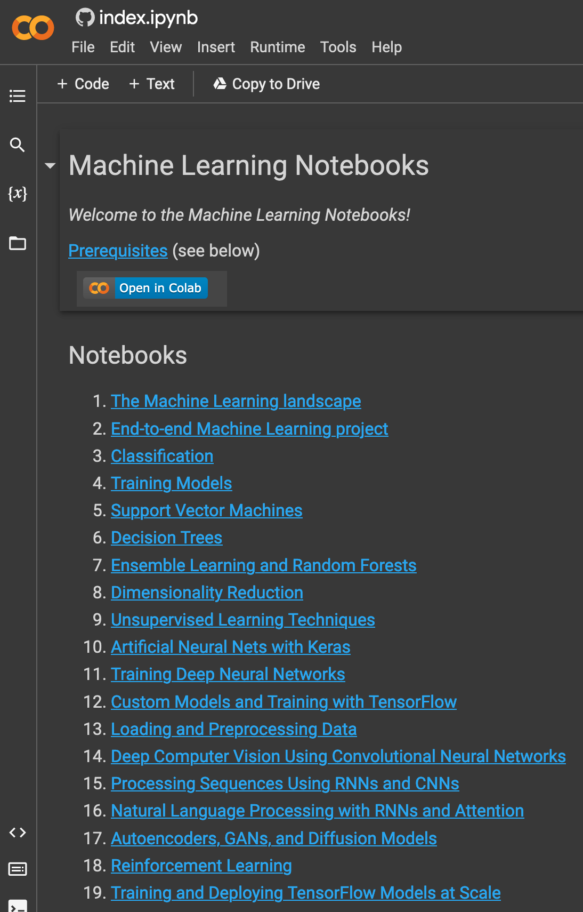
Code examples and tutorials
This course is heavily based on the following book:
Géron, A. (2023). Hands-On Machine Learning with Scikit-Learn, Keras & TensorFlow. (Third edition). O’Reilly.
All code examples that we will use from this book are available as Jupyter notebooks at https://homl.info
There is a notebook for each chapter of the book, and each notebook contains a button, “Open in Colab”, which lets you open and run the notebook in Google Colab - you’ll need a Google account to do this
You can also run in, e.g., PyCharm, with the Jupyter Notebook package installed
You can also access these notebooks as well as tutorials on relevant Python frameworks and mathematical topics here:
https://colab.research.google.com/github/ageron/handson-ml3/blob/main/index.ipynb
In the next Python workshop, we will work through the material covered in the tutorials on NumPy, Pandas and Matplotlib

Slide 7
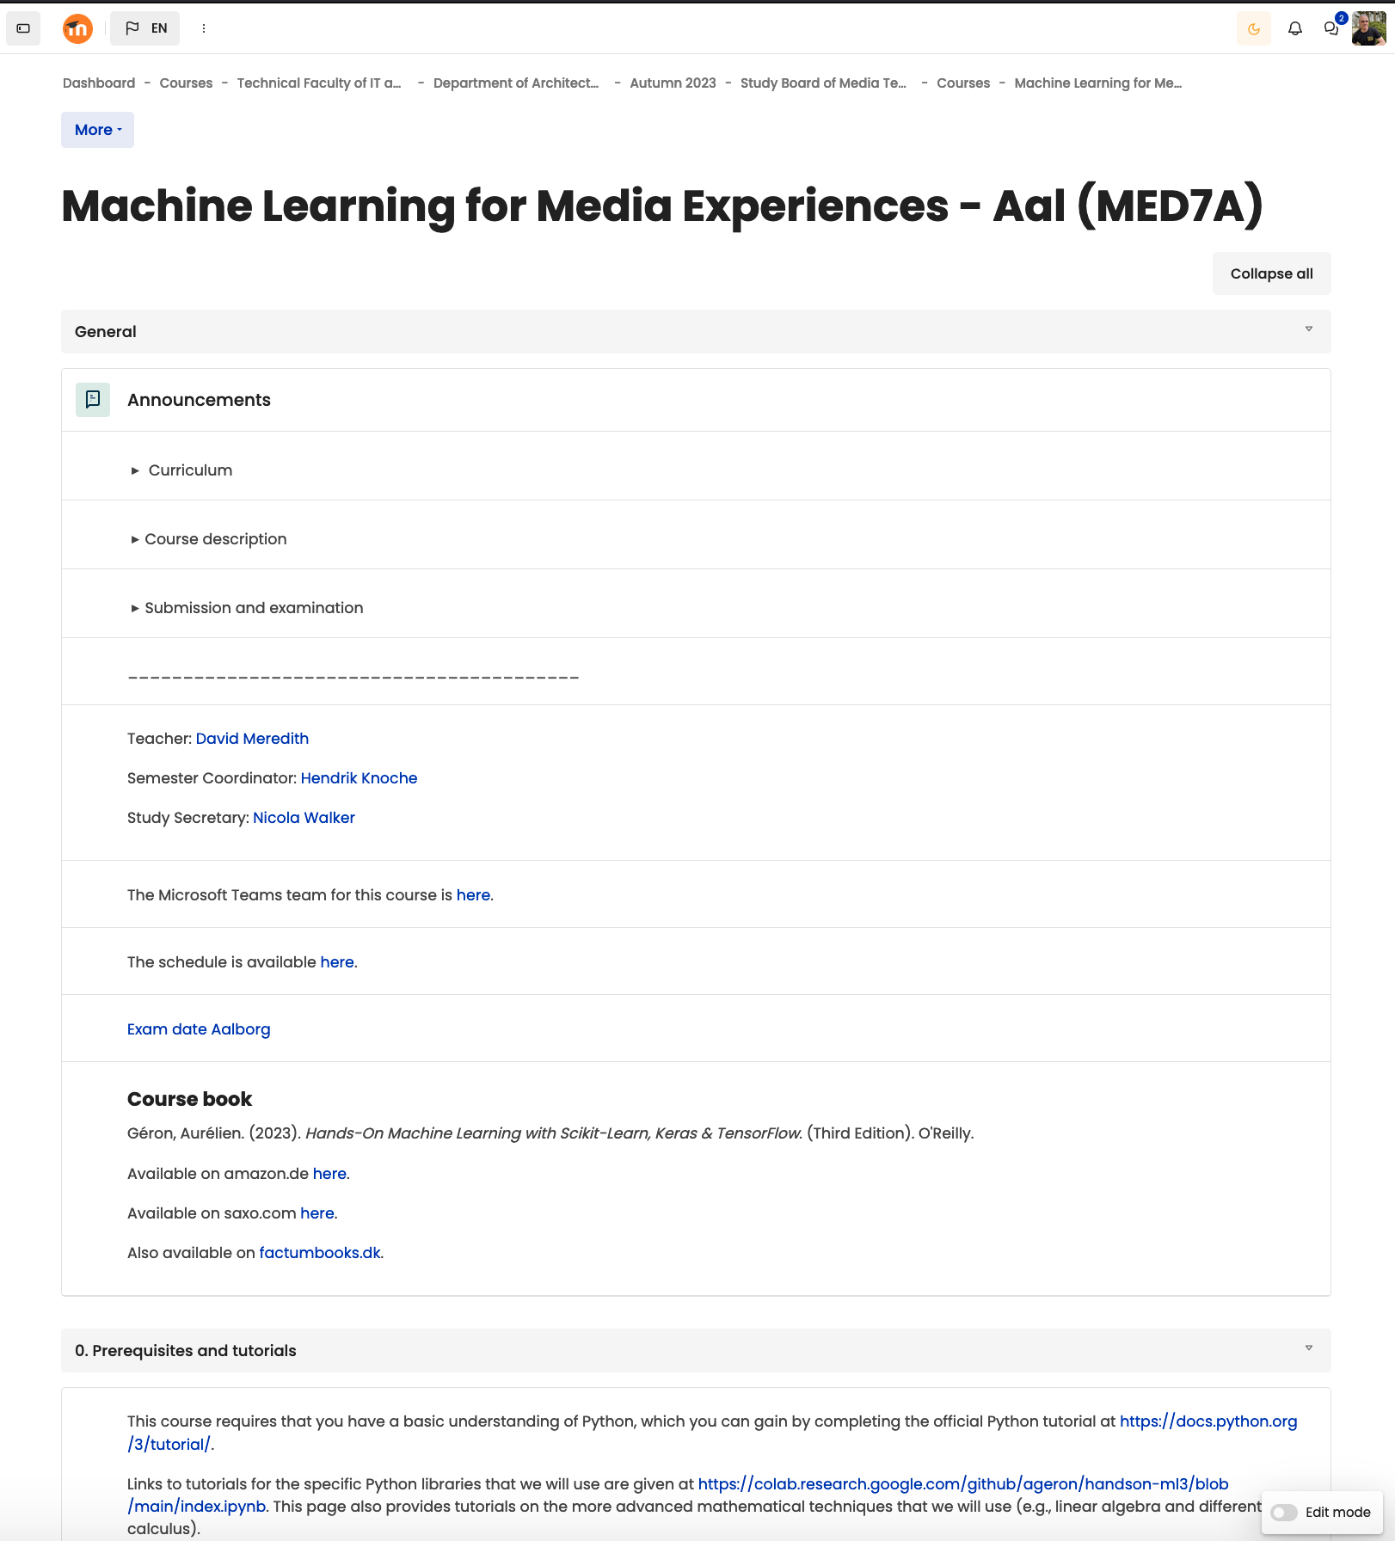
Overview of course
Course will consist of 12 lecture sessions
Each session will consist of
45 minute lecture
15 minute break
45 minute lecture
2 hours exercise session (supervised)
You need to devote this scheduled time to the course – do not use the exercise sessions to work on other tasks such as the semester project!
You will need to carry out an individual miniproject (ca. 2 ECTS), which will be assigned to you by the course lecturer
The exam will be an oral examination in which you will be asked questions about your mini-project and the course material in general

Slide 8
Overview of course
The topics covered in the course will include the following:
What machine learning is, what kinds of problem it can be used to solve, the main categories and basic concepts of ML
The steps involved in carrying out a machine learning project
Learning by fitting a model to some data
Optimizing a cost function
Handling, cleaning and preparing data
Selecting and engineering features
Selecting a model and tuning hyperparameters using cross-validation
The problems of underfitting and overfitting
The most common learning algorithms: linear and polynomial regression, logistic regression, k-nearest neighbours, support vector machines, decision trees, random forests and ensemble methods
Dimensionality reduction
Unsupervised learning techniques, including clustering, density estimation and anomaly detection
What neural nets are and what they’re good for
Building and training (deep) neural nets using TensorFlow and Keras
Topics 1-11 will involve us mostly using Scikit-Learn
Topics 12-13 will involve us using TensorFlow and Keras

Slide 9
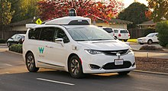
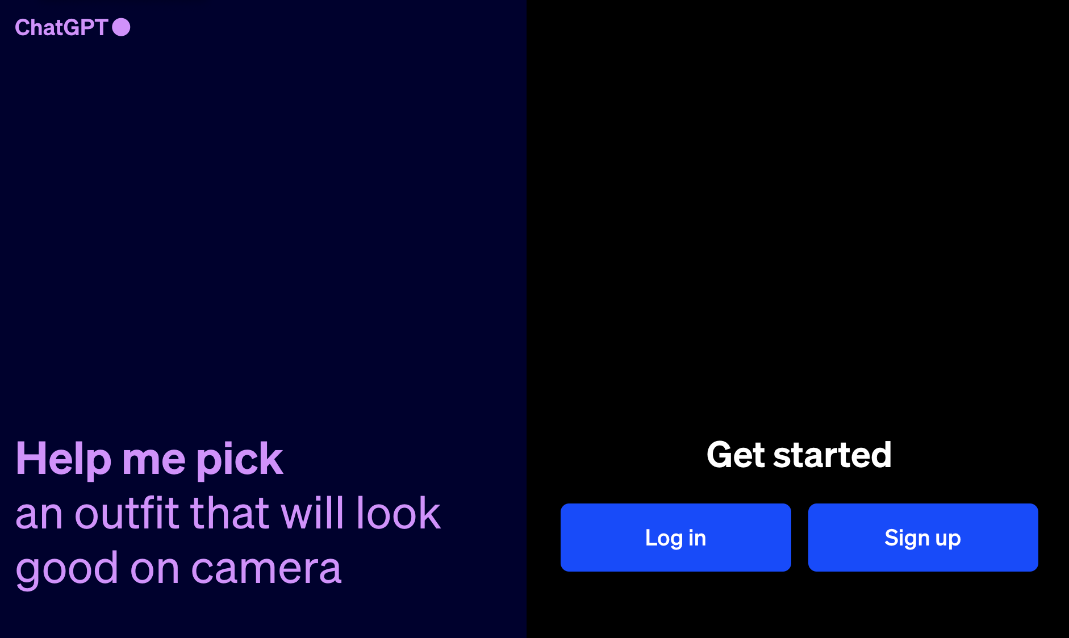

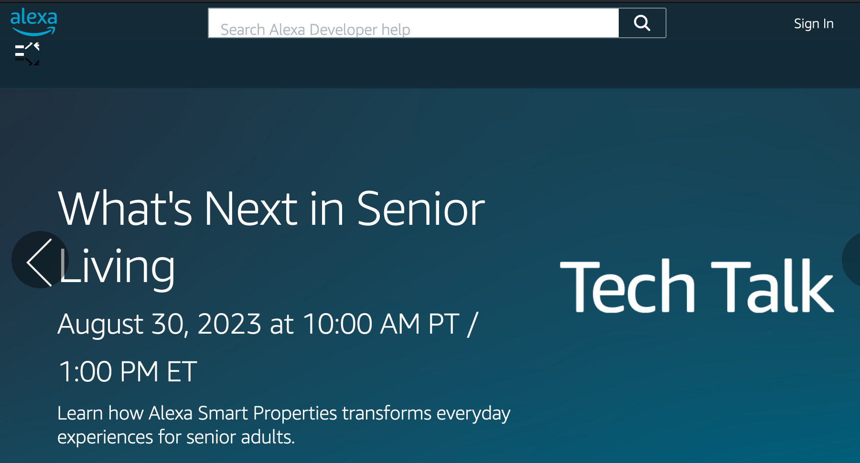
The Machine Learning Landscape
Machine learning has been around for a long time, in the form of systems for, e.g., optical character recognition or spam filtering, which have been in use since the 1990s
Today thousands of products and services use ML in some form to make them capable of “learning from experience”, examples include
voice prompts, automatic translation, computer vision, image recognition and retrieval, product recommendation, information retrieval
In this lecture we address the following questions
What does it mean for a machine to learn?
If you download a copy of Wikipedia to your hard-drive, that doesn’t mean that your machine now knows and understands everything about everything!
What are the different main categories of machine learning system?
supervised vs. unsupervised
online vs. batch learning
instance-based vs. model-based learning
What are the steps involved in a typical machine learning project and what are the main challenges that are faced along the way?
How do we evaluate and fine-tune a machine learning model?

Slide 10
What is machine learning?
Machine learning is the science and craft of programming computers so that they can learn from data
How do we know if a machine has learnt from some data?
“A computer program is said to learn from experience E with respect to some task T and some performance measure P, if its performance on T, as measured by P, improves with experience E.” (Tom Mitchell, 1997)
This means that P needs to be selected so that it really does measure how well the system performs on task T
For example, a spam filter is a machine learning program that learns to tell the difference between spam mails and “ham” mails from a training set of mails in which each mail has been labelled (by humans) as either spam or ham
Each mail in the training set is called a training instance or training sample
The part of a machine learning system that learns from the data and makes predictions is called a model
In the case of a spam filter, the task, T, is to flag new mails as either spam or ham, the experience, E, is the training data and the performance measure, P, needs to be defined as something appropriate, such as the proportion of new mails that are correctly classified (known as accuracy)
If you just download Wikipedia, then your computer has a lot of data available, but it has not used this data to become better at performing any particular task, so this does not constitute machine learning
Notes:
asdf

Slide 11
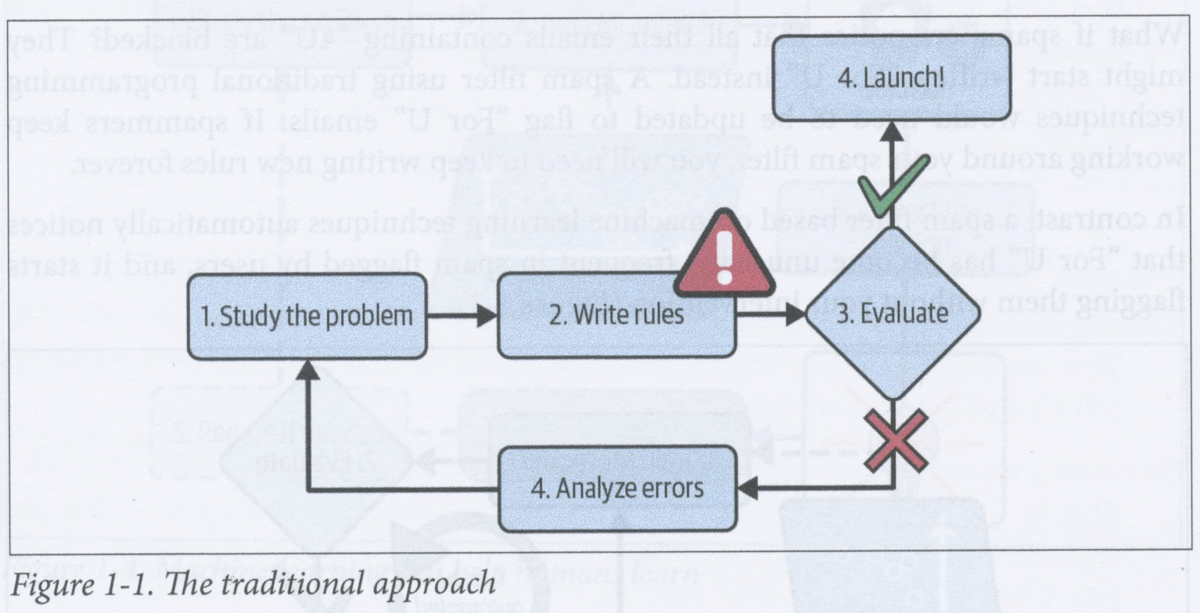
Why use machine learning?
How would you build a spam filter without using data for learning?
1. Study some spam emails to try to discover some rules (or features) that can be used to distinguish spam from ham (e.g., mis-spellings, use of exclamation marks in the subject field)
2. Design an algorithm that uses the rules/features you discovered to determine whether a given mail is spam or ham.
3. Test the program and then repeat steps 1 and 2 until the program performs well enough to put into production.
In the case of spam, you will probably find that you need a lot of complex rules in order to get decent performance
In contrast, a spam filter based on machine learning would automatically learn patterns that are good for distinguishing between spam and ham (e.g., ones that occur frequently in spam and infrequently in ham, or vice versa)
This usually leads to a simpler program (though typically a more complex model) that can, given enough data of the right type, end up being more accurate than is feasible using manually constructed rules

Slide 12
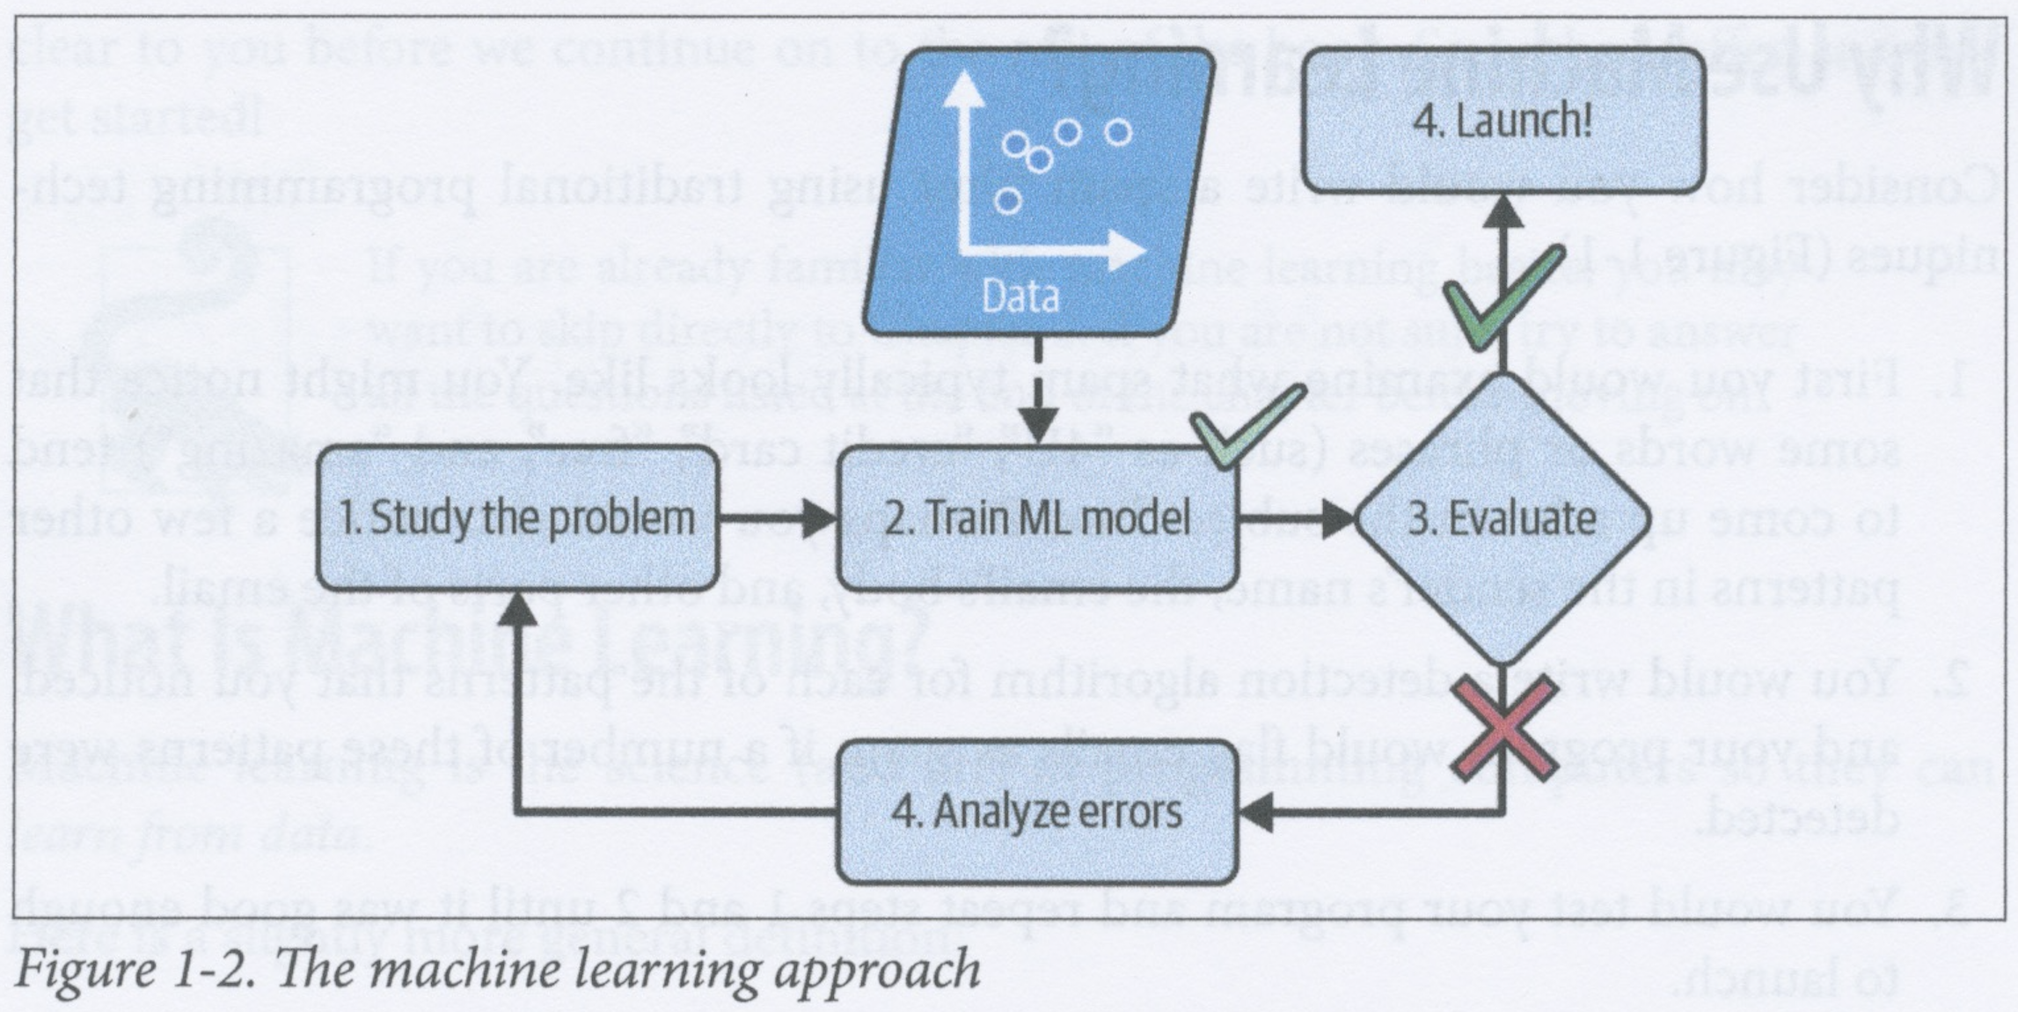
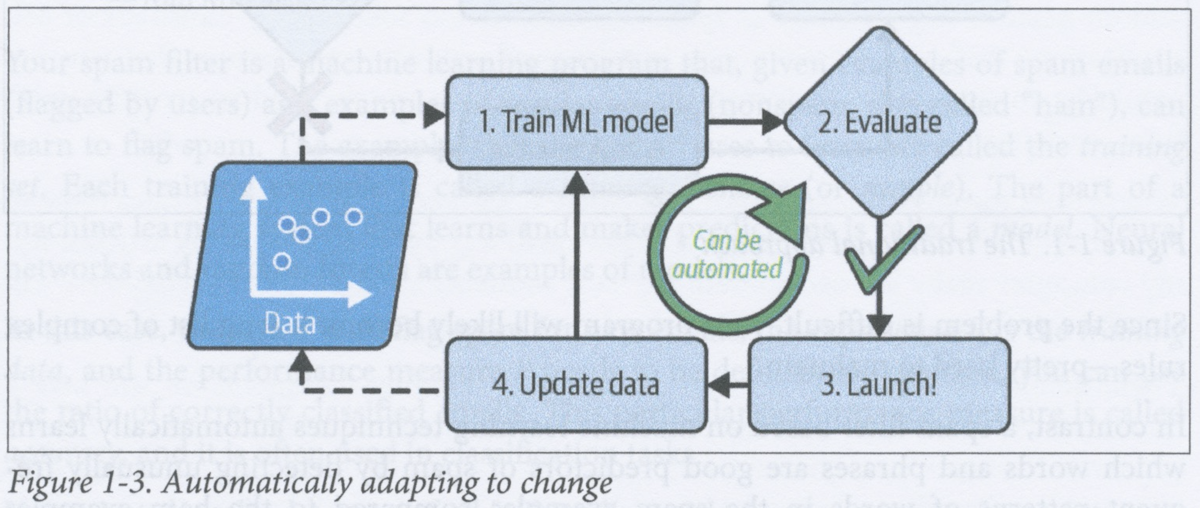
Why use machine learning?
Suppose you have a rule-based spam filter that has the rule “Block all mails that contain the string, ‘4u’”
What if spammers discover that all their mails containing ‘4u’ are blocked and start using “For U” instead?
You would then have to manually update and modify the rules in your spam filter so that it blocks mails containing the string “For U”
If spammers keep working around your filter, you will become trapped in an infinite cycle of updating your spam filter rules
In contrast, a spam filter based on machine learning might automatically notice that “For U” has become more frequent in spam flagged by users and start flagging these mails as spam without human intervention

Slide 13
Why use machine learning?
Machine learning is also good for problems that are either very complex or for which there does not exist any known algorithm
For example, it might be straightforward to write a rule-based algorithm for distinguishing been the spoken words “one” and “two” that uses the fact that “two” starts with a recognizable “t” sound
However, it would be impractical to adopt this approach to solve the general speech recognition task which requires the ability to distinguish between many different words and phrases, spoken by millions of different people in many different types of environment
For the general problem, the current best performing systems are ones that use machine learning

Slide 14
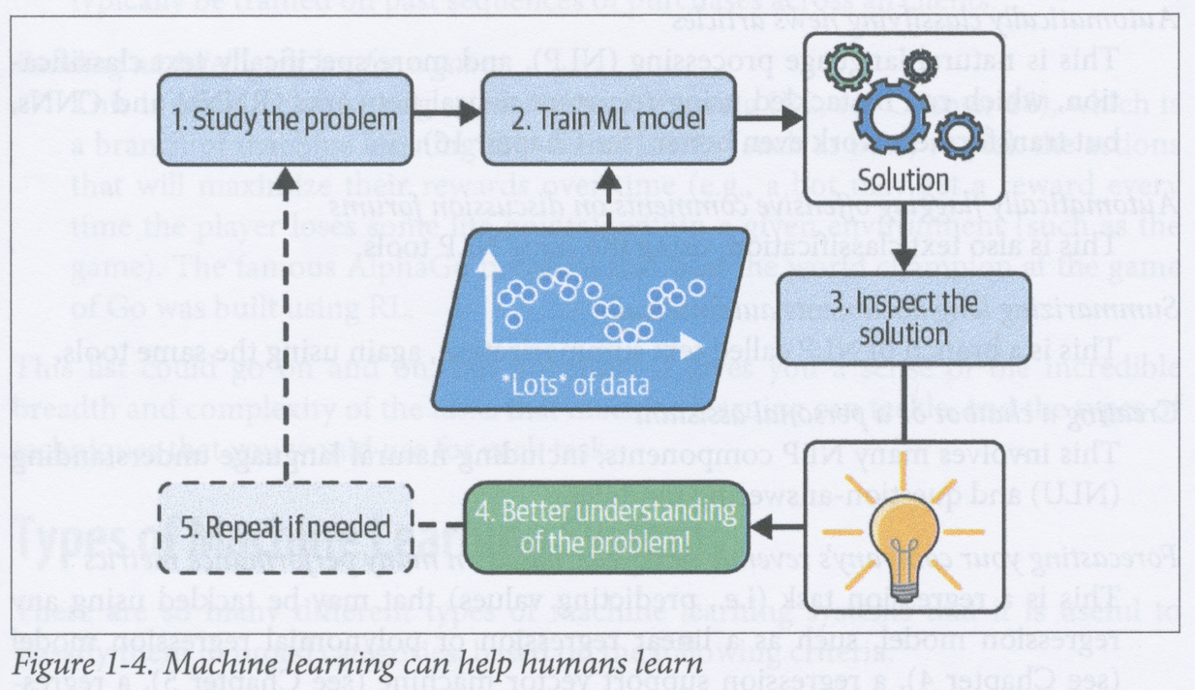
Why use machine learning?
In principle, one might be able to inspect what a successful machine learning model has learnt from a large amount of data and gain some insight into the regularities and patterns in that data
this is called data mining
However, many modern machine learning models are very complex and it is typically as hard for humans to see regularities in these models as it is for them to see regularities in the data used to train them
This is the problem of “Explainable AI”

Slide 15
Why use machine learning?
In sum, machine learning is especially good for
problems for which a hand-crafted system would require a lot of fine tuning and many complex rules
some complex problems for which no rule-based solution has yet been found
tasks that are carried out in changing or fluctuating environments (ML systems can relatively easily be retrained on new data)
getting insights into the regularities in data (though the most successful models for complex processes are often not good at doing this)

Slide 16
Examples of applications
Application | Type of task | Examples of techniques used
Analysing images of products to classify them (e.g., for quality control) | Image classification | CNNs, transformers
Detecting tumours in brain scans | Semantic image segmentation where each pixel is classified | CNNs, transformers
Classifying news articles | Text classification, a specific task within natural language processing (NLP) | RNNs, CNNs, transformers
Flagging offensive comments on social media or other fora | Text classification | RNNs, CNNs, transformers
Summarizing long documents | Text summarization | RNNs, CNNs, transformers
Chatbot | Natural language understanding, question-answering | Various NLP techniques
Forecasting revenue | Regression | Any regression technique, e.g., linear or polynomial regression, regression SVM, regression random forest, ANN, CNNs, RNNs, transformers
Voice control of an app | Speech recognition | RNNs, CNNs, transformers
Detecting credit card fraud | Anomaly detection | Isolation forests, Gaussian mixture models, autoencoders
Classifying customers for targeted marketing | Clustering | k-means, DBSCAN
Visualizing high-dimensional data | Data visualization and dimensionality reduction | Dimensionality reduction, e.g., PCA
Recommending products based on past purchases | Recommender systems | ANNs
Intelligent bot in a game | Reinforcement learning | Reinforcement learning

Slide 17
Types of machine learning systems
We can usefully organise machine learning systems according to the following criteria:
How they are supervised: ML models can be e.g., supervised, unsupervised, semi-supervised, or self-supervised
Whether they learn on the fly: ML models can use either online or batch learning
Whether they process new inputs by
direct comparison with specific inputs that have already been recognized (instance-based learning) or
create a generalized predictive model from past inputs (model-based learning)
These criteria form independent dimensions of a space within which ML models can be organised
For example, a spam filter that consists of an ANN that incrementally learns from new labelled inputs would be an online, model-based, supervised learning system

Slide 18
Training supervision
ML systems can be categorised according to the type and amount of training they receive
The main categories are
supervised learning
unsupervised learning
self-supervised learning
semi-supervised learning
reinforcement learning

Slide 19
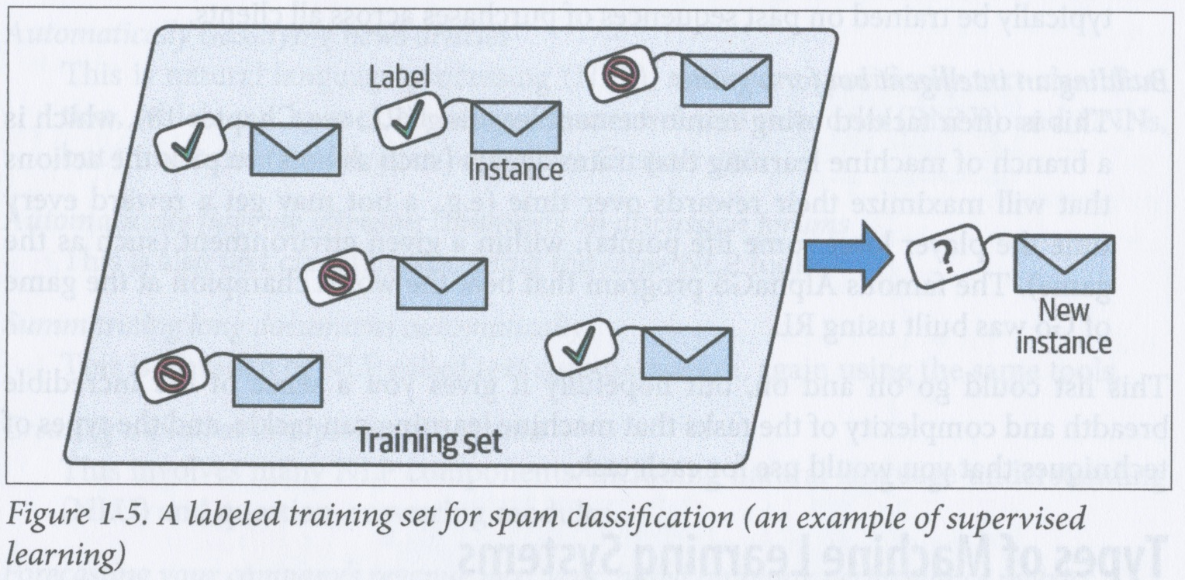
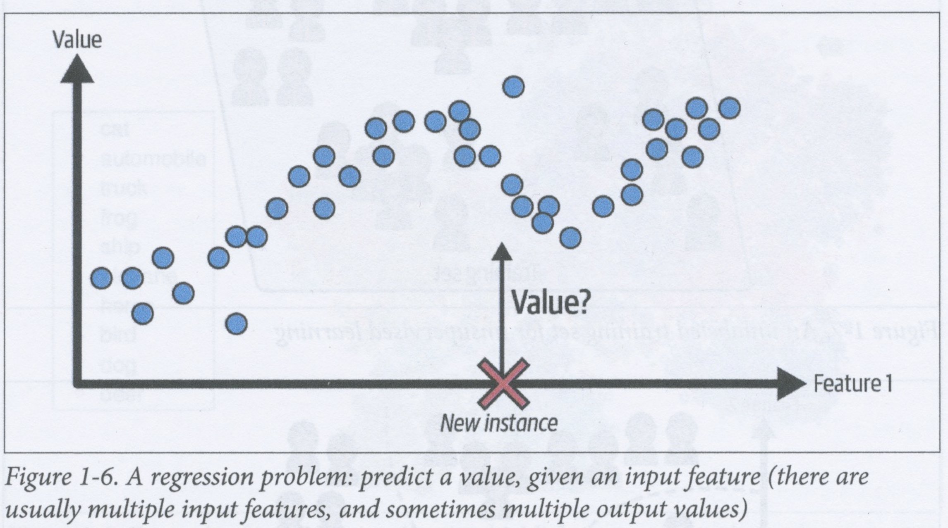
Supervised learning
In supervised learning, the model is trained using a set of labelled instances
A typical supervised learning task is classification
e.g., spam filter that classifies emails into spam or ham
Another typical supervised learning task is regression, where the system has to predict a target value (e.g., price of a car), given a set of features (e.g., mileage, age, brand, model,...)
Training set consists of labelled samples where the values of the features and the target are provided for each instance
Some regression models can also be used for classification
e.g., logistic regression outputs a value that can be interpreted as being the probability of belonging to a class

Slide 20
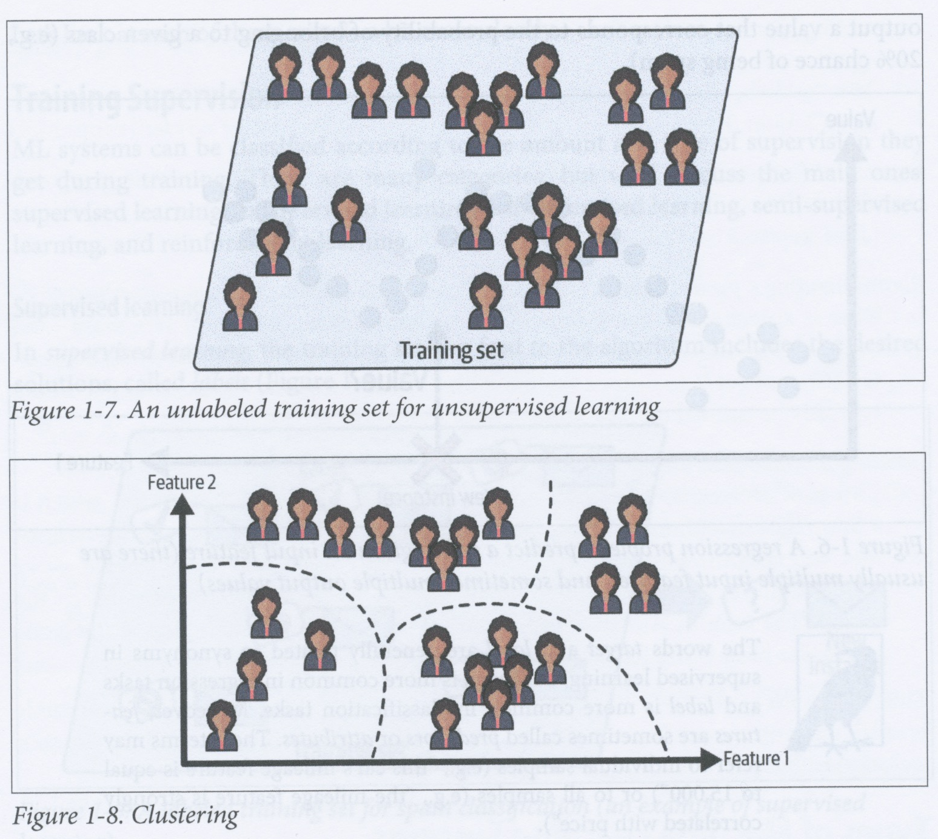
Unsupervised learning - clustering
In unsupervised learning, the training set is unlabelled
A typical unsupervised learning task is clustering
In clustering, the system attempts to find the best way of dividing the data up into classes
For example, if you have sufficient information about the people who visit your blog, then you might be able to use an unsupervised learning algorithm to discover the proportions of the different types of user
e.g., 40% teenagers who like comic books and visit after school, 20% adults who like sci-fi and visit on weekends
A hierarchical clustering algorithm will provide a multi-level segmentation of your data into hierarchical clusters (i.e., clusters that are themselves subdivided into subclusters)

Slide 21
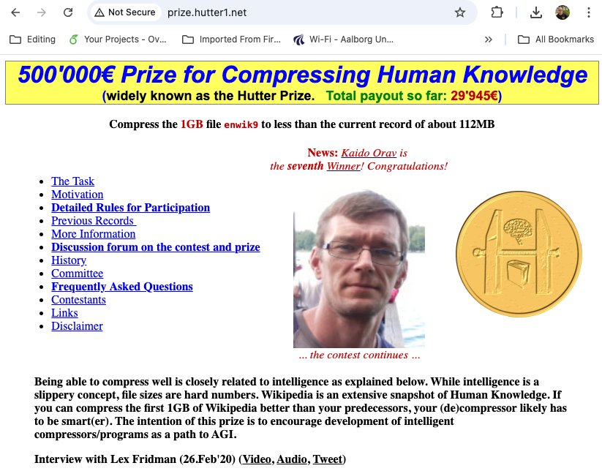
Unsupervised learning and compression
Unsupervised learning is about discovering the best way of describing (i.e., understanding) data
Theoretically (according to the theory of Kolmogorov Complexity) the best ways of understanding data are described by the shortest possible descriptions of that data
This implies that understanding is basically compression
Unsupervised learning algorithms are therefore often compression algorithms (either lossy or lossless)

Slide 22
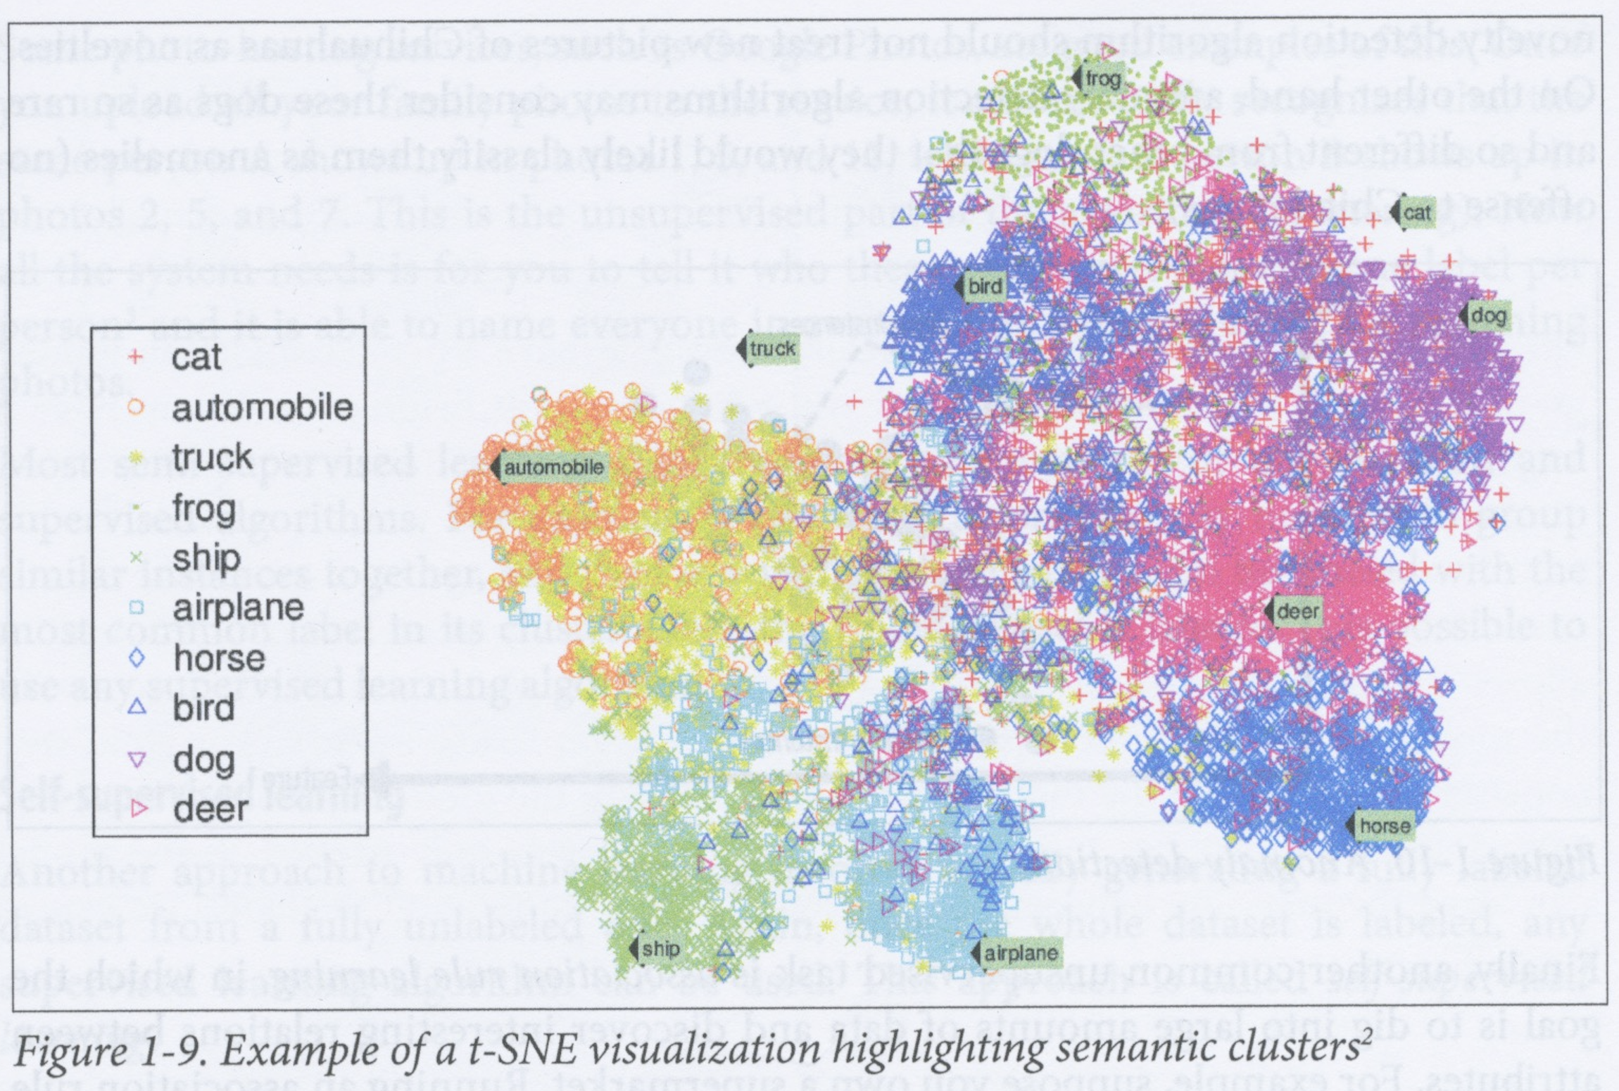
Unsupervised learning – visualization and dimensionality reduction
Another typical unsupervised learning task is visualization
Visualization algorithms may also use clustering (or some other compression technique) to try to get the best possible 2d or 3d image that represents the structure of the data
Visualization also often involves dimensionality reduction where the goal is to simplify the data in a way that does not throw too much information away
This can sometimes be done by merging correlated features into one
e.g., mileage and age features of a car might be correlated and therefore mergeable into a single feature

Slide 23
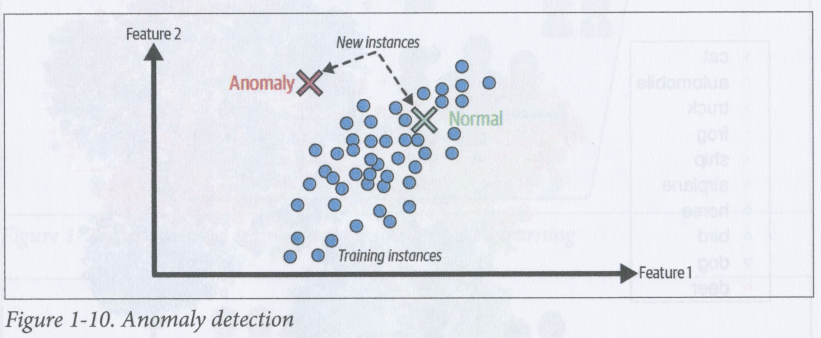
Unsupervised learning – anomaly and novelty detection
Anomaly detection is another typical unsupervised learning task that involves discovering instances that are unusual – i.e., anomalous
User for detecting credit card fraud, manufacturing defects, cleaning data by removing outliers, for example
System is trained primarily on normal instances
Related task is novelty detection which also involves detecting new instances that are different from those in the training set
Requires training set to be very “clean” – i.e., devoid of instances that you would want your algorithm to detect
e.g., if you have a dog breed detector and 1% of the training samples are chihuahuas, then the system might consider a chihuahua to be an anomaly, but not a novelty
The purpose of association rule learning is to discover interesting relationships between attributes of data instances
e.g., if you run a supermarket and you track what customers buy, then you might be able to use association rule learning to discover that people who buy BBQ sauce and potato chips also tend to buy steak

Slide 24
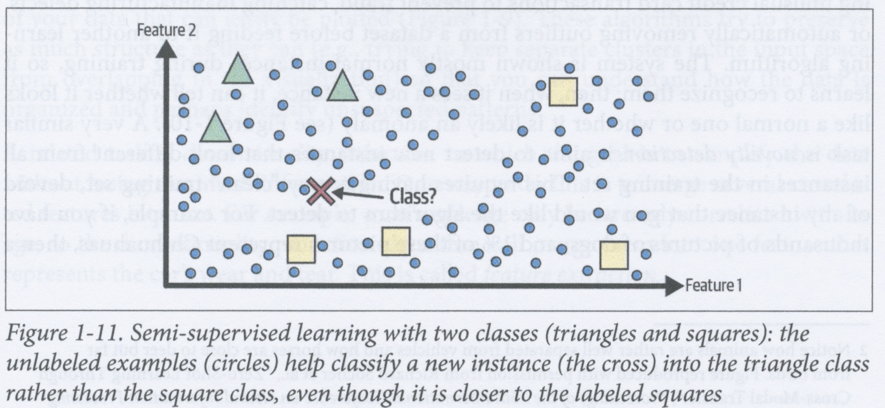
Semi-supervised learning
Labelling data typically takes a lot of time and/or effort
Often easy to get unlabelled data
Some algorithms can deal with data that is only partially labelled – these are called semi-supervised learning algorithms
For example, if you upload a dataset of images to Google Photos, then it will recognize that the same person, A, appears in, say, photos 1, 5 and 11, while a different person, B, appears in photos 2, 5 and 7
You then just need to tell it once who the people, A and B, are and it will automatically label all the other photos that contain these people
Semi-supervised learning algorithms combine unsupervised and supervised learning, e.g.,
unsupervised clustering algorithm to divide the dataset up into classes where each class contains similar instances
assuming some instances are labelled, then all instances within a cluster can be given same label
once all instances are labelled, then supervised learning algorithm can be used to learn from the labelled data

Slide 25
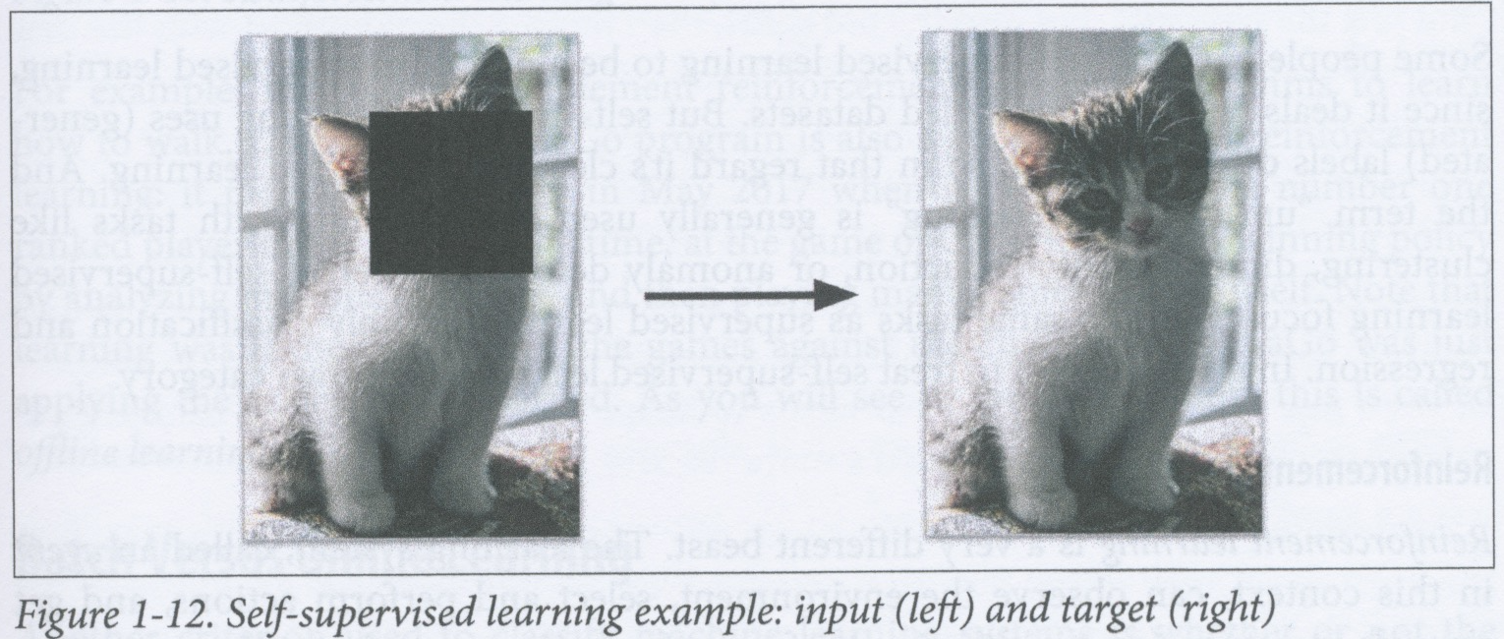
Self-supervised learning
Self-supervised learning involves generating a fully labelled dataset from a fully unlabelled one
Once the dataset is labelled, it can be used to train a supervised learning algorithm
For example, if you have a dataset of images, then you can
generate a set of inputs by randomly masking parts of images in the data
use the original unmasked images as the targets (i.e., labels)
train a supervised learning algorithm to identify the original images from the masked images
Resulting model can be used, e.g., for repairing damaged images or erasing unwanted elements from images
Can also be tweaked to work as a classifier
e.g., a self-supervised model that successfully repairs images of animals could maybe be tweaked to detect the species of animal
This is an example of transfer learning – we apply the knowledge learnt on one task to another

Slide 26
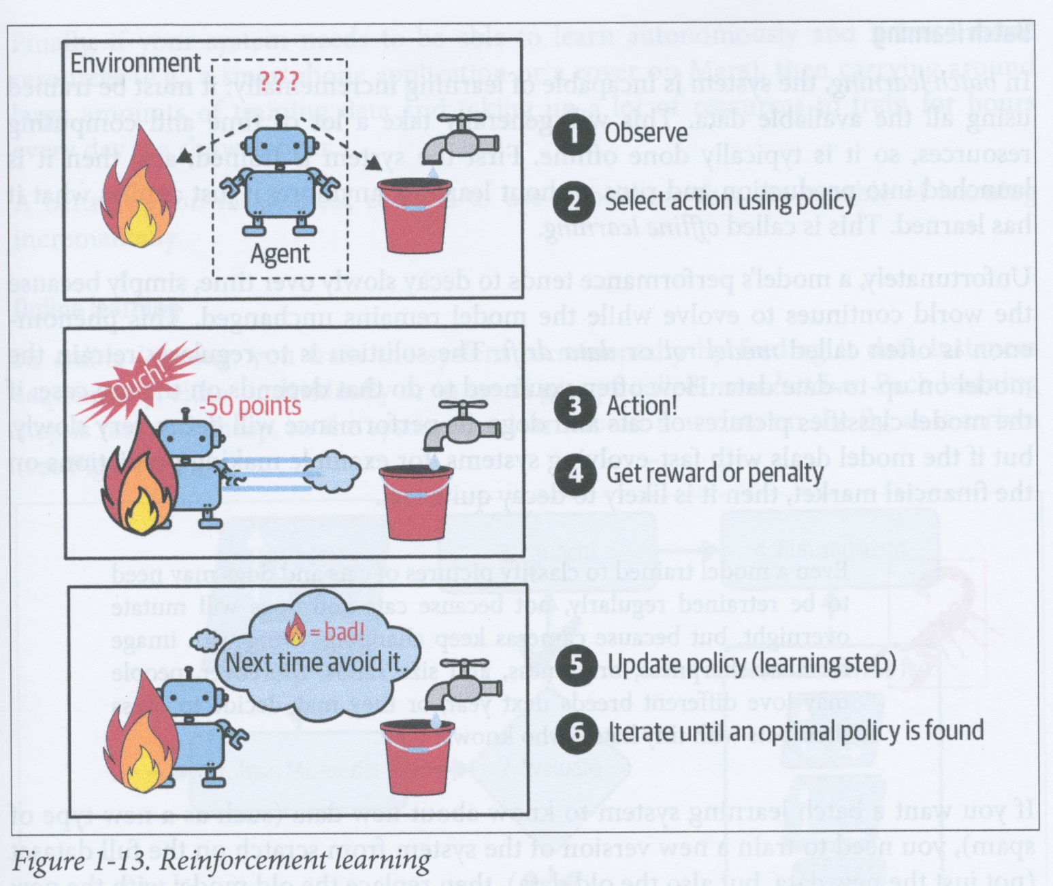
Reinforcement learning
Reinforcement learning (RL) is often used in robotics
RL involves an agent that
observes its environment
then performs an action selected from a set of possible actions
then receives either a reward or a penalty for its action
An RL system learns a policy that determines how it behaves in any given situation in a changing environment and allows it to gain the most reward over time
RL has been successfully used to teach robots to walk and negotiate difficult territory
RL has also been used to train agents to play games, e.g., the AlphaGo system

Slide 27
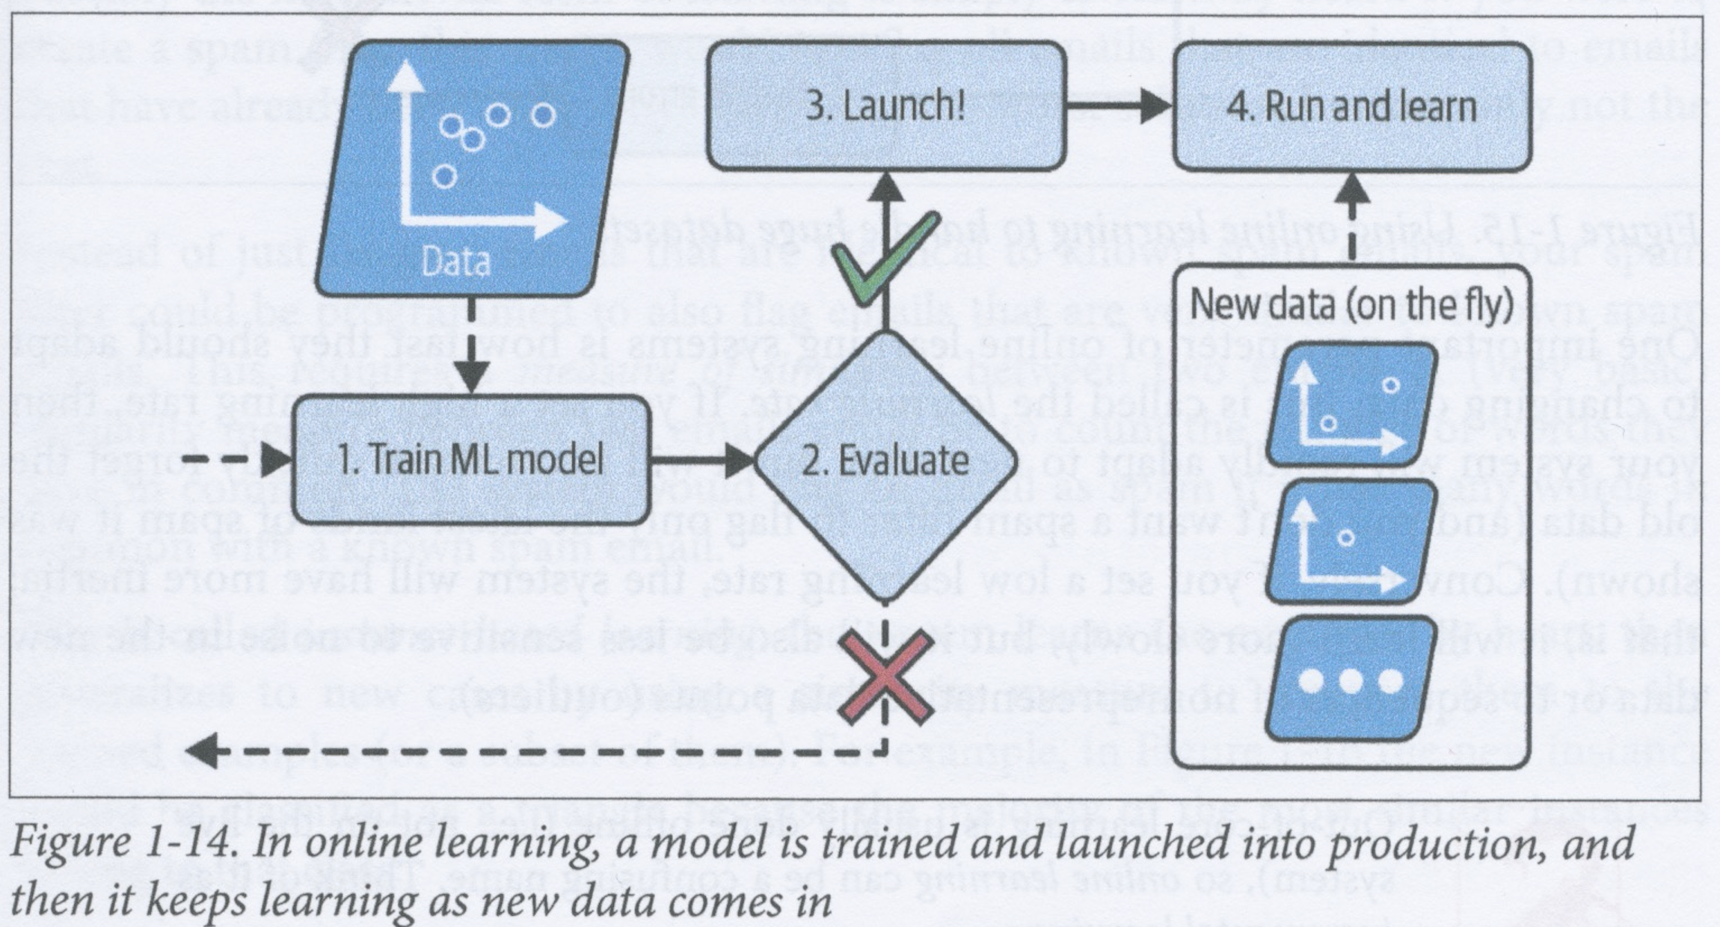
Batch learning vs. Online learning
Another criterion used to categorise ML systems is whether the system continuously learns incrementally from incoming data (online learning) or does all its learning in a single phase (batch learning)

Slide 28
Batch learning
In batch learning, the system is trained using a training set in a separate initial phase that is completed before it is applied to its task
This is also called offline learning
Since environment within which the system performs its task will tend to change, one can expect the performance of an offline batch learning system to gradually worsen over time
This is known as model rot or data drift
Batch learning systems should therefore typically be periodically retrained
Frequency of re-training required depends on task, e.g., a system that discriminates between cats and dogs will probably only very infrequently require retraining, but a system that does regression on stock-market data might need to be retrained much more frequently
Totally retraining a system often takes quite a lot of time (on the order of hours), so batch learning is not practical if the environment is changing very quickly

Slide 29
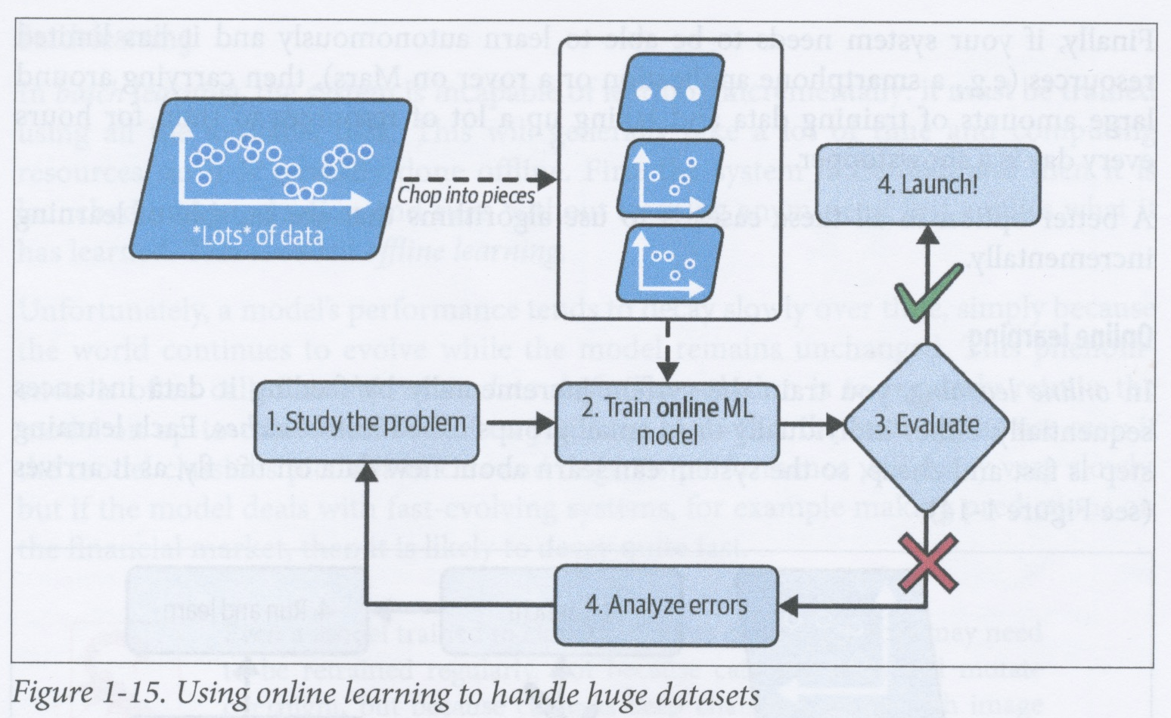
Online learning
In online learning, the system continuously, incrementally learns from the instances that it receives as input, either individually or in small batches called mini-batches
Each learning step is short and cheap, so the system can learn from new data on the fly
Online learning is good for systems that need to be updated very frequently or for systems that have limited computing resources (e.g., mobile devices)
Online learning can also be used to train a model on huge datasets that cannot fit into computer memory (out-of-core learning)

Slide 30
Online learning – learning rate
An important parameter of online learning is the learning rate
This determines the rate at which the system adapts to new data
A high learning rate causes your system to rapidly adapt to new data
But it also causes it to more rapidly forget what it learnt from older data
A low learning rate will cause your system to change more slowly in response to new data
But it will also be less sensitive to noise and outliers in the new data
Think of online learning as incremental learning
In online learning, what is already known is adjusted in the light of new data
In batch learning, the system builds an entirely new global knowledge base using all the data, including the new data

Slide 31
Online learning – the challenge of bad data
If you feed an online learning system bad data, then its performance can decline at a rate that depends on its learning rate and the data quality
Bad data could come from, for example, a faulty sensor or someone intentionally trying to sabotage the system
You should therefore monitor such a system and promptly switch the learning off if you notice that performance is dropping
You could also perform such monitoring automatically using an anomaly detection algorithm

Slide 32
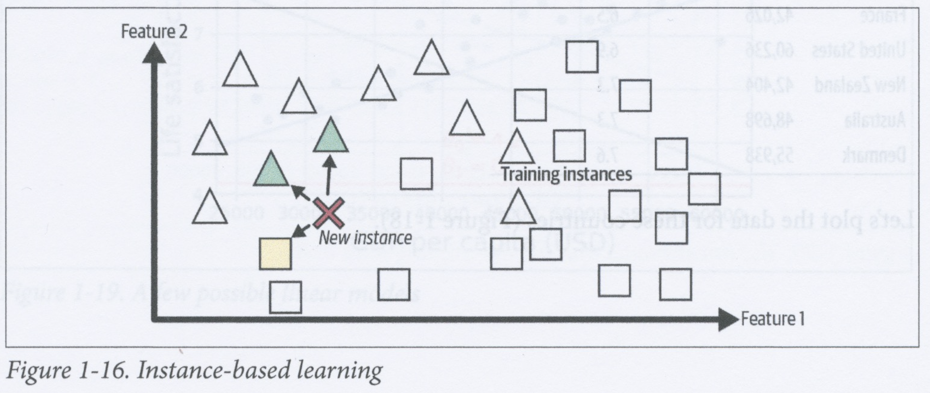
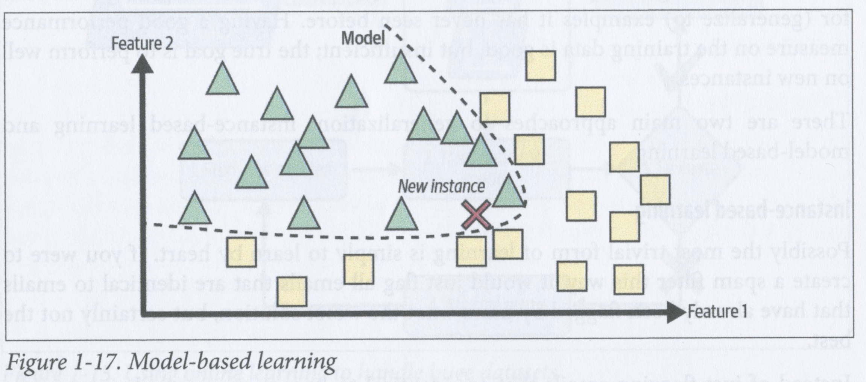
Instance-based vs. model-based learning
ML models make predictions about previously unseen inputs based on knowledge learnt from previous inputs (which might be labelled or not)
Making a prediction about an unseen input involves generalizing from previous inputs
ML models can be categorised according to the way in which they generalize from the data on which they are trained
There are two main categories of method for generalizing from data: instance-based learning and model-based learning

Slide 33
Instance-based learning
In instance-based learning, the system knows the labels and maybe other properties about a fixed set of instances
When presented with a new unseen sample, the system compares it with each of its fixed set of instances and predicts that the target value of the new item will be the same as (or some average of) those known instances that are most similar to it
Essentially interpolation over the space defined by the training set
This requires that you define some similarity measure for comparing previously unseen items with already known items
An example of such a method is the k-nearest neighbour algorithm

Slide 34
Model-based learning
The other main way of generalizing is to build a model of the training data and then use this model to predict properties of previously unseen instances
A model of some data is a compressed description of the data that attempts to identify regularities and structure in the data that can be used to predict properties of newly encountered instances
In the case on the left, the model is a definition of a boundary between two classes within a space defined by two features

Slide 35
Model-based learning example
As an example of model-based learning we consider the question of whether money makes people happy
We can address this question as follows
Find measures of life satisfaction for different countries
Find the gross domestic product (GDP) per capita for each country
Explore whether there is any relationship between life satisfaction and GDP per capita, e.g., by seeing if there is a simple linear relationship
Try using any found relationship to predict the life satisfaction of a previously unseen country from its GDP per capita

Slide 36
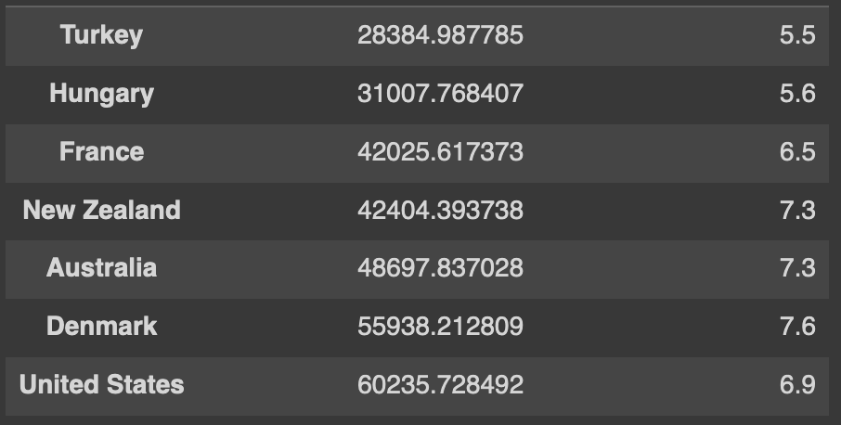
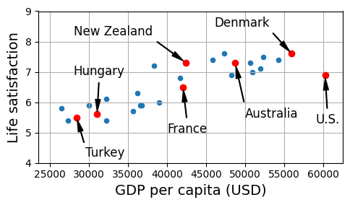
Model-based learning example – obtaining and exploring the data
Download the Better Life Index data from OECD (https://www.oecdbetterlifeindex.org) and World Bank statistics (https://ourworldindata.org) about GDP per capita
Join the tables and plot the data for a subset of the countries
This graph suggests there might be a simple linear trend (although the data is clearly quite noisy)

Slide 37
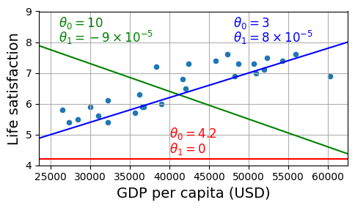
Model-based learning example - selecting a model
As it looks like there might be a linear relationship between GDP and life satisfaction, we decide to try to find the best-fit line that fits the data – this is called linear regression
We need to find a line of the form life_satisfaction = 𝜽₀ + 𝜽₁ x GDP_per_capita
𝜽₁ is the slope (gradient) of the line
𝜽₀ is the life_satisfaction value when GDB_per_capita = 0
The graph shows examples of the lines that correspond to particular choices of values for 𝜽₀ and 𝜽₁

Slide 38
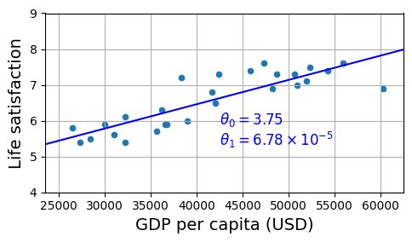
Model-based learning – selecting a model
We need to try to find the parameter values that will give us the model that will perform best on unseen data
We generally try to find a set of model parameter values that either minimise some cost function or maximise some fitness function (a.k.a. utility function)
In the case of linear regression, we usually define the cost function to be the difference between the model’s predictions and the training examples, and we aim to minimise this cost
We can use the linear regression algorithm (implemented in scikit-learn) to find the best-fit line for our training data – this step of determining the model parameters is called training the model
For the data in our example, the model parameters turn out to be 𝜽₀ = 3.75 and 𝜽₁ = 6.78 x 10⁻⁵
These parameter values give the line shown on the left

Slide 39
Model-based learning – running the model
Now we have a model, we can use it to predict the life satisfaction of a country based on its GDP per capita
For example, Cyprus’ GDP per capita is $37655 and our model therefore predicts that its life satisfaction index should be 6.30

Slide 40
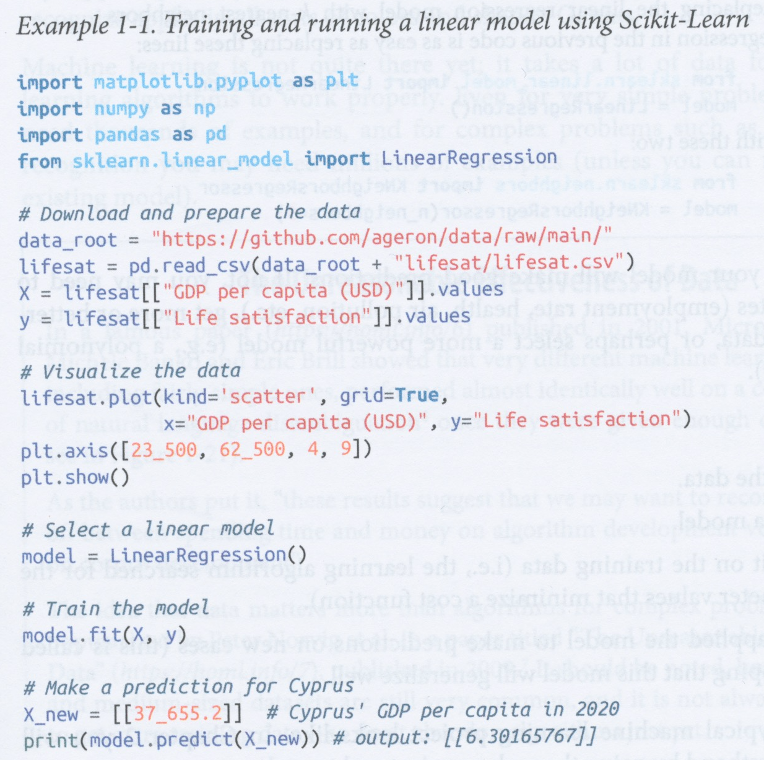
Python code for this example
The Python code on the left gets the raw data, prepares and visualizes it, selects a model, trains the model and then uses the model to make a prediction

Slide 41
Using instance-based learning instead
One could also have selected an instance-based learning model, such as a k-nearest neighbour regressor
A k-NN regressor would find the k countries with the most similar GDP per capita to Cyprus and then predict that Cyprus’ life satisfaction index would be the average of the indices for these k countries
For example, if k = 1, then such a model would predict that Cyprus’ index would be the same as Israel (7.2), while if k = 3, then the model would predict an index equal to the average of those of Israel, Lithuania and Slovenia (6.33)
To switch from a linear regression model to a k-nn regressor model, you only have to change two lines in the code (see left)
Replace
from sklearn.linear_model import LinearRegression
model = LinearRegression()
with
from sklearn.linear_model import KNeighborsRegressor
model = KNeighborsRegressor(n_neighbors=3)

Slide 42
Model-based learning example
If all goes well, then your model will make good predictions
If not, then you could
use more attributes (e.g., employment rate, health, air polution, ...)
get more or better data
select a more powerful model type (e.g., polynomial regression)
In sum, we
studied the data
selected a model
trained the model to obtain model parameter values
applied the model on a previously unseen instance

Slide 43
Main challenges of machine learning
Basically, the two things that can go wrong with a machine learning model are that one has either “bad data” or a “bad model”
Data can be “bad” for a number of reasons, such as
insufficient quantity
non-representative of the population of all instances
poor quality
irrelevant features
Models can be “bad” because they either
overfit the training data
underfit the training data

Slide 44
Bad data: Insufficient quantity of training data
Very young children appear to be able to learn categories given an extraordinarily low number of positive examples
e.g., a young child will learn what an apple is and be able to recognize previously unseen instances of apples after having been shown only a few apples
Machine learning systems aren’t quite this good yet!
Machine learning models typically need a lot of data (thousands to millions of instances) to construct good models

Slide 45
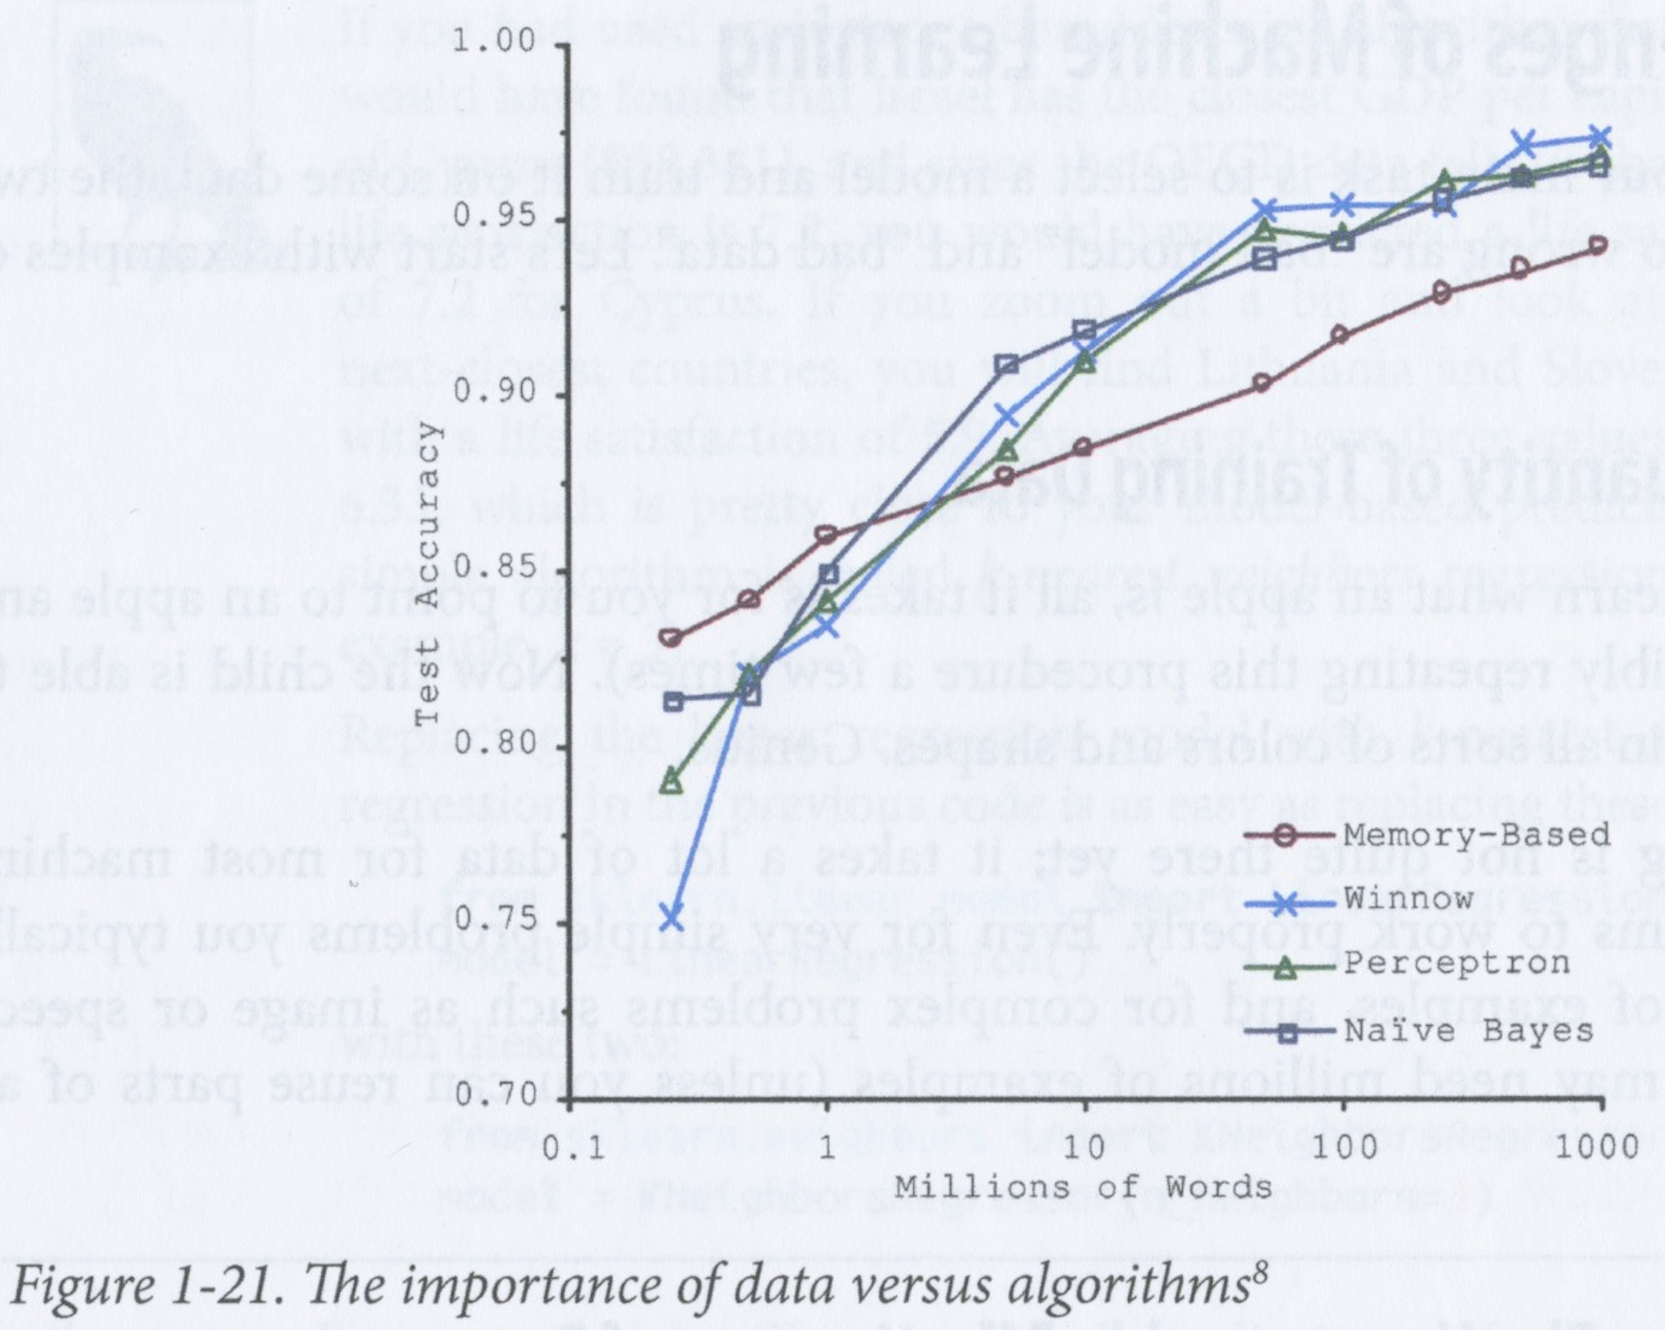
Unreasonable effectiveness of data
On the other hand, if you have enough good data, then the specific type of model used becomes less important
Banko and Brill (https://homl.info/6) showed that very different machine learning algorithms all performed very similarly on a natural language disambiguation problem provided they were given enough data (see graph on left)
They suggested that more resources should be put into corpus development than algorithm development
Norvig et al. (https://homl.info/7) also proposed that data matters more than algorithms for complex problems
However, there are still many domains in which large, good quality datasets are almost impossible to get, and in such cases, it is still important to work on algorithms

Slide 46
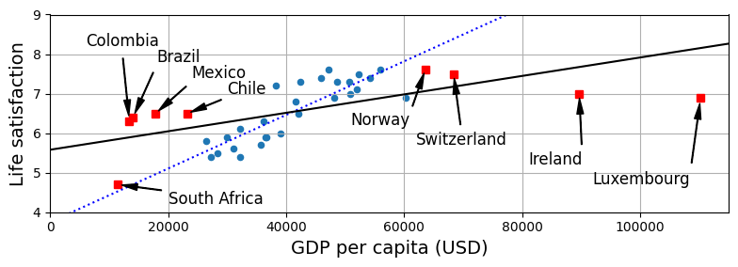
Bad data: Non-representative training data
In order to generalize well, your model must be trained on data that is representative of the population of instances upon which it will be applied
For example, the set of countries used for training our GDP-per-capital model of life satisfaction did not contain any instances where the GDP per capita was less than $23500 or higher than $62500
The graph above shows what the data looks like when we include more countries
The black line is the best fit line for this larger dataset
adding a few extra countries has significantly changed the model
seems clear that a simple line is not going to be able to model this data well
very rich countries seem to be no happier than moderately rich countries and some poorer countries seem to be just as happy as many rich countries!

Slide 47
Bad data: Non-representative training data
If the training set is too small, then it is likely to be non-representative as a result of chance, leading to sampling noise
Even very large samples can be non-representative if the sampling method is flawed – leading to sampling bias

Slide 48
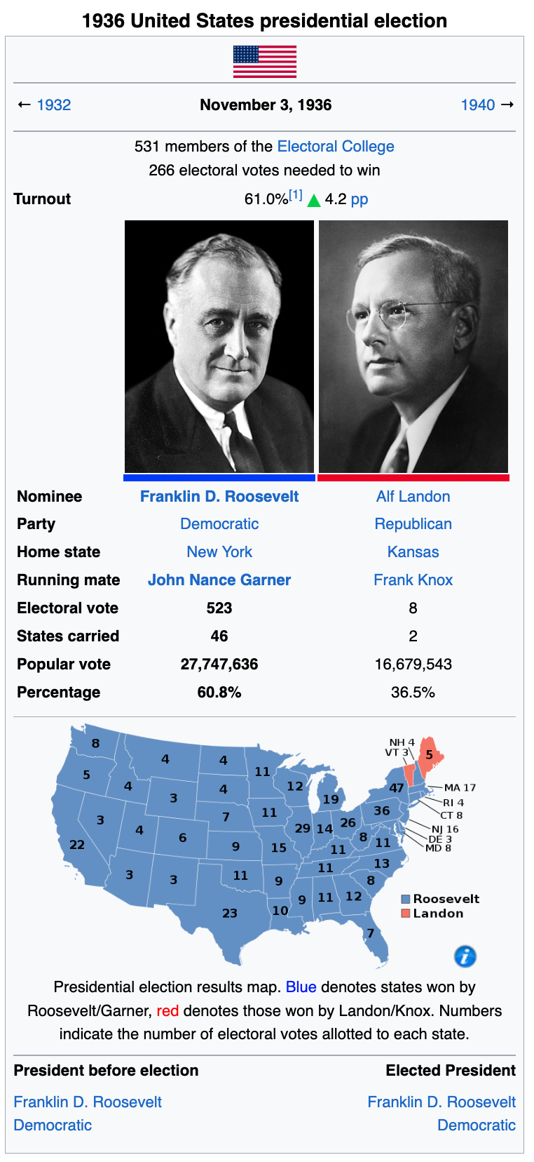
Bad data: Example of sampling bias
In the US presidential election in 1936, Landon was competing against Roosevelt
The Literary Digest conducted a very large poll, sending out a mail to about 10 million people and getting 2.4 million responses
On the basis of this poll, the Literary Digest predicted confidently that Landon would win with 57% of the votes
In fact, Roosevelt won with 61% of the votes
The problem was with the Literary Digest’s sampling method:
They obtained their names and addresses from phone directories, lists of magazine subscribers, club membership lists etc, which favoured wealthier people who more likely to be Republicans (hence Landon)
Less than 25% of the people polled responded, introducing sampling bias by eliminating people who, e.g., didn’t care about politics or didn’t like the Literary Digest – this is called nonresponse bias

Slide 49
Bad data: Poor-quality data
It is harder for a learning algorithm to discover patterns and regularities in data that is full of errors, outliers or noise (e.g., due to poor-quality measurements)
Often worthwhile to clean up the data before training your model on it – data scientists typically invest a lot of time on doing this
Some cases where you might want to clean up your data include
if some instances are clearly outliers – you can either manually fix them or discard them
if some instances are missing features or values (e.g., 5% of your customers didn’t give their age), then you can
ignore the attribute altogether
ignore the instances with the missing features
fill in the missing values (e.g., with median or mean values)
train one model with the feature and one without

Slide 50
Bad data: Irrelevant features
An ML system will only learn effectively if the training data contains enough relevant features and not too many irrelevant ones
Important to come up with a good set of features to train on – this is called feature engineering and involves the following steps
Feature selection – selecting the most useful features to train on
Feature extraction – combining existing features to produce more useful ones (e.g., by using dimensionality reduction)
Creating new features by gathering new data

Slide 51
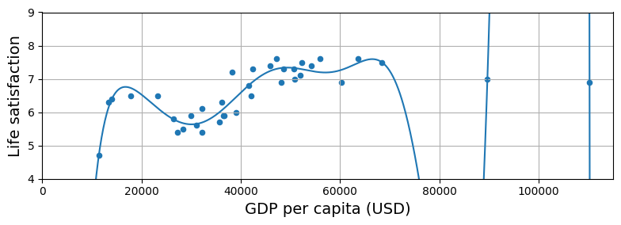
Bad model: Overfitting the training data
A model might perform very well on the training data but perform badly when presented with previously unseen instances – this is called overfitting
This typically happens when the model is too complex or the data is very small – it does not sufficiently compress the training data and fails to extract the regularities in it that can be used to make successful predictions on new instances
Graph shows a high-degree polynomial regression model of the life satisfaction data
it fits the data better than the simpler linear model, but what predictions will it make for a country with a GDP per capita of, say, 80000 USD?

Slide 52
Bad model: Overfitting the training data
Bad data can also lead to overfitting
e.g., using the country’s name as a feature in the Life satisfaction data might lead the model to learn that countries with names that contain a “w” are more likely to have high life satisfaction!
Overfitting happens when the model is too complex relative to the amount and noisiness of the data
Solutions to overfitting include
Simplify the model by using one with fewer parameters or one that learns on fewer features
Gather more training data
Clean the data to remove noise

Slide 53
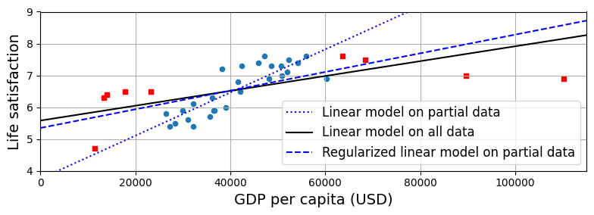
Bad model: Overfitting the training data
Constraining a model to make it simpler and thus reduce risk of overfitting is called regularization
For example, a linear regression model has two parameters, 𝜽₀ + 𝜽₁, which gives the model two free variables or two degrees of freedom
If we force 𝜽₀ to be 0, so that we only consider lines that pass through the origin, then we only have 1 degree of freedom and we will not be able to find a model that fits the data as well as if we use both parameters
If we force 𝜽₀ to be within some interval, then the number of degrees of freedom is between 1 and 2
The aim is to find the simplest model that accounts for all the regularity in the data
The complexity of a model is usually modelled by how many free parameters it has

Slide 54
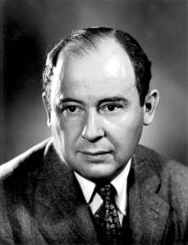
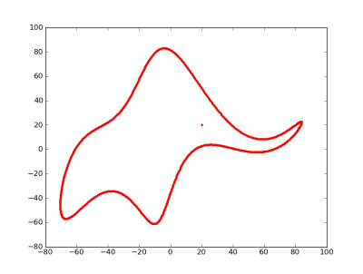
Degrees of freedom: modelling an elephant
According to the famous physicist, Enrico Fermi, the computing pioneer, John von Neumann joked that “with four free variables I can fit an elephant and with five I can make him wiggle his trunk” (Dyson, 2004)*
Deep networks typically have thousands or even millions of free variables, making them capable of modelling almost any data – and also making them prone to overfitting!
Actually you can indeed model an elephant with 4 free variables...**
*Freeman Dyson. (2004). A meeting with Enrico Fermi. Nature, Vol. 427, p. 297. https://www.nature.com/articles/427297a.pdf
** Jurgen Mayer, Khaled Khairy, and Jonathon Howard (2010). Drawing an elephant with four complex parameters. Am. J. Phys. Vol. 78, p.648. DOI:10.1119/1.3254017.

Slide 55
Example of regularization
Above are 3 models
dotted line is original linear model trained on countries represented by circles
solid line is model trained on all countries (circles and squares)
dashed line is a model trained on the circles but with a regularization constraint – doesn’t fit circles as well, but generalizes better to all the data
Amount of regularization to apply is determined by a hyperparameter whose value is set before training starts and held constant throughout training
A hyperparameter is a parameter of the learning algorithm itself, not of a specific model generated by a learning algorithm

Slide 56
Bad model: Underfitting the training data
Underfitting happens when the model learnt is too simple relative to the training data – the model fails to capture all the structure in the data
in effect, it throws away too much information in the data
For example, a linear model of life satisfaction underfits because it is too simple to capture all the factors that are involved in determining life satisfaction
Underfitting can be fixed by
selecting a more powerful type of model with more parameters (but remember von Neumann's elephant!!)
feed better features to the learning algorithm (feature engineering)
reducing constraints on the model (i.e., reducing the regularization constant hyperparameter)

Slide 57
The story so far
Machine learning is about making machines improve at carrying out a task by getting them to learn from data instead of providing more "hand-crafted" rules
There are various different types of ML system, e.g.,
supervised or not
batch or online
instance-based or model-based
Systems do not perform well if
the data is too small, non-representative, noisy, full of irrelevant features
the model is too simple (in which case it will underfit)
the model is too complex (in which case it will overfit)

Slide 58
Testing and validating a model
To find out how well a model generalizes to previously unseen instances, we have to test it on such instances
We typically have some corpus of labelled data and we split this into two sets: the training set and the test set
Typically one uses 80% of the corpus for training and 20% for testing
But this depends on how big your corpus is
The error rate on new cases is called the generalization error (or out-of-sample error)
We estimate the generalization error by testing the model on the test set
If your training error is low but your generalization error is high, then this means your model has overfit the training set

Slide 59
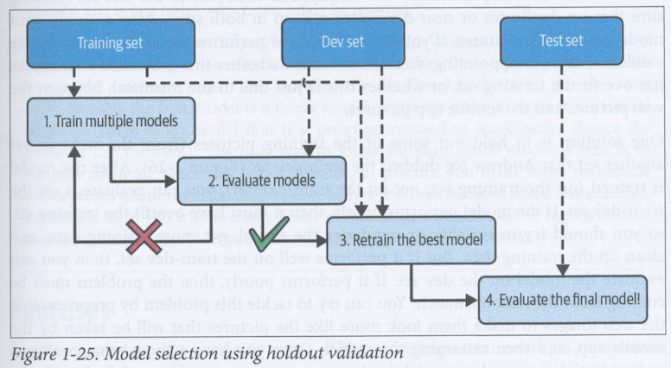
Hyperparameter tuning and model selection
Suppose we want to decide between two or more model types or we want to determine the best value for a hyperparameter
We choose a particular model and hyperparameter value and train it (i.e., determine the model parameters) using a training set and then test it on a test set
Suppose we do this for all the model types and hyperparameter values we’re interested in and we then pick the specific model that performs best – say it has a 5% error on the test set
We then run it on real world data and find that this model that performed best on the test data has a 15% error on real-world data
What happened?

Slide 60
Hyperparameter tuning and model selection
What happened is that you effectively used the test set to “train” the choice of model type and the hyperparameters and you never actually tested your final selected model
You therefore need to split your dataset into three subsets if you intend to try to find optimal hyperparameter values or evaluate different model types against each other
You need:
the training set for training the parameters of individual models
a validation set for determining (i.e., “training”) hyperparameters and deciding on model types
a test set for testing the final selected model to see how it generalizes to unseen data
This is called holdout validation because you "hold out" an extra part of the dataset for validation
The validation set is also known as the development set or dev set, because it is a "test" set that you use for developing your model

Slide 61
Hyperparameter tuning and model selection
The overall procedure is:
Train each specific model (which is of a particular type and has particular hyperparameter values) on the training set
Test each specific model on the validation set (dev set)
Select the specific model that performs best on the validation set and train it on the union of the test set and the validation set
Test this newly trained model on the test set to estimate the generalization error
Usually works well, but potential problems are
if the validation set is too small, then model evaluations will be imprecise and you won’t necessarily find the optimal model – test set should be representative of the population
if the training set is too small (e.g., because the validation set is too large), then it is unlikely to be representative of the population and the models will not generalize well

Slide 62
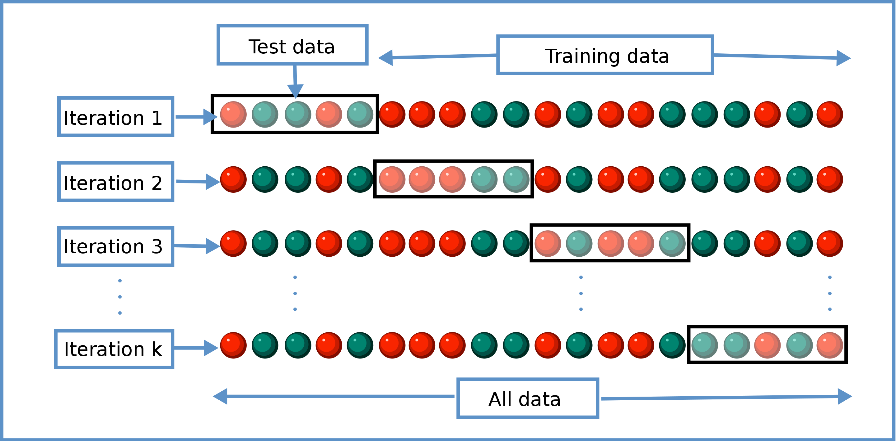
(k-fold) cross-validation
Problems of validation set size can be mitigated by cross-validation
You split the union of the training set and the validation set into k “folds” (typically 5 or 10)
You validate each model k times
You partition the union of the training set and the validation set into k equally-sized subsets
On each iteration, you validate the model with a different one of these subsets as the validation set and the rest as the training set
You find the mean performance over all k "folds"
Main drawback is that testing the models takes k times as long
(from https://en.wikipedia.org/wiki/Cross-validation_(statistics) )

Slide 63
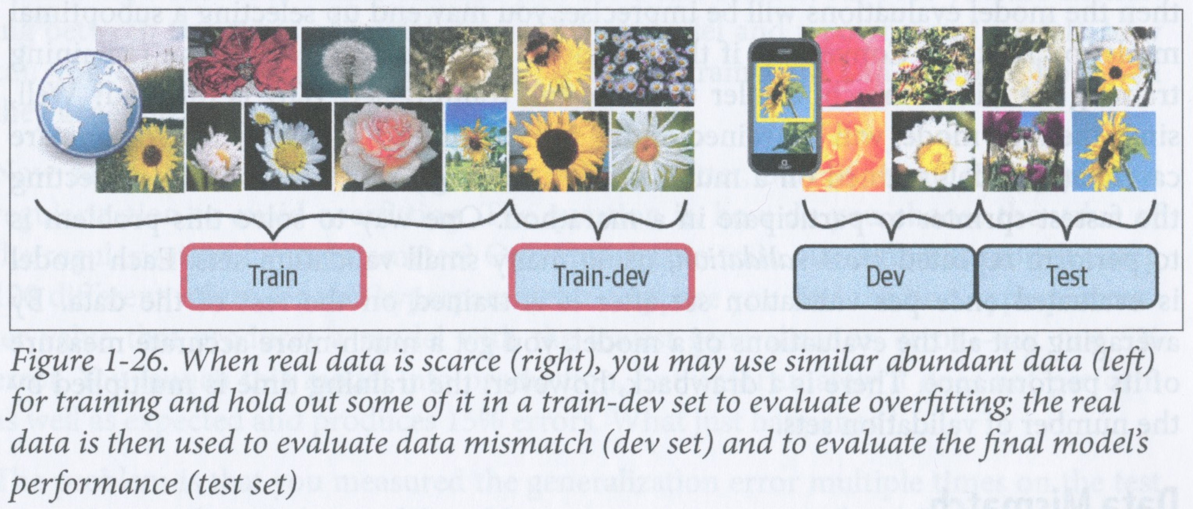
Data mismatch
Suppose you want to build a mobile app for a specific mobile OS for identifying flowers from pictures taken with the specific device
Suppose you have only 1000 pictures of flowers taken with the same type of device (let’s call these device pictures)
But you have access to millions of pictures of flowers on the web taken with lots of different devices (we’ll call these web pictures)
Ideally you want all the validation and test instances to be device pictures
So you decide to
train your candidate models on a large set of web pictures
validate your models on a smaller set of device pictures
test the best performing model after validation on a test set of device pictures
You find that none of the models perform very well on the validation set
Is this because the models have overfit to the training set, or is it because there is a data mismatch between the web pictures and device pictures?

Slide 64
Determining data mismatch with a train-dev set
One solution, due to Andrew Ng, is to split your dataset into 4 sets as follows:
training set of web pictures
train-dev set of web pictures
dev set of device pictures
test set of device pictures
In other words,we “hold out” a portion of the original training set of web pictures as a “train-dev set”

Slide 65
Determining data mismatch with a train-dev set
We then proceed as follows
We train all the candidate models on the (new, smaller) training set of web pictures
We evaluate the models on the train-dev set of web pictures
If a model performs poorly on the train-dev set, then it must have overfit the training set
So you need to simplify the model, regularize it, get more training data, clean up the data etc.
If a model performs well on the train-dev set, then we can evaluate it on the dev set
If it performs poorly on the dev set, then there must be a data mismatch between the web pictures and the device pictures
You can attempt to address this problem by pre-processing the web pictures in some way so that they are more similar to device pictures, and then retraining and testing with the training and train-dev sets, respectively
Once you have a model that works well on both the train-dev set and the dev set, then you test it on the test set

Slide 66
No free lunch theorem
A model should be a compressed description of the training data that distinguishes meaningful regularity from noise
When you choose a specific type of model (e.g., a linear regression model), you are making an assumption about what kind of regularity exists in the data
David Wolpert (1996) showed that there is no way of knowing for sure in advance (a priori) which type of model will work best with some given data (https://homl.info/8)
This is called the “No Free Lunch Theorem”
In practice, you therefore try to make some reasonable assumptions about what types of model will work best

