Slide 1
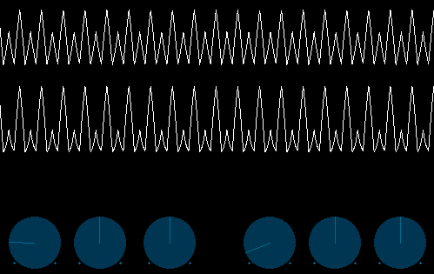
Minim
David Meredith
dave@create.aau.dk

Slide 2
Minim
Minim is an easy-to-use Processing library for integrating audio into your sketches
The most recent version (2.1.0 Beta) includes a music programming framework based on “unit generators” (UGen)
A UGen is an audio processing object that does a “single” thing
UGens can be patched together to produce “synthesis chains” that perform complex transformations on the sound

Slide 3
Installing Minim
Download the Minim 2.1.0 BETA library zip file from http://code.compartmental.net/tools/minim/
Unzip the library into the libraries folder inside your Processing sketchbook folder
See the Libraries lecture to remind yourself how to find out where your sketchbook folder is
You then need to remove the version of Minim that is included with Processing
On OS X: Find Processing.app, right click, choose “Show Package Contents”, go to Contents/Resources/Java/modes/java/libraries and delete the minim folder in there
On Windows: Find the directory that contains Processing.exe, and go to modes/java/libraries and delete the minim folder there
Restart Processing
You should see the Minim library under the “Sketch>Import library...” menu

Slide 4
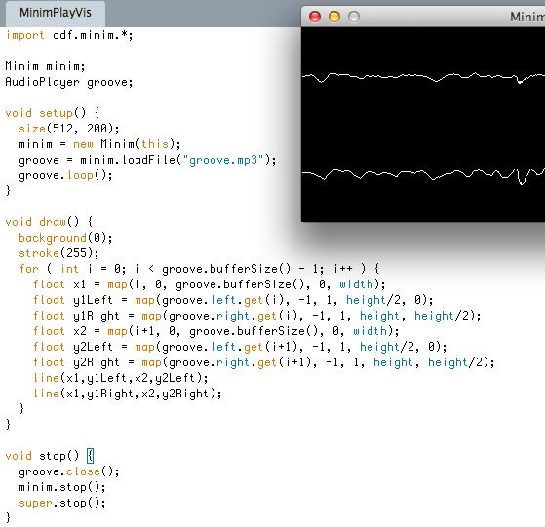
Import Minim library
Declare Minim and AudioPlayer object
Construct Minim object
Loop mp3 file
Load mp3 file into AudioPlayer object (file must be in data library)
Map buffer size to window width
Map sample value to graph height
Override stop() method
Close AudioPlayer
Stop minim object
Call the superclass’s stop method

Slide 5
PlayInternetRadio
If you know the URL for an internet radio station, then you can just load this like a local audio file and listen to it

Slide 6
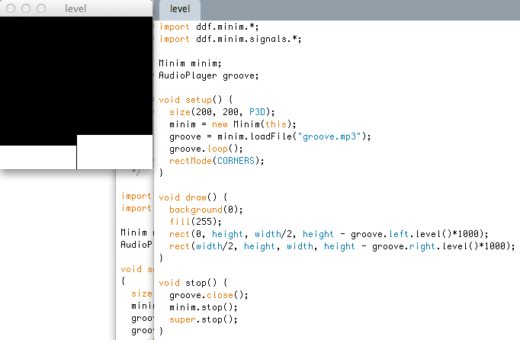
Use level method to give RMS value of instantaneous amplitude
Remember to close the AudioPlayer object and the Minim object before calling the superclass’s (PApplet’s) stop() method

Slide 7
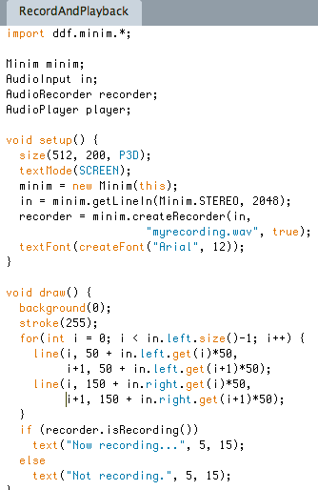
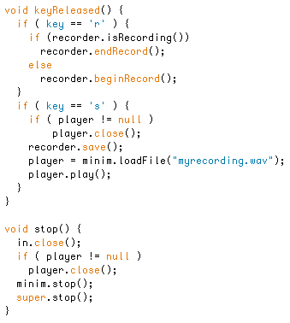
Appends to buffer
44.1kHz, 16-bit
Writes buffer to disk
Buffer length
Defines file format
Remember to close player, stop minim object and call the PApplet’s stop() method
Buffered recorder

Slide 8
SquareWaveSignal
Shows how to send a square wave signal to an AudioOutput
get the AudioOutput from a Minim object using Minim.getLineOut();
Set the portamento which controls how long it takes the signal to change smoothly in frequency
Use addSignal() to add the signal to the AudioOutput

Slide 9
Polyphony
Shows how to take two signals (a triangle wave and a sine wave) and send both to the same AudioOutput
Uses ControlP5 library to add some knobs that allow you to change frequency, amplitude and pan of the two signals
See Polyphony sketch

Slide 10
UserDefinedSignal
Shows how you can make your own signal (in this case MouseSaw) by implementing the AudioSignal interface
Need to override (i.e., write your own version of) two methods:
generate(float[] samp) which is for a mono signal
generate(float[] left, float[] right), which is for a stereo signal
Which version of generate is actually called depends on whether the signal is added to a stereo or mono AudioOutput

Slide 11
Scrubbing
Plays a file and provides three buttons: play/pause, fast-forward, rewind
Shows use of inheritance and abstract classes
Play, Rewind and Forward are subclasses of the abstract class, Button
Means they have to implement the abstract methods in Button

Slide 12
DrumMachine
Uses ControlP5 gui library to draw lots of boolean toggle switches corresponding to beats
Uses millis() to determine if it is time to move to the next beat
Uses loadSample() to load a sample wav file for each drum sound and then the trigger() method to trigger each sample when it is required
Implements controlEvent callback which is run whenever a ControlP5 action has been made
Uses id of controller to identify which controller has been clicked

Slide 13
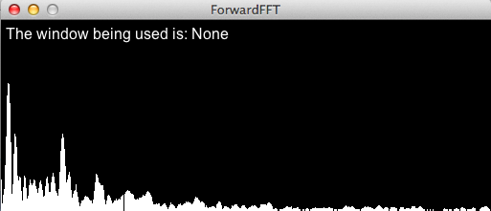
ForwardFFT
Can use FFT object to carry out a fast Fourier transform on a sound
Must specify size of FFT time-domain buffer and sample rate when construct it
Make these the same as the AudioPlayer’s buffer size and sample rate
Run forward() method to run FFT
Use specSize() method to iterate through FFT to draw lines for frequency bands

Slide 14
Music Programming with Minim
Use UGens (Unit Generators)
An object that does only one thing
e.g., generate a tone, filter audio, create an amplitude envelope....
Chain UGens together into a synthesis chain
This is called patching
e.g.
oscillator -> output
oscillator -> filter -> delay -> output
In Minim: oscil.patch(filter).patch(delay).patch(output);

Slide 15
Synthesis algorithms
Synthesis algorithm can be made of one or more synthesis chains connected together
Consider a summer UGen
adds together everything that is patched to it
e.g.
noise -> filter1 -> summer oscil -> filter2 -> summer summer -> delay -> output
in Minim:
noise.patch(filter1).patch(summer); oscil.patch(filter2).patch(summer); summer.patch(delay).patch(output);

Slide 16
UGens have inputs
Oscil UGen has amplitude, frequency and phase input (parameters)
e.g.
lfo -> oscillator.amplitude oscillator -> output
Here lfo (low frequency oscillator) provides values for oscillator’s amplitude
In Minim:
lfo.patch(oscillator.amplitude); oscillator.patch(output);

Slide 17
Instruments and notes
Synthesis algorithm must be encapsulated inside an instrument if you want to be able to play notes rather than just have sound lasting as long as the program runs
A note (in Minim) is a sound that has a beginning and an end
When create an Instrument, must specify what happens when instrument’s noteOn() and noteOff() methods are called
e.g., noteOn() might start attack segment of an amplitude envelope; noteOff() might just end an amplitude envelope

Slide 18
Playing notes
To play a note, use the AudioOutput’s playNote() method
Minim defines a default instrument, so you could just use the following code to play a few notes
out.playNote(1.0, 2.9, “C3”); out.playNote(2.0, 1.9, “E3”); out.playNote(3.0, 0.9, “G3”);
First argument is onset time, second is duration, third is pitch

Slide 19
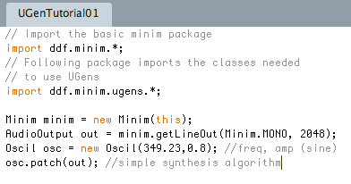
Simple synthesis example

Slide 20
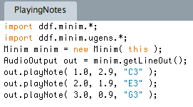
Playing some notes

Slide 21
filterExample
Shows how to use UGens to create an oscillator, send its signal through a filter with an oscillating cutoff frequency and then to the output
Uses the Constant UGen to output a constant value which is added by a Summer UGen to a sine wave
The output of the summer is sent to the cutoff parameter of the filter
A sawtooth oscillator is patched to the filter which is then patched to the AudioOutput

