Slide 1
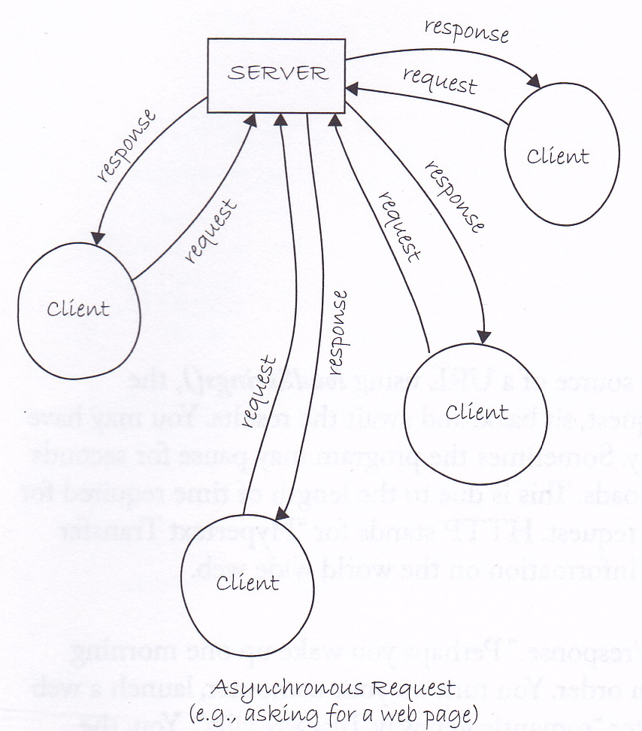
Data Streams
David Meredith
dave@create.aau.dk

Slide 2
Source
Chapter 19 of
Shiffman, D. (2008). Learning Processing. Morgan Kaufmann, Burlington, MA. ISBN: 978-0-12-373602-4.

Slide 3
Getting information from the web

Slide 4
Getting information from the web
The XMLWeather program sometimes takes some time to get the information it needs to print its output
It needs to have a “conversation” with a machine somewhere else in the world (a server)
This conversation is called an HTTP Request
HTTP stands for “Hyper-text transfer protocol”
HTTP is a “request/response” protocol used for transferring information around on the internet

Slide 5
HTTP Request/Response
Suppose you start a web browser and type in the URL, http://www.aau.dk
The web browser (client) sends an HTTP Request to a server computer called www.aau.dk to ask for the server to send its default home page
Lots of other clients might also be asking the server to send information, so we may have to wait a little
Then, after a while, the server computer sends back an HTTP Response that includes all the byte data for your browser to display the home page
The client sends another message to the server telling it that it has recieved the data
The connection between the server and the client is then stopped
This is bi-directional, asynchronous communication

Slide 6
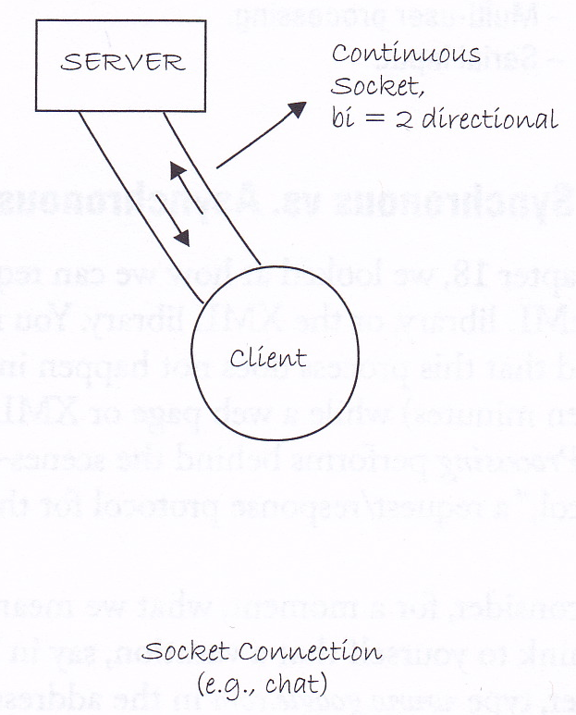
Synchronous, socket connection
Asynchronous connection is fine for the web
But time lags would be disastrous in, e.g., a multi-player game, internet chat or a real-time performance application
For this we use a synchronous, socket connection
Continuous connection between two computers via a socket on each computer
A socket has an IP number, identifying the machine and a port number identifying the program on the machine that the information is being sent to/from

Slide 7
Server programs
A server (in this context) is a program running on a “server” computer
Note that the word is used to refer to both machines and programs
The server program accepts requests for connections from other programs called clients
The server program is identified by a 16-bit number called a port number
A port number is between 0 and 65535
Avoid port numbers less than 1025 – these are used for common services (e.g., FTP, HTTP, SMTP)

Slide 8
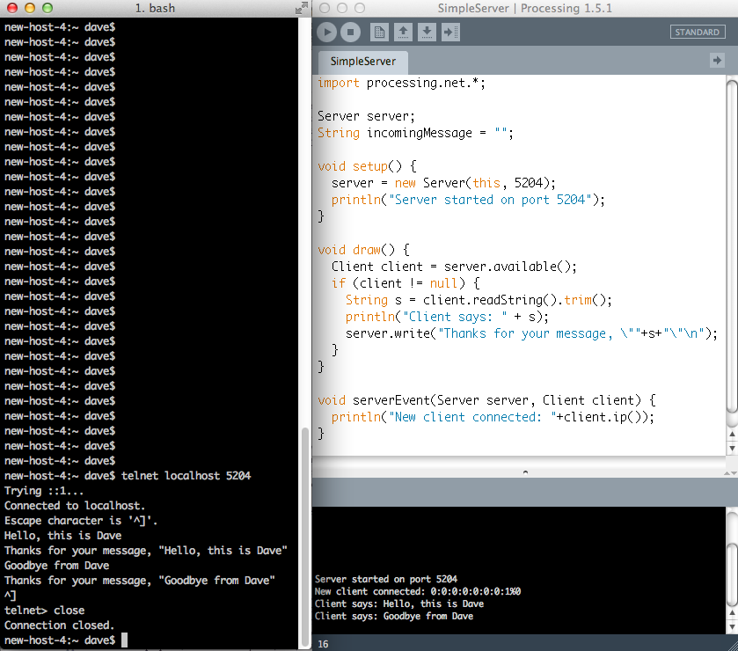
Creating a server
Import the network library
Declare a Server object
Create a Server object and set it to wait for incoming connections on port 5204
Checks if message available from client. If so, returns Client, if not, returns null
Can use telnet or putty to connect to the server program
Read and trim the message from the client
Server sends a message back to client
serverEvent() callback function called when a new client connects
Get the IP address of the client

Slide 9
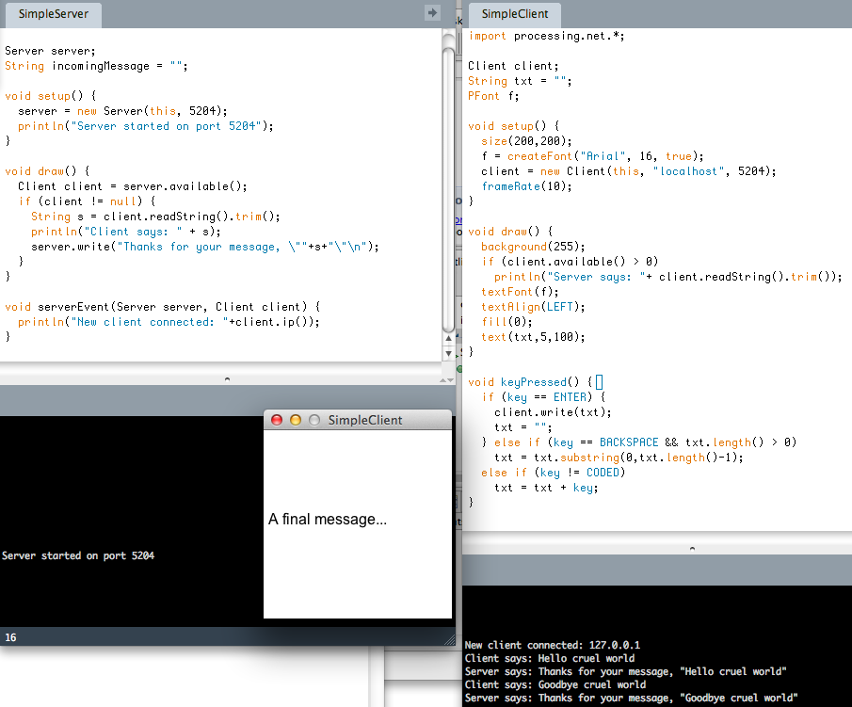
Creating a client

Slide 10
Broadcasting
We’ve seen how information can be sent between a client and a server in the form of Strings
What if we want to send numeric data?
e.g., continuously broadcast the temperature outside your house or the amount of motion of a camera
Have a server program running that broadcasts this number
Clients can then connect to this server program and read the information it broadcasts

Slide 11
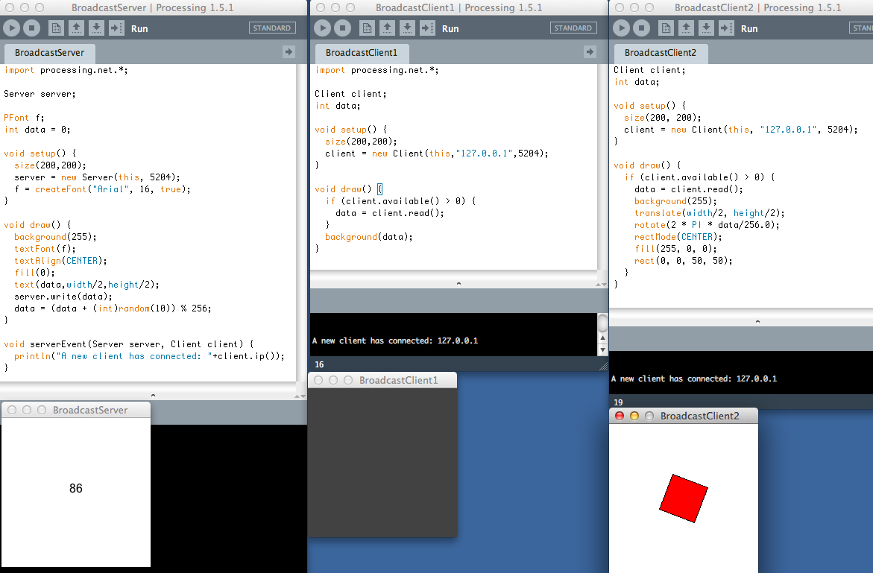
Broadcasting numeric data
Reads one byte of data

Slide 12
Multi-user communication: The Server
In the previous example, the server broadcast information to multiple clients
What if we want information from a client to be broadcast to all other clients?
For example, could have a shared “whiteboard” that five or more clients all draw on and all see
If a client draws something on the blackboard, information is sent to the server which then re-broadcasts it to all the clients

Slide 13
Formatting the data
Suppose we need to send multiple data, e.g. current x and y co-ordinates of the mouse position
Can send the data as a String, but first need to encode it in a way that can be understood at the other end
For example, can have a format as follows:
<x coord>,<y coord>*
e.g. “125,200*”, “50,150*”
String data = mouseX + “,” + mouseY + “*”

Slide 14
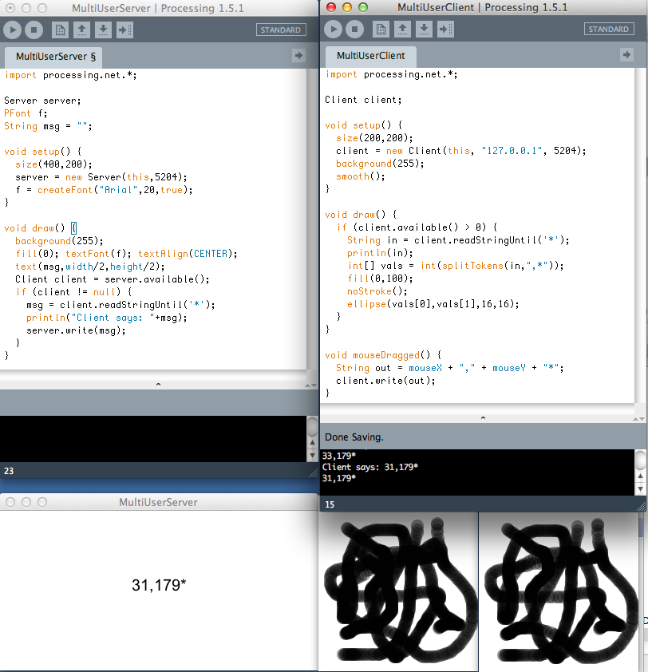
Multi-User Communication

