Slide 1
Advanced Object-Oriented Programming
David Meredith
dave@create.aau.dk

Slide 2
Source
Chapter 22 of
Shiffman, D. (2008). Learning Processing. Morgan Kaufmann, Burlington, MA.

Slide 3
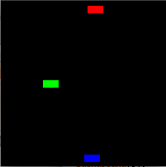
Introduction
Remember objects and classes?
An object contains data in variables and has its own functions, called methods, that you call by using the ‘dot’ syntax:
myObject.myMethod();
You make instances of objects by constructing them from a class which is like a cookie-cutter that can be used to make lots of cookies of the same shape

Slide 4
Some important OO concepts
Encapsulation
Hiding the stuff the user doesn’t need to see
Inheritance
Making specializations of a class that add extra functionality
Polymorphism
A variable can store objects of a class and any subclass of that class
Method overloading
Making a new custom version of a method for a subclass

Slide 5
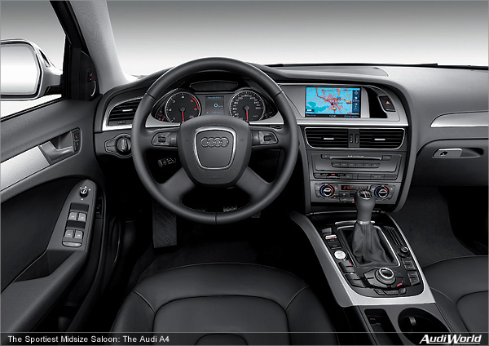
Encapsulation
Encapsulation is hiding away the stuff that the user doesn’t need to know about
A device or object is encapsulated when the user can see and use its controls, knows what he or she can achieve with the controls but doesn’t need to know exactly how the device or object carries out the task
For example, a car is an encapsulated device because lots of people can drive it using its standard controls without knowing exactly how the car works (literally) under the hood

Slide 6
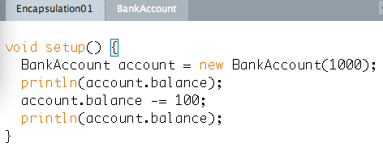
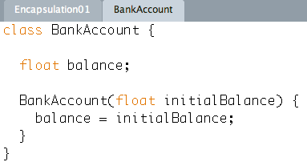
Breaking encapsulation
This sketch is not encapsulated because the user can access the object’s variables directly
This means that the programmer cannot change the implementation without also changing the interface

Slide 7
Breaking encapsulation
What if the bank charges $1.25 for making a withdrawal?
What if the bank changes the withdrawal charge periodically?
If you want to use the BankAccount class, you have keep track of the bank’s charges and manually code for them each time you use the class

Slide 8
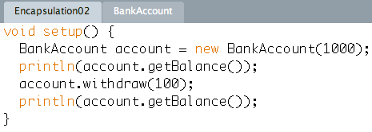
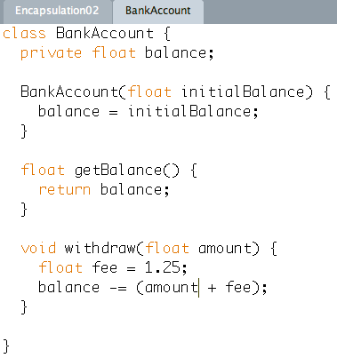
Good encapsulation
User cannot access balance variable directly
Must do it via “withdraw()” method
This allows bank to add a charge for a withdrawal and change this charge without changing the interface
User of BankAccount class will continue to just call
account.withdraw(amount)
Also have a “getter” function that returns the current value in the balance variable

Slide 9
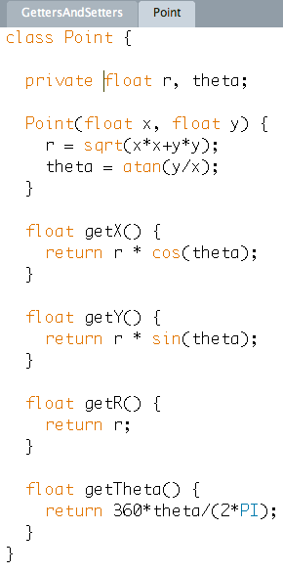
Getters and setters
Make instance variables private
Access them using getters and setters
Decouples interface from implementation
Can change implementation without changing interface

Slide 10
Inheritance
Building a simulation of a zoo in which each type of animal is represented by an object
Set of attributes depends on type of animal
If define independent class for each type of animal then break “write once” principle

Slide 11
Inheritance
Inheritance is the process by which a class contains all the attributes and operations of its superclasses
Define class Animal which contains attributes common to all animals
Define Bird to contain everything in Animal plus wingSpan
Define Parrot to contain everything in Bird
Define Quadruped to contain everything in Animal plus height, foreLegLength and hindLegLength
Define Elephant to contain everything in Quadruped plus trunkLength and tuskLength
Here only write each distinct attribute once
Elephant inherits from Quadruped which inherits from Animal
Bird inherits from Animal
Quadruped is a subclass (or derived class) of Animal
Quadruped is a superclass (or base class) of Elephant
Quadruped is a specialization of Animal
Animal is a generalization of Quadruped
An Elephant is a Quadruped
An Elephant is an Animal

Slide 12
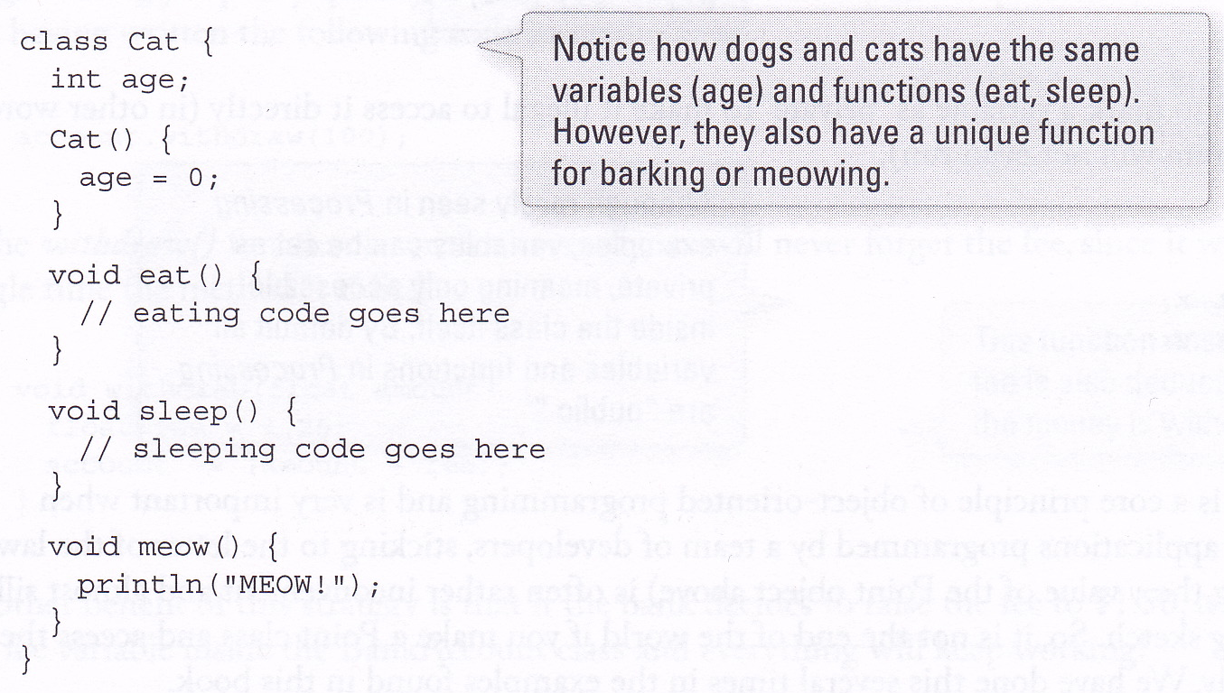
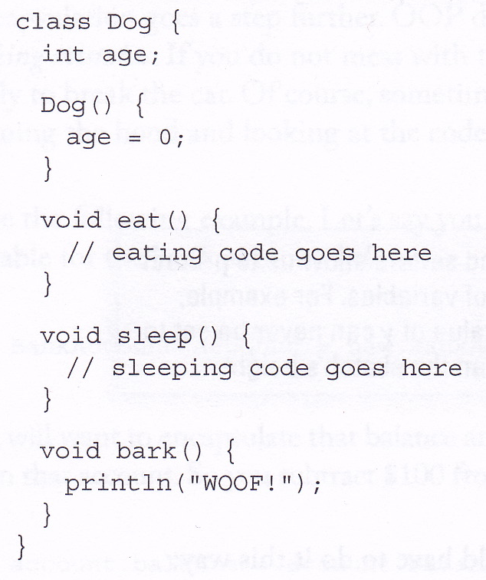
Inheritance in Processing
We could define Dog and Cat class independently
But we’d then have to repeat code
Define same variables and methods in each class

Slide 13
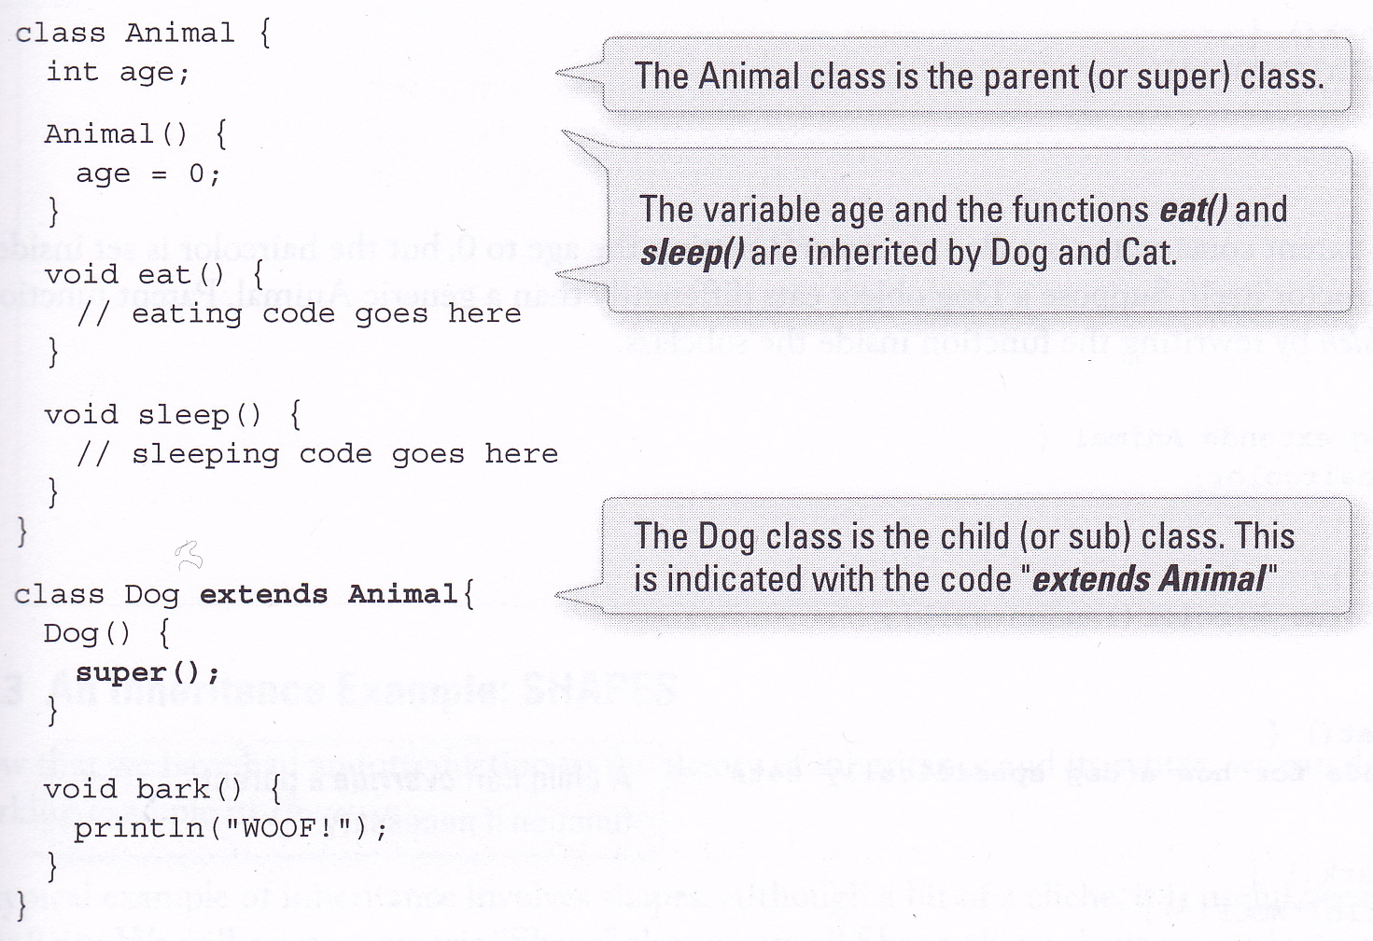
extends and super()
When calling superclass’ constructor using super(), this must be the first line in the subclass’ constructor

Slide 14
Adding new variables to subclasses
You can add new variables as well as new methods to subclasses
Here we add a variable, haircolor, and randomly set it in the Dog’s constructor

Slide 15
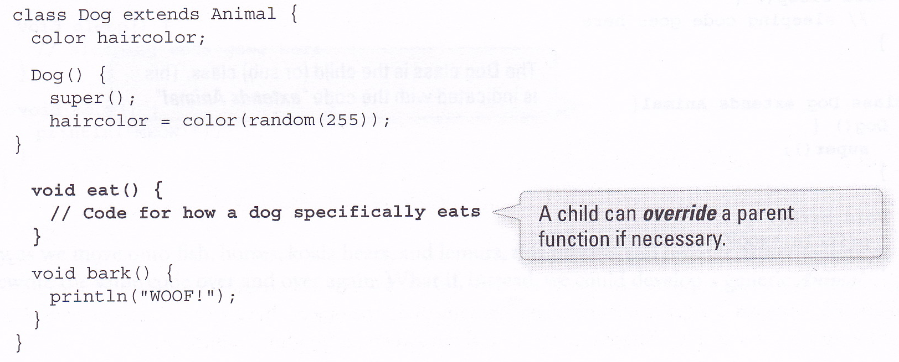
Method overriding
You can also redefine or override methods inherited from superclass
Here, the eat() method from Animal is overridden in Dog

Slide 16
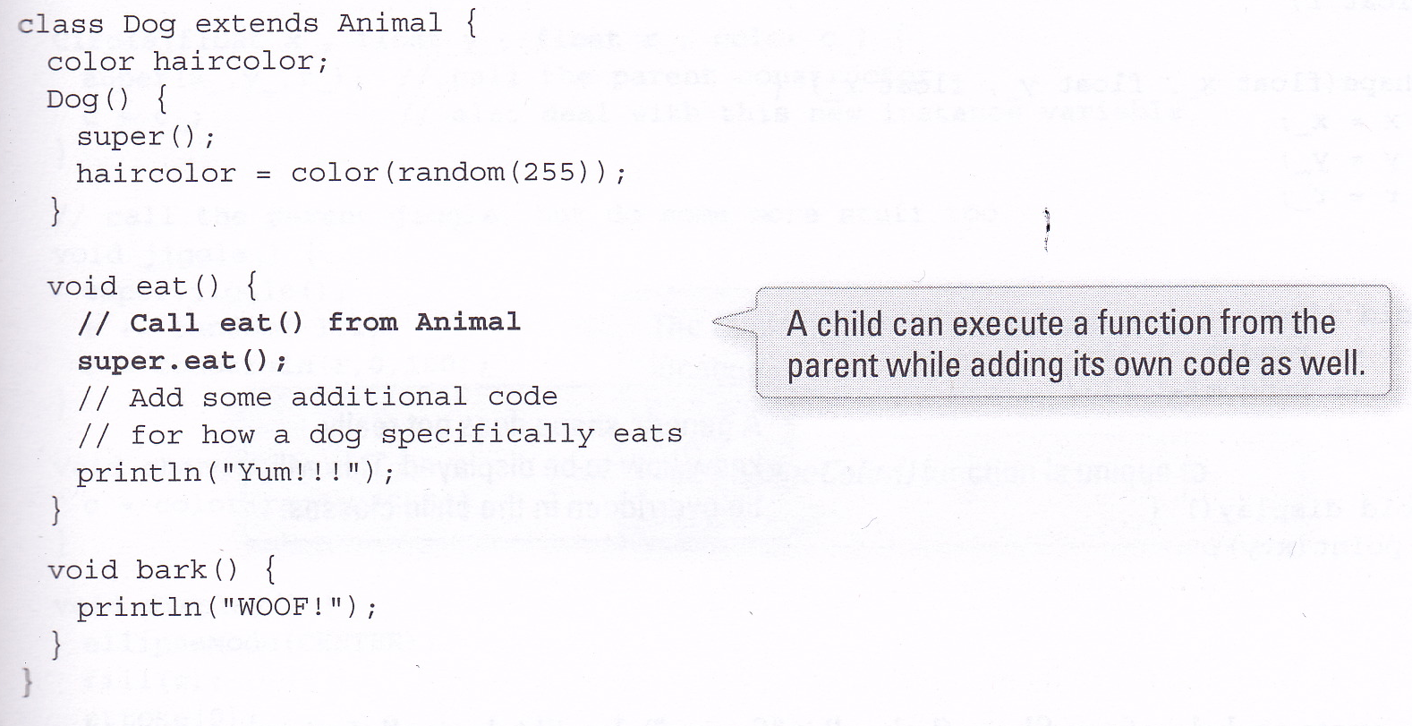
Method overriding with super

Slide 17
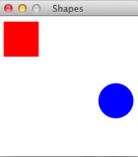
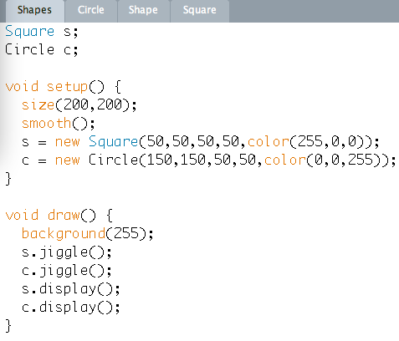
Shapes
Creates two objects, a Circle and a Square
On each frame, jiggles the shapes around and displays them
Circle class and Square class extend Shape class
Inherit everything defined in Shape class
Means we don’t have to re-define things that are already defined in the Shape class

Slide 18
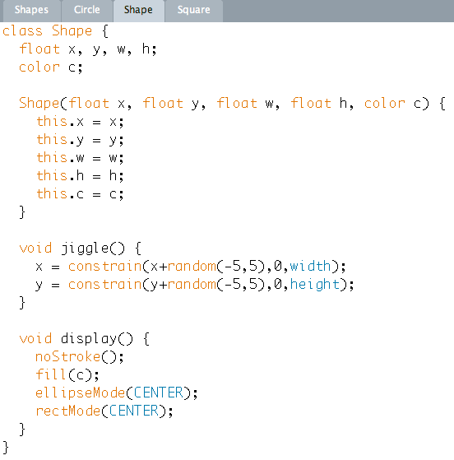
Shape class (the superclass)
this.x refers to the instance variable called x
Used to distinguish from constructor argument which is also called x
Shape.display() sets colour of object and drawing mode, but doesn’t actually draw anything

Slide 19
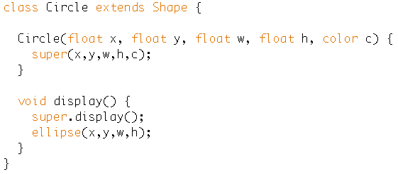
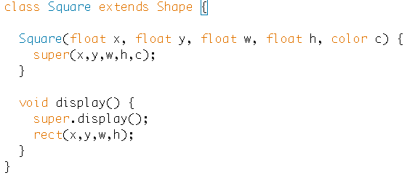
Circle and Square subclasses
Circle and Square classes extend Shape
Inherit everything (except constructor) from Shape
Need to define their own Constructors because Constructor must have same name as class
Need to override display method
But also must call Shape’s display method in order to set colour etc.

Slide 20
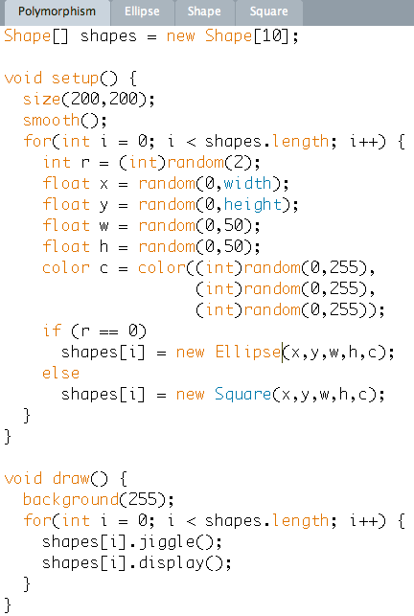
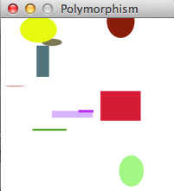
Polymorphism
Make an array of Shapes
Put Ellipses and Squares of different colours and sizes into the array
Iterate through the array, jiggling each Shape and then drawing it
shapes[i] is polymorphic because it can refer to many different types of object
Can refer to a Shape or any subclass of Shape

Slide 21
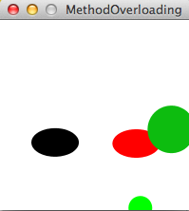
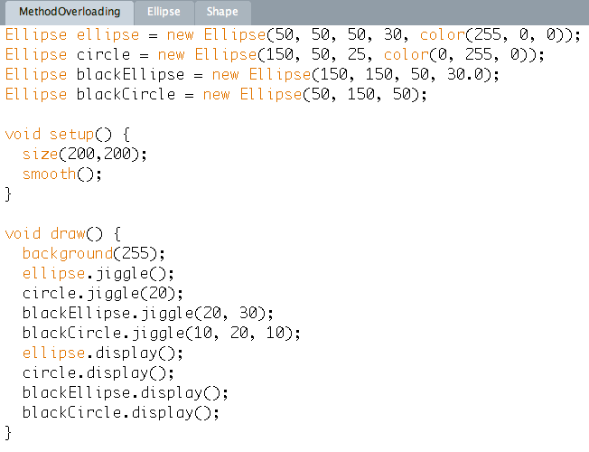
Method overloading
You can define two or more methods (or constructors) with the same name in the same class!
But you must make sure that the pattern of argument types in each method with the name is different!

Slide 22
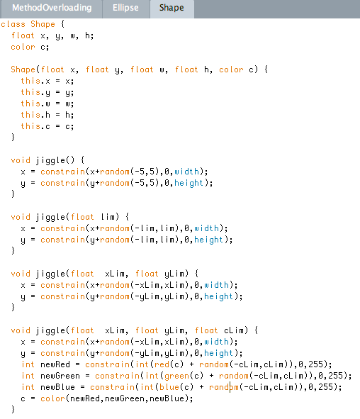
Overloaded methods
The jiggle() method in the Shape class is overloaded several times

Slide 23
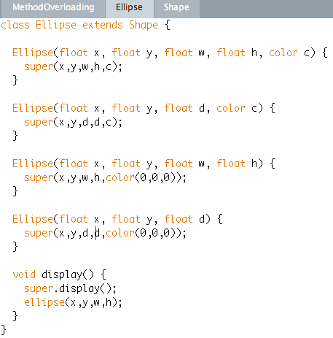
Overloaded constructors
The Ellipse constructor is overloaded to allow for the user to provide different pieces of information

