Slide 1
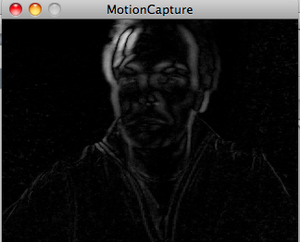
Video in Processing
David Meredith
dave@create.aau.dk
Aalborg University

Slide 2
Source
Chapter 16 of
Shiffman, D. (2008). Learning Processing. Morgan Kaufmann. ISBN: 978-0-12-373602-4.

Slide 3
Overview
Displaying live video
Displaying recorded video
Creating a software mirror
How to use a video camera as a sensor

Slide 4
Setting stuff up for processing video
On a Mac
Attach a camera to your computer (or use the one that’s built in)
Make sure software and drivers for your camera are installed
Test the camera in another program (e.g., iChat, Skype) to make sure it’s working

Slide 5
Setting stuff up for processing video
In Windows
Attach a camera or use the built-in camera
Make sure any drivers and software for your camera are installed
Test the camera
Install QuickTime Version 7 or higher
Install a video digitizer (vdig) to allow QuickTime applications to capture video in Windows
See http://eden.net.nz/7/20071008/

Slide 6
5 Steps to Live Video
Import the Processing video library
Declare a Capture object
Initialize the Capture object
Read the image from the camera
Display the video image

Slide 7
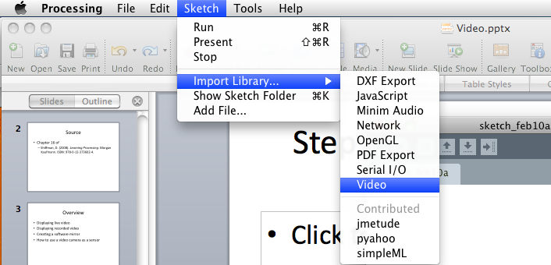
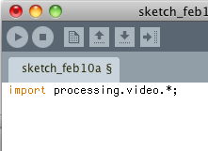
Step 1: Import the processing video library

Slide 8
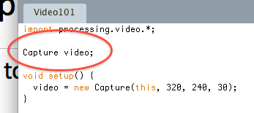
Step 2: Declare a Capture object

Slide 9
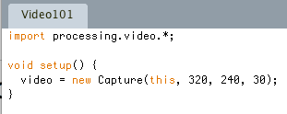
Step 3: Initialize the Capture object
Width of video captured by this Capture object
Height of video captured by this Capture object
Frame rate at which to capture video (fps)
“this” refers to this Processing sketch. When the camera captures a new image, we want it to alert this sketch (not some other one)

Slide 10
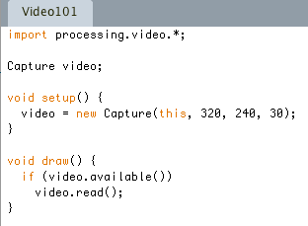
Step 4: Read the image from the camera (Method 1)
Use the Capture method available() to find out if there is an image available to be read
returns true if there is, false if there isn’t
If there is an image available to be read, then use read() to read the image into memory

Slide 11
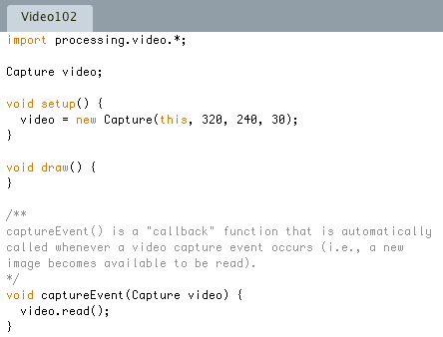
Step 4: Read the image from the camera (Method 2)
Override the captureEvent() callback function which is automatically called whenever there is a video capture event

Slide 12
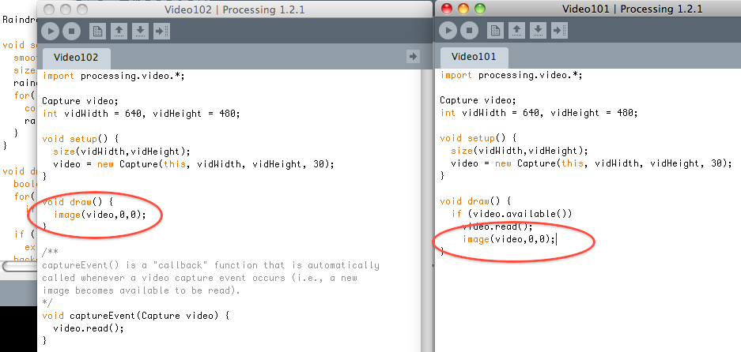
Step 5: Display the video image
A Capture object can be treated like a PImage and displayed using the image() function

Slide 13
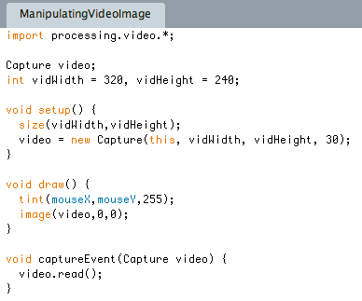
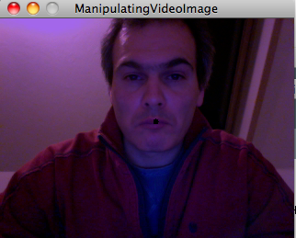
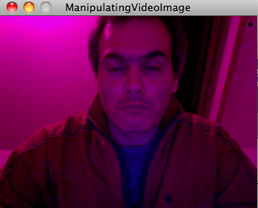
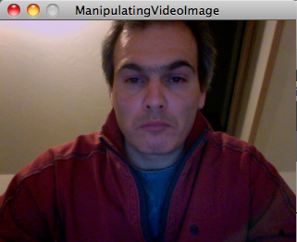
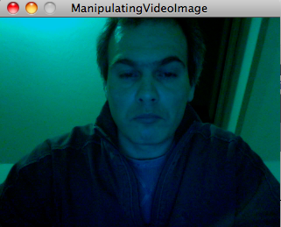
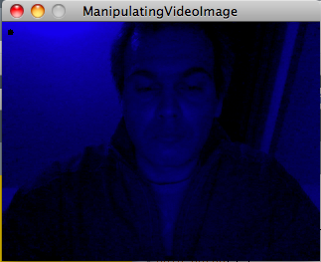
Manipulating a video image

Slide 14
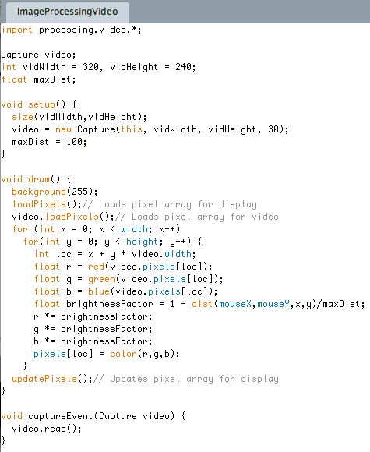
Captures can be treated as PImages
Anything that can be done to a PImage, can be done to a Capture object!

Slide 15
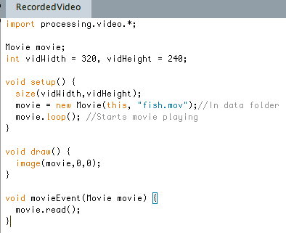
Recorded Video
Declare Movie object
Initialize Movie object
Start Movie playing
Display movie
Read frame from movie when there is a movie event

Slide 16
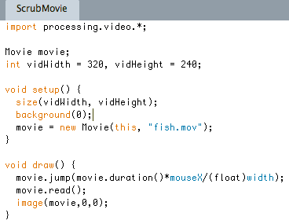
Scrubbing forward and backwards
Jumps to specified position in the movie. The argument is the number of seconds through the movie to which to jump

Slide 17
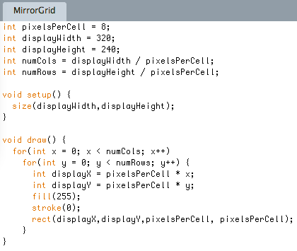
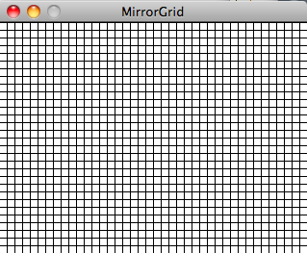
Software mirrors
Take the live input from the camera and use this to produce a processed moving image that “mirrors” the user
Begin by taking an 80 x 60 pixel input image and mapping it to a grid of squares filling a 640 x 480 pixel window

Slide 18
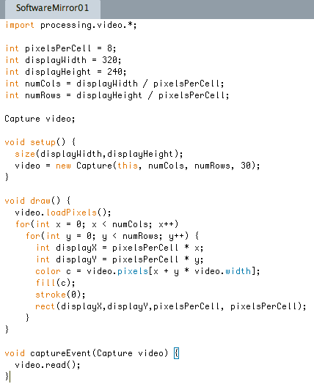
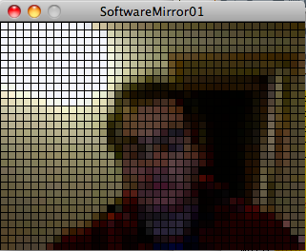
Software Mirrors

Slide 19
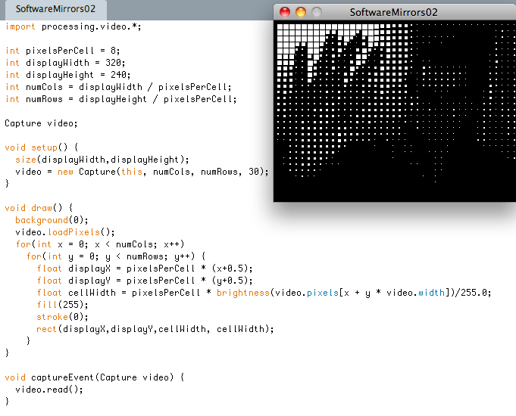
Software Mirrors

Slide 20
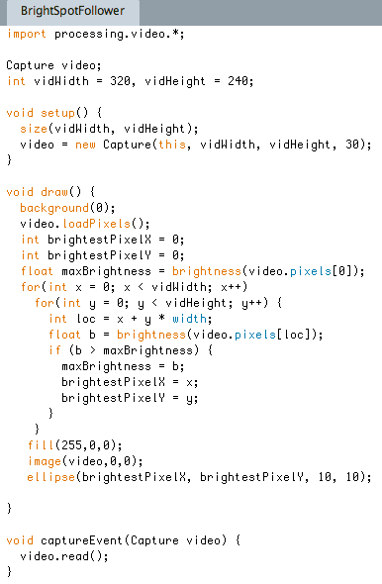
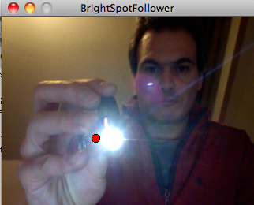
Tracking the brightest spot

Slide 21
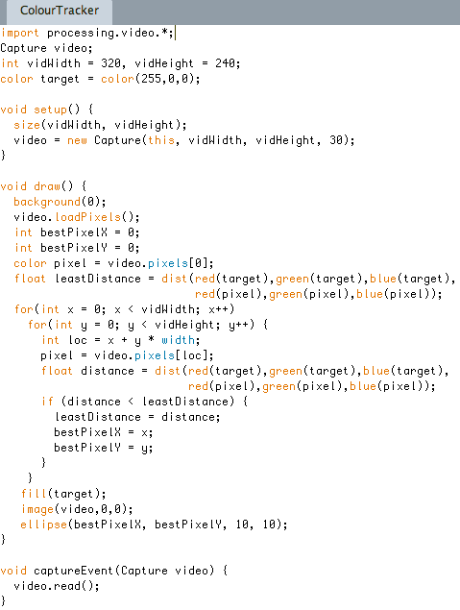
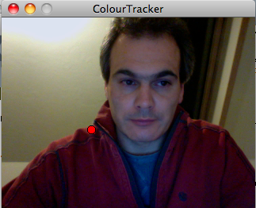
Tracking a colour

Slide 22
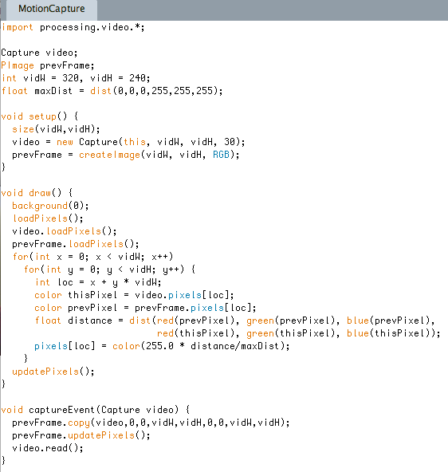
Motion detection

