Slide 1
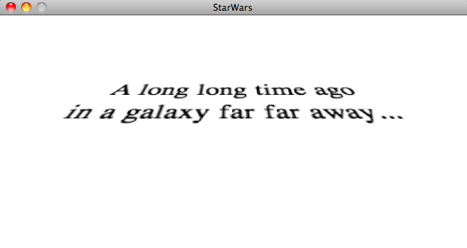
Text
David Meredith
dave@create.aau.dk
Aalborg University

Slide 2
Source
Chapter 17 of
Shiffman, D. (2008). Learning Processing. Morgan Kaufmann. ISBN: 978-0-12-373602-4.

Slide 3
Overview
Storing text in a String object
Basic String functionality
Creating and loading fonts
Displaying (rendering) text

Slide 4
Strings
The String class is an inbuilt class in Processing
A String object is designed to hold a string of characters
You can tell a literal String because it has double-quotes around it, e.g.,
println(“Some text to print to the console”);
PImage img = loadImage(“filename.jpg”);

Slide 5
Nothing special about in-built classes
Processing has lots of in-built classes like
PImage for storing images
Movie for storing a movie
Capture for storing recorded video
String is just like one of these, except that it’s designed to hold strings of text
String is actually a standard Java class that is made accessible in Processing
Remember that Processing is an interface to (or “window onto”) the Java programming language
Some things are visible through this window, others aren’t
String is one of the things that is visible!

Slide 6
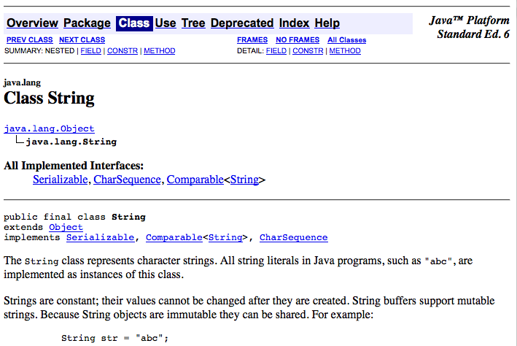
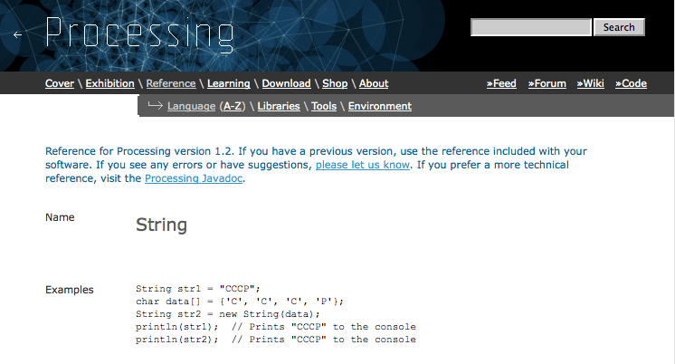
Help with using Strings
String is a Java class, so if you’re brave, you can find out all about it by reading the String page in the Java API, which is here
http://download.oracle.com/javase/6/docs/api/java/lang/String.html
Before doing this, perhaps you should first look at the Processing reference entry on Strings, which you will find here
http://www.processing.org/reference/String.html

Slide 7
What is a String?
A String is basically an array of characters
If we didn’t have strings, then to process some text, we’d have to do something like
char[] text = {‘H’, ’e’, ’l’, ’l’, ’o’, ’ ‘, ’W’, ’o’, ’r’, ’l’, ’d’};
But because we have Strings, we can do
String text = “Hello World”;

Slide 8
Some String methods
Because a String is an object, it has some useful methods defined for it
If s is a string, then
s.charAt(i) returns the (i+1)th char in the String (zero-based indexing)
s.length() returns the number of characters in the String

Slide 9
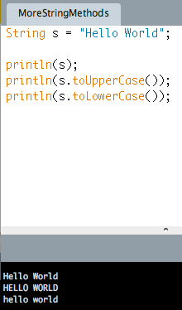
Changing case
If s is a String, then
s.toUpperCase() returns a new String which is the same as s except that all the letters are upper case
s.toLowerCase() returns a new String which is the same as s except that all the letters are lower case

Slide 10
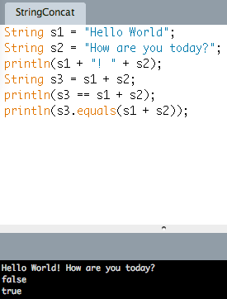
The equals() method and concatenation (‘+’ with Strings)
Strings can be chained together using the ‘+’ operator
If s1 and s2 are Strings, then s1 == s2 is true if s1 and s2 occupy the same place in the computer’s memory
If s1 and s2 are Strings, then s1.equals(s2) is true if every character in s1 is the same as the character at the same position in s2

Slide 11
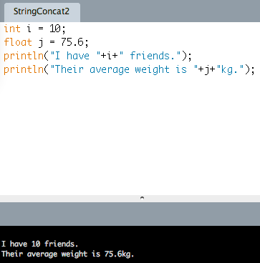
Concatenating Strings with other things
If you concatenate a String with a non-String using the + operator, then Processing automatically finds the String representation of the non-String and concatenates this with the String…get it?

Slide 12
6 Steps to displaying some text
Choose a font by selecting “Create Font” from the Tools menu
Declare a PFont object
Load the font into the PFont object by using loadFont()
Specify the font to use by calling textFont()
Set a fill colour using fill(c)
Use the text() function to draw the text in the display

Slide 13
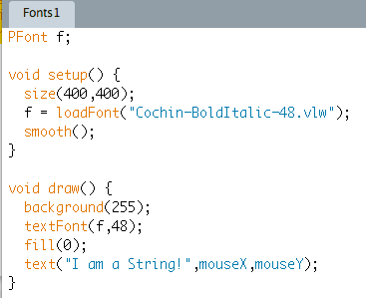
Example
This file has to be stored in a folder called ‘data’ inside the sketch folder
Use textFont() to specify the font and size. The size of the font should be the same as the original size of the created font. If it isn’t, you may get pixelation and other quality problems.
Use fill() to specify the colour of the text to be displayed
The text() function takes 3 arguments: the String to be displayed and the x and y co-ordinates of the position to display the String

Slide 14
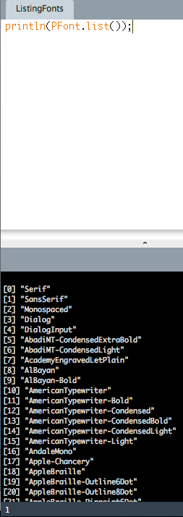
Listing all available fonts
Use PFont.list() to list all the available fonts
You can use any of these fonts when you call createFont() to make a font programmatically
Rather than making it by using the “Create Font” menu item in the “Tools” menu

Slide 15
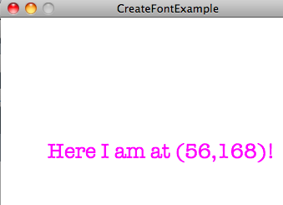
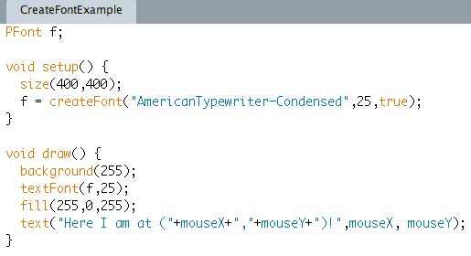
createFont()
createFont(font,size,smoothing)
takes three arguments:
font is the name of the font as a String
size is the size of the font in points
smoothing is either true or false and indicates whether the font should be smoothed (anti-aliasing)
createFont allows font to be scaled to any size without pixelation

Slide 16
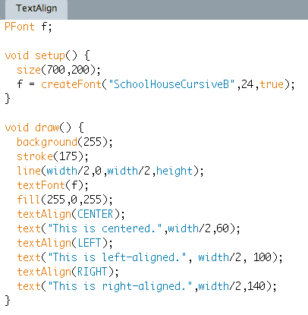
textAlign()

Slide 17
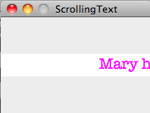
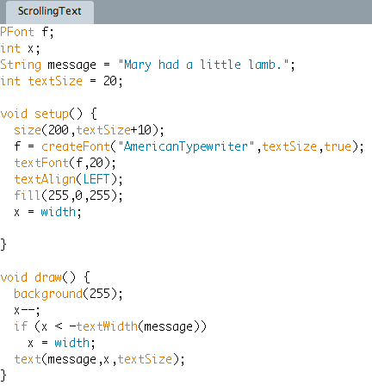
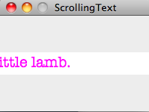
textWidth(String)
If s is a String, then
textWidth(s) returns the width of s in pixels

Slide 18
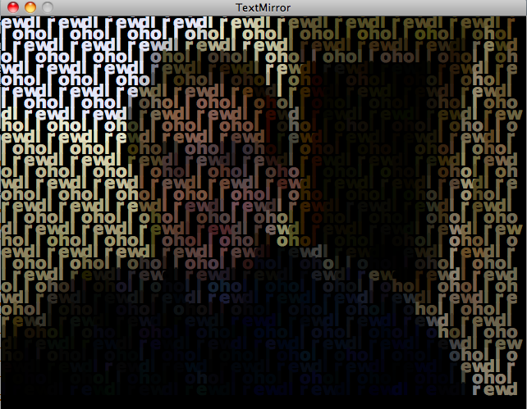
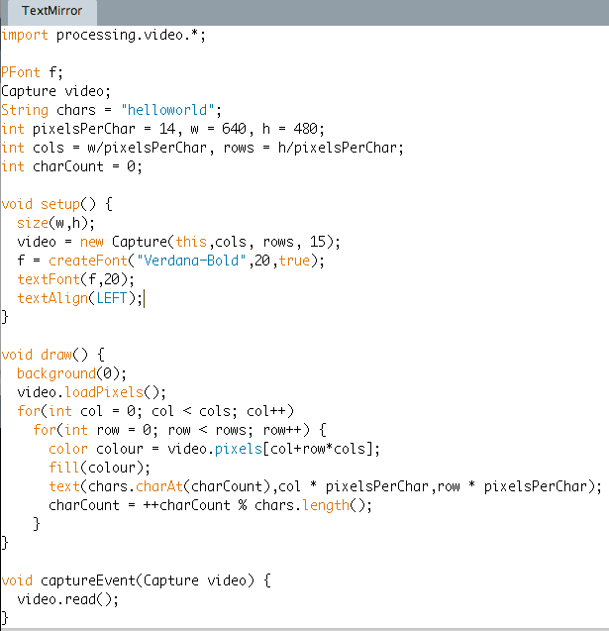
A Text Mirror
Remember we have to “loadPixels” before we can use the pixels array
Remember to read the next video frame in the captureEvent callback function
% chars.length() sets charCount to 0 again when it reaches the last char in chars

Slide 19
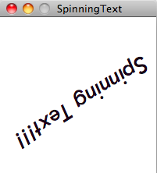
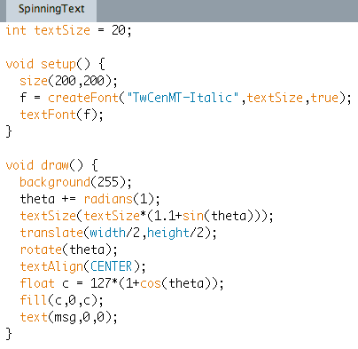
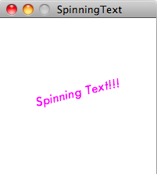
Rotating and translating text
Increase theta by 1 degree on each frame
Make the text size oscillate from very small to about twice the original size
Translate the origin to the centre of the display
Make the colour oscillate from very dark to very bright magenta

Slide 20
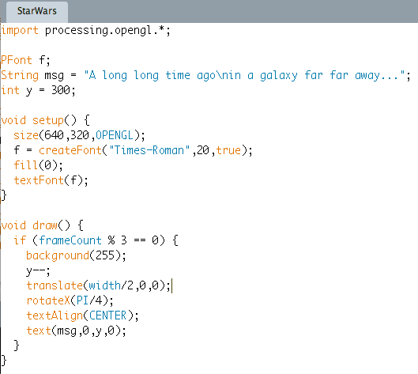
Text in 3D
\n inserts a hard line return in a string
Use rotateX() to rotate the co-ordinate system around the X-axis

Slide 21
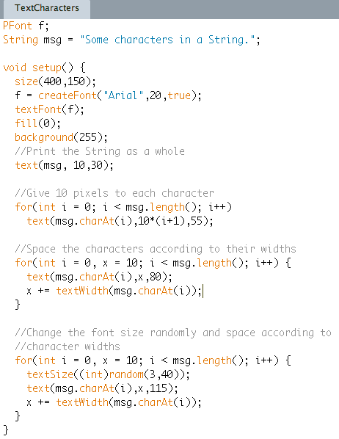
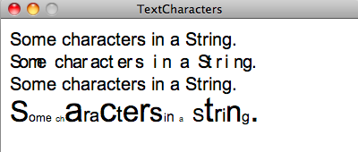
Displaying text a character at a time

Slide 22
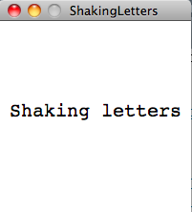
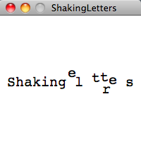
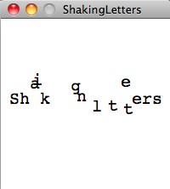
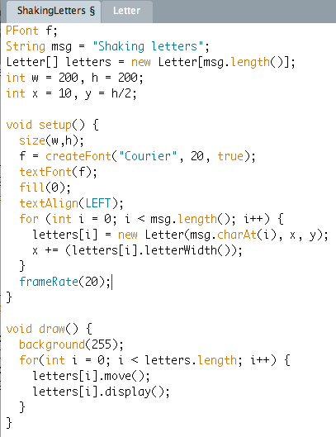
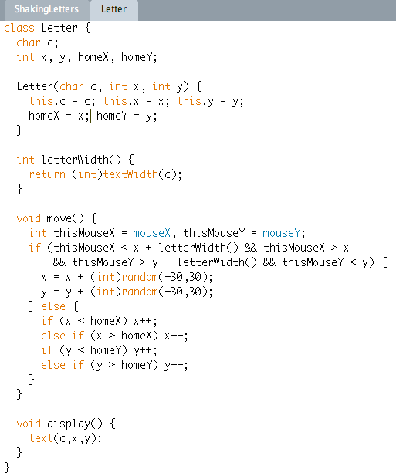
Shaking letters

Slide 23
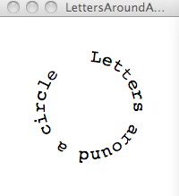
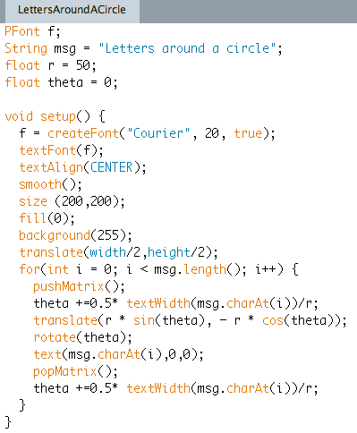
Letters on a circle
Text must be centered on x position
Must advance theta by half of this character’s width before and after printing

