Slide 1
Data Input
David Meredith
Aalborg University

Slide 2
Source
Chapter 18 of
Shiffman, D. (2008). Learning Processing. Morgan Kaufmann. ISBN: 978-0-12-373602-4.

Slide 3
Manipulating Strings
Already met the String class and some of its methods, e.g.,
charAt(int i), toUpperCase(), equals(String s), length()
Will now look at some more methods that let us find substrings within Strings
indexOf(String s) and substring(i,j)

Slide 4
indexOf(String s)
s1.indexOf(s2) returns the index of the first occurrence of s2 in s1
If s2 does not occur in s1, then returns -1
Remember that Strings are like arrays in that they used zero-based indexing
i.e., the index of the first character is 0 and the index of the last character is 1 less than the length of the String

Slide 5
substring(i,j)
If s is a String, then s.substring(i,j) returns the string that contains the characters from index i to index j-1 in s (inclusive)

Slide 6
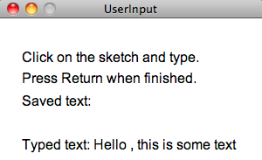
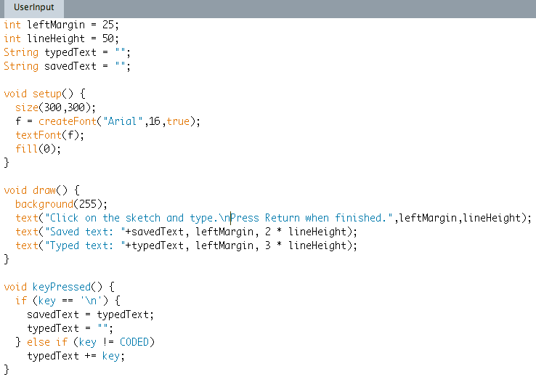
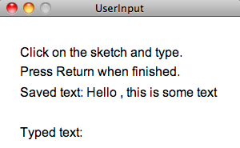
User input

Slide 7
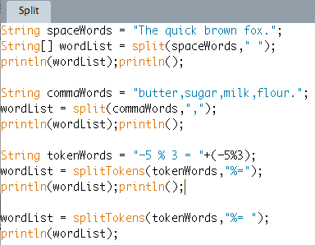
split() and splitTokens()
Note full stop in final string
Note spaces still present
Now spaces are gone
String of adjacent delimiters treated as one

Slide 8
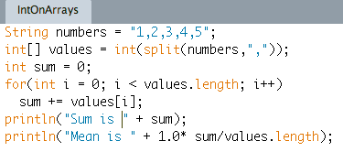
Using int() to parse an array of Strings
int() can take an array of Strings and return an array of ints

Slide 9
join()

Slide 10
Reading text from a file using loadStrings()
The input text file, stored in the data folder
Using loadStrings() to read the lines from the text file
The array of Strings produced by loadStrings()

Slide 11
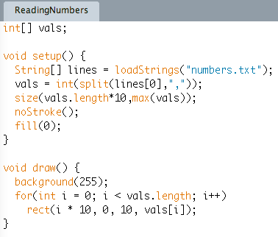
Reading numeric values from a text file

Slide 12
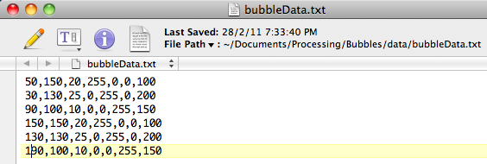
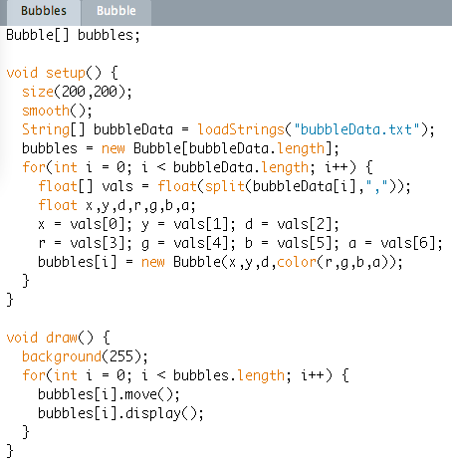
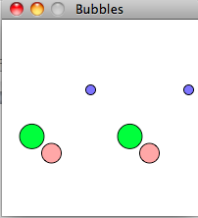
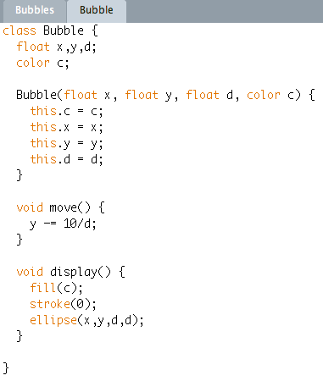
Creating objects from a file

Slide 13
Saving data to a file
Saves the strings array to a file called data.txt in the sketch folder
Saves the strings array to a file called newData.txt in the data subfolder of the sketch folder

Slide 14
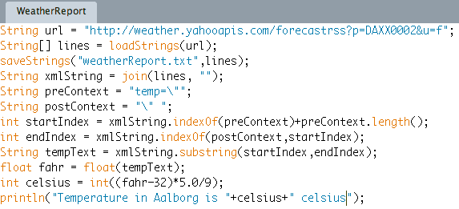
Extracting information from an XML feed

Slide 15
Counting words in texts

Slide 16
Introduction to XML
Data from Yahoo’s weather RSS feed is an XML file
An XML file stores structured data, with each piece of data between tags:
<tagName>data</tagName>
The end tag has the same name as the start tag but is preceded by a forward slash

Slide 17
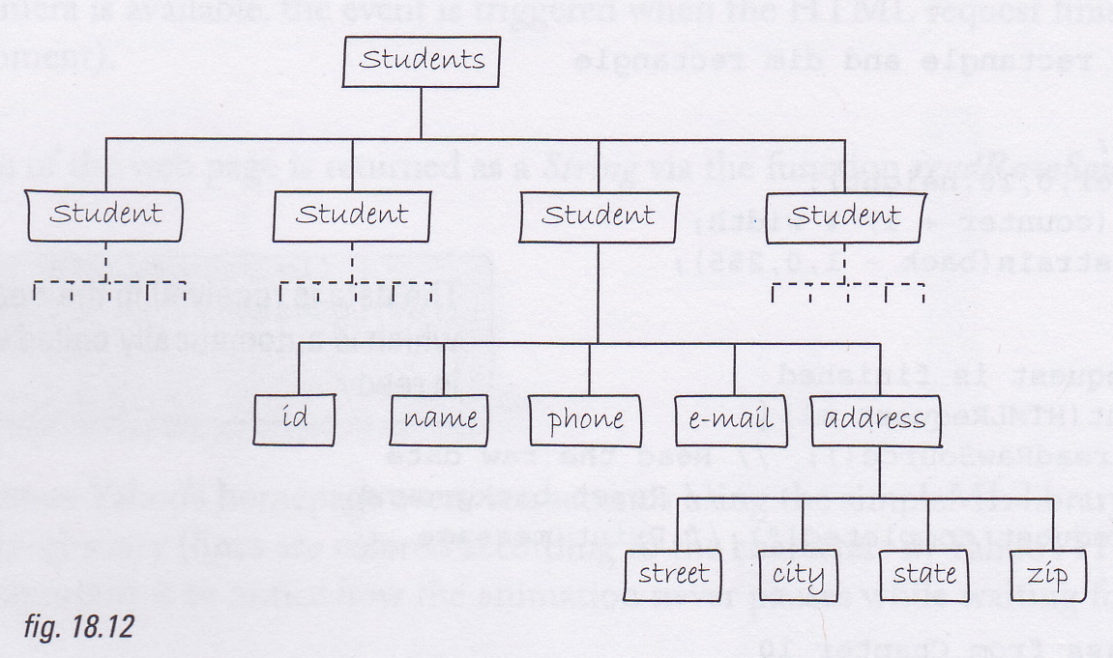
XML Trees
Each XML file is actually an encoding of a tree structure

Slide 18
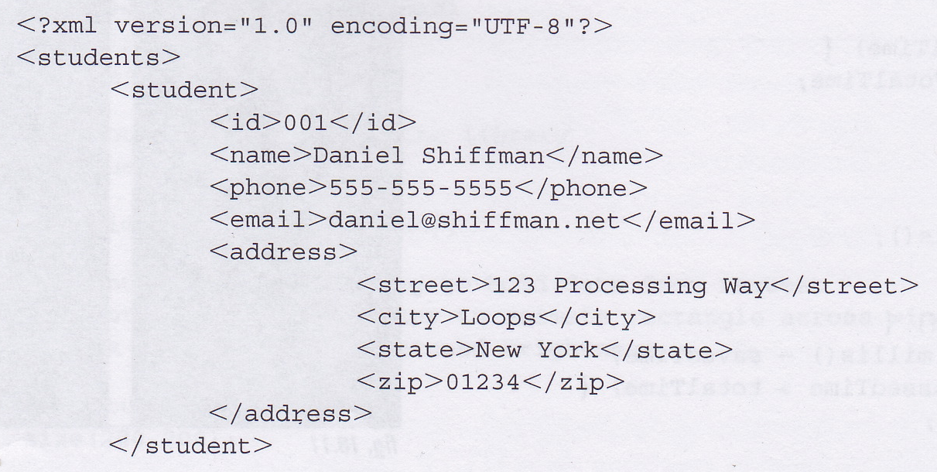
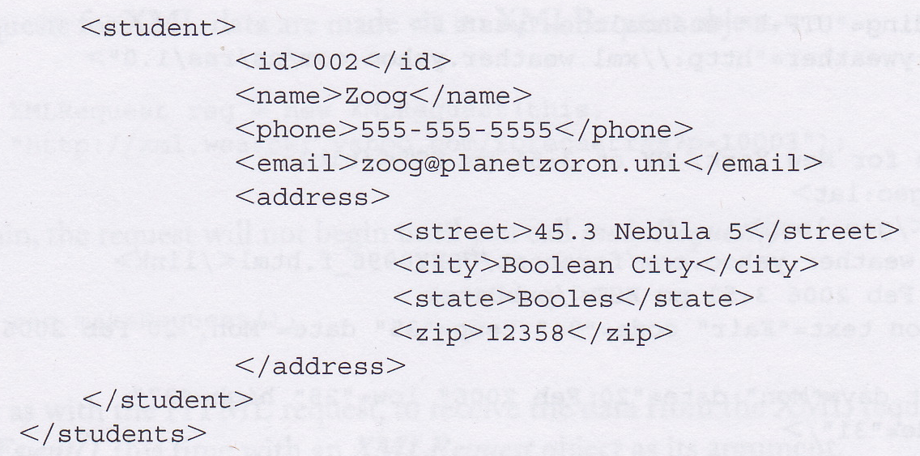
XML code

Slide 19
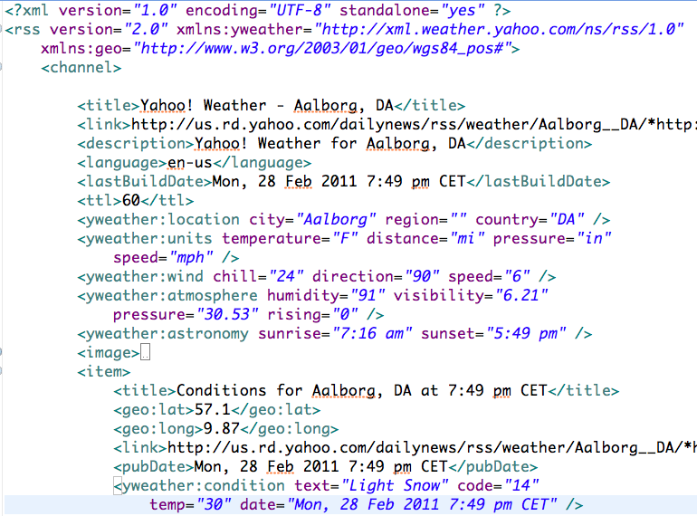
A Yahoo Weather RSS file

Slide 20
Using XMLElement

