Slide 1
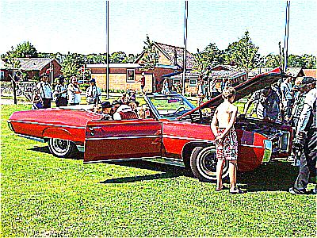
Images
David Meredith
dave@create.aau.dk
Aalborg University

Slide 2
Source
This lecture is based on Chapter 15 of
    Shiffman, D. (2008). Learning Processing. Morgan Kaufmann. ISBN: 978-0-12-373602-4.

Slide 3
Overview
The PImage class
Displaying images
Changing image colour
The pixels of an image
Simple image processing
Interactive image processing

Slide 4
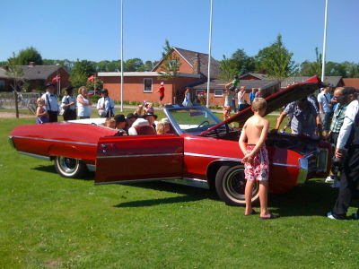
Images
A digital image is just an array of rectangular pixels
Each pixel is represented by a set of four numbers giving the red, green, blue and transparency (alpha) values for that pixel
We can use these numbers in any way we want…

Slide 5
The PImage class
PImage is a class just like the classes you’ve defined yourself, except that PImage is provided, ready-made by Processing
A PImage object is designed to represent an image
A PImage object has methods and variables that let you manipulate images

Slide 6
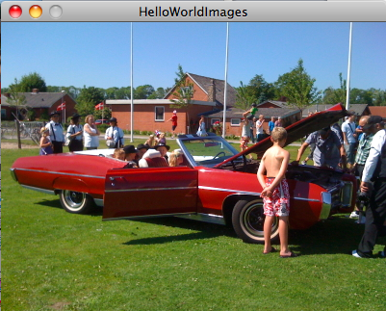
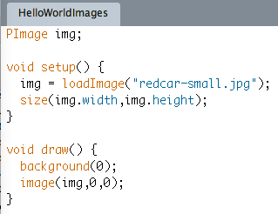
Loading and displaying an image
loadImage(fileName) loads the image fileName. If fileName is not a complete path, then the file must be in a folder called ‘data’ inside the sketch folder.
Processing accepts GIF, JPG, TGA and PNG files.
The image(img,x,y) function displays the image, img, with its top left corner at (x,y)
The width and height instance variables on an image give its width and height. You access them using the normal ‘dot’ notation, as shown.

Slide 7
Loading and creating an image
The loadImage(fileName) function reads the image file from the file called fileName and returns a PImage object holding the image
  This is a slow process, so don’t do it on every frame (i.e., in the draw() function)!
  You should do all image loading in the setup function
The image(img, x, y) function displays the image stored in img in the display area with its top left corner at (x,y)
If you want to create a blank image (which you can later paint as you like), use the function
createImage(w, h, col)

Slide 8
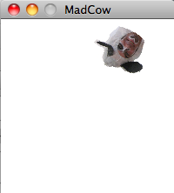
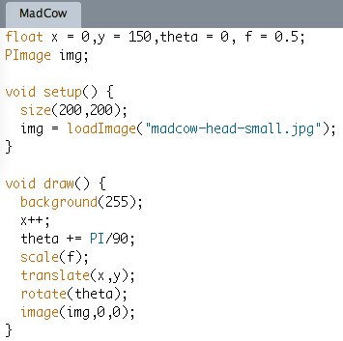
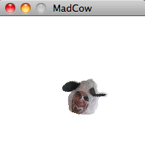
Animating an image

Slide 9
tint()
We can change the global colour and transparency properties of an image by calling tint() before we display the image, e.g.
  tint(100);
  image(img,0,0);
  This would darken the image
tint() can take 1, 2, 3 or 4 arguments depending on whether you want to change brightness, colour or transparency

Slide 10
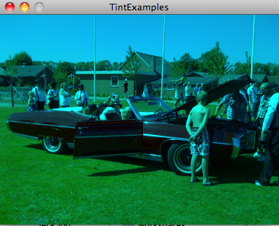
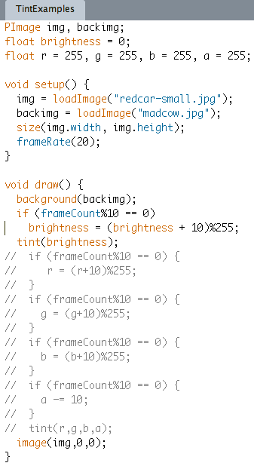
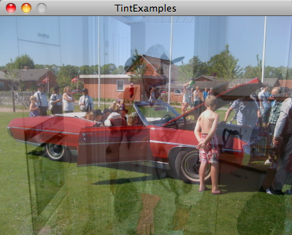
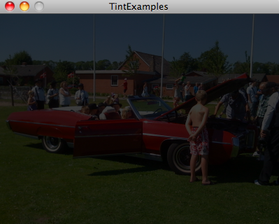
tint() examples
Set a background image by giving a PImage object as an argument to background()
Change brightness by giving 1 argument to tint()
Change r, g and b values of colour as well as opacity (alpha) by giving 4 arguments to tint()

Slide 11
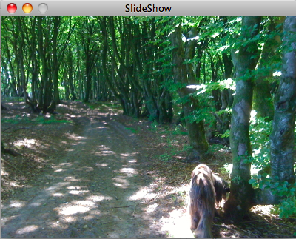
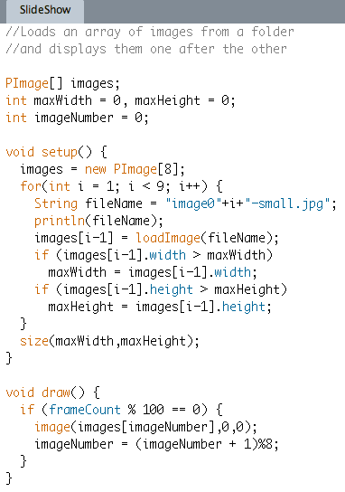
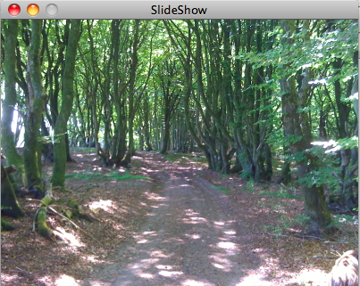
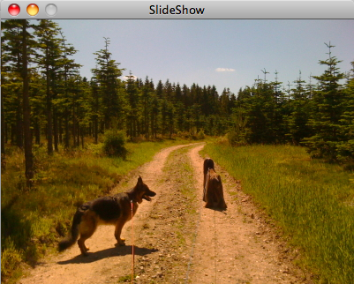
Arrays of images
Construct an array of images
Use + to concatenate Strings
Find maximum width and height of images so that display area is big enough
Keep cycling through images by using % to start again.

Slide 12
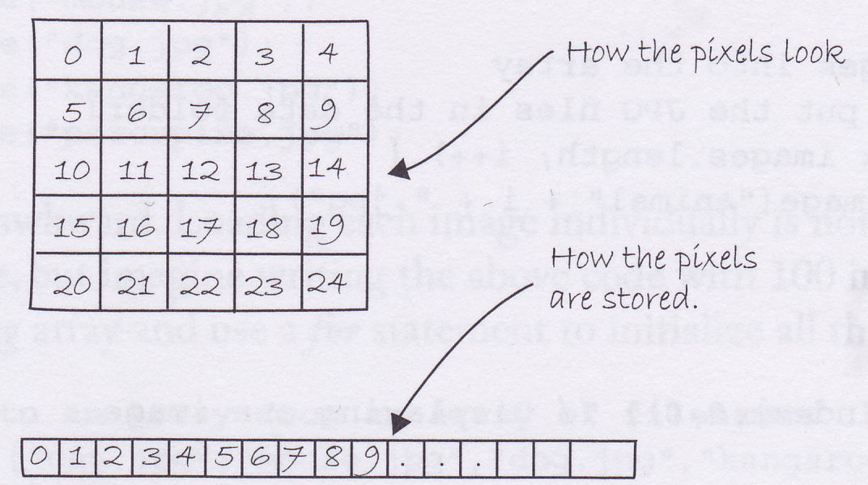
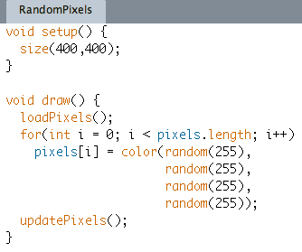
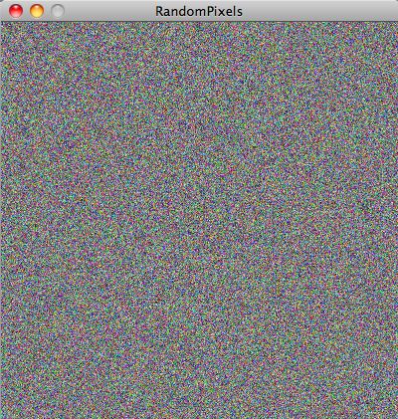
Manipulating pixels directly
Call loadPixels() to make the pixels array available
pixels is just a 1D array in which each element is a color
Iterate through the pixels array, setting each element to a random colour
Call updatePixels() after you’ve finished working with the pixels array to make your changes take effect

Slide 13
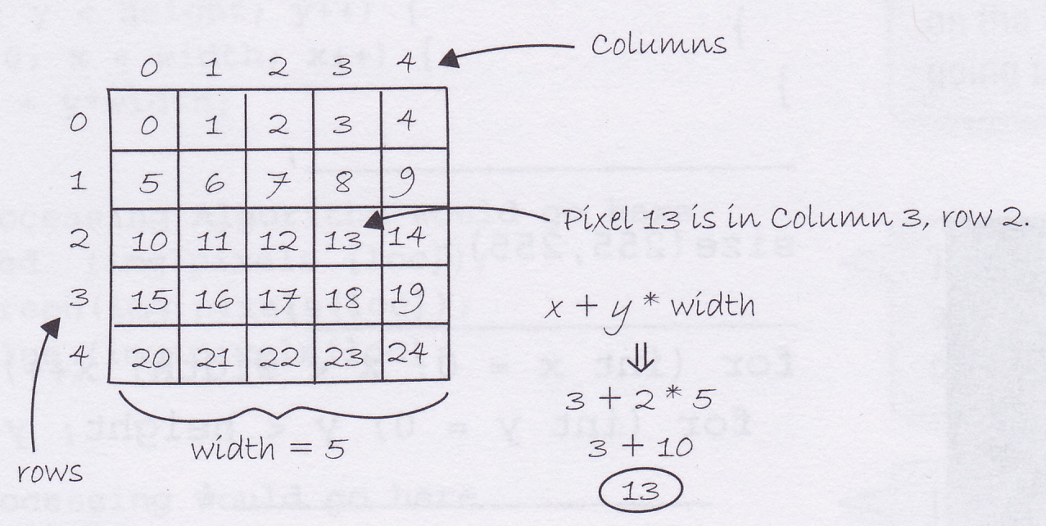
Finding the position of a pixel in the pixels array from its (x,y) co-ordinates
pixels is a system-defined 1-dimensional array
But the pixels in the display are in a rectangular region and each pixel has an (x,y) co-ordinate
The rows are just laid down next to each other in the pixels array
The position, i,of the pixel at (x,y) is given by
  i = x + y * width

Slide 14
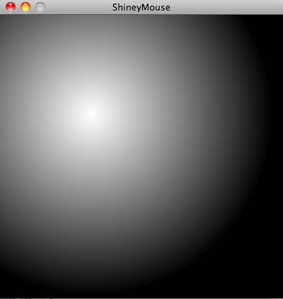
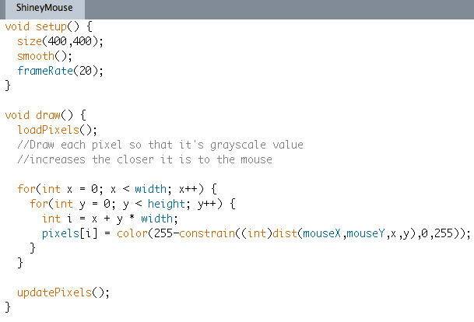
Using (x,y) position to choose colour of a pixel
Remember to call loadPixels() to make the pixels array available
Position, i, in pixels array given by
i = x + y * width
Each pixel set to a grayscale value that is higher the closer the pixel is to the mouse position
Call updatePixels() at the end of each frame so that your changes can take effect

Slide 15
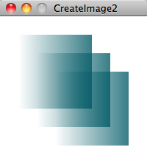
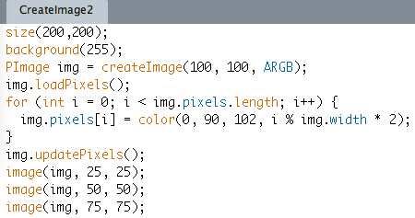
Creating an image
Create the PImage using
createImage(w,h,format) where format can be RGB, ARGB or ALPHA
Call the PImage method, loadPixels to make the image’s pixels array available
Call the PImage method, updatePIxels() when finished manipulating pixels array

Slide 16
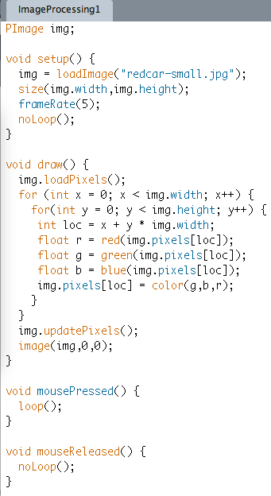
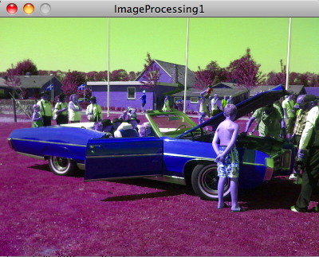
Image processing
noLoop() stops draw() from repeating
Use img.loadPixels() to make the pixels array of img available
Use two nested for loops to scan through all the pixels
Remember that the index of a pixel in the 1D pixels array is given by
x + y * width
Use the red(), green() and blue() functions to get the RGB values of a pixel
Set each pixel to its new color value
Call img.updatePixels() after you’ve finished processing the image
Override mousePressed() to make the program loop while the mouse button is down
Override mouseReleased() to make the program stop looping when the mouse is releasedis down

Slide 17
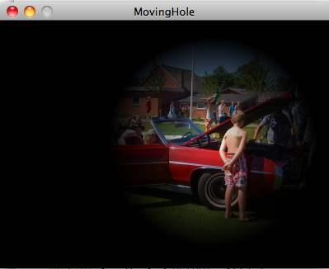
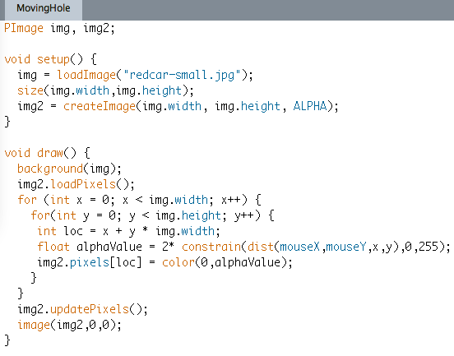
Seeing through an image
Create the image to cover the background with an alpha channel
Set the background image
Load the cover image’s pixels so we can change them
Set the alpha value so that it is greater (more opaque) the further the pixel is from the mouse
Set each cover image’s pixel value
Update the cover image’s pixels and display it

Slide 18
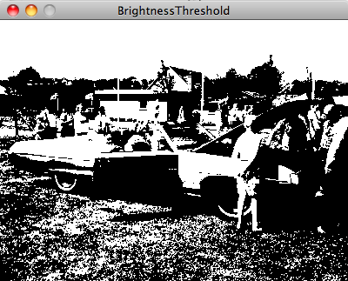
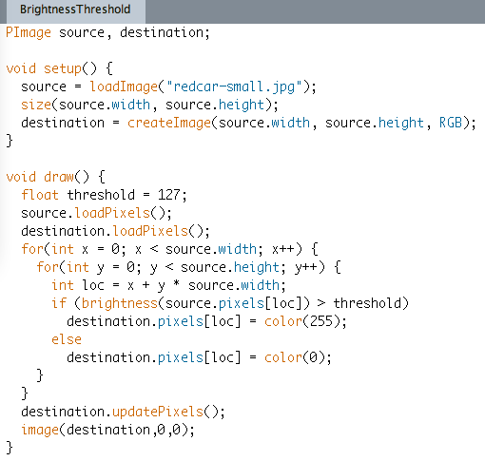
Brightness threshold using a source image and a destination image
Load source image from file
Create a blank destination image the same size as the source
Make the pixel arrays of the source and the destination available
Use the brightness() function to find a brightness value for each pixel
Set the destination pixel to either black or white, depending on brightness
Update the pixels in the destination, then display it

Slide 19
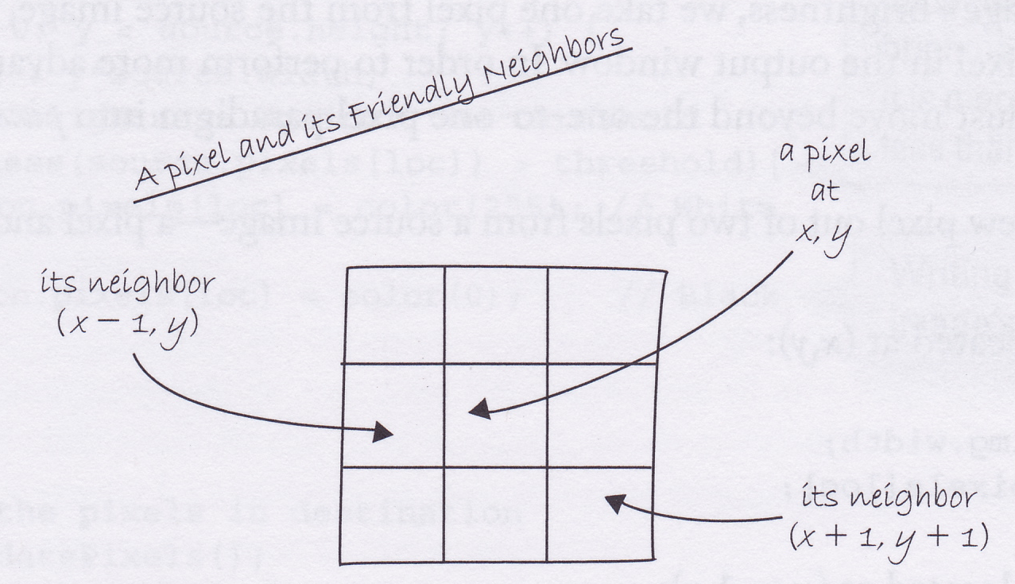
Pixel group processing
The value of a pixel in the destination can depend on the values in a whole region in the source
Typically destination value is a weighted average of the pixels in a small area around the same position in the source

Slide 20
Sharpening
-1 | -1 | -1
-1 | 9 | -1
-1 | -1 | -1
Pixel at centre position in destination is weighted sum of values in 3 x 3 region around same position in source
Matrix of weights (see above) is called a convolution matrix or convolution kernel
Values of weights must add up to 1
If surrounding pixels are the same as the centre pixel (contrast is low), then destination value is the same as the centre pixel
If contrast between centre and surrounding pixels is high, then this is emphasized in destination

Slide 21
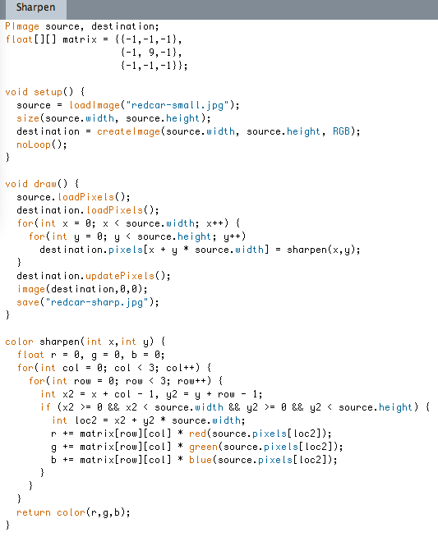
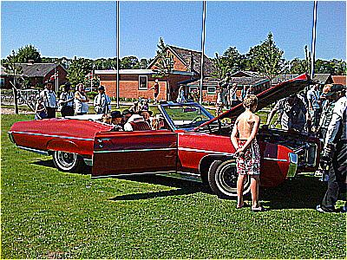
Sharpen

Slide 22

Blur
Can blur just by changing the matrix in Sharpen to the one below
1.0/9 | 1.0/9 | 1.0/9
1.0/9 | 1.0/9 | 1.0/9
1.0/9 | 1.0/9 | 1.0/9

Slide 23
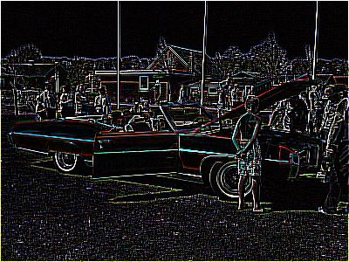
Convolution
Image at left created using same code with matrix changed to the one below
-2.5 | 2 | -2.5
2 | 2 | 2
-2.5 | 2 | -2.5

