Slide 1
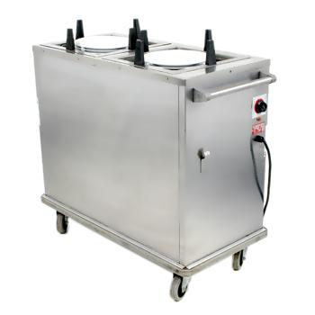
Translation and Rotation in 2D and 3D
David Meredith
dave@create.aau.dk
Aalborg University

Slide 2
Source
This lecture is based on Chapter 14 of
Shiffman, D. (2008). Learning Processing. Morgan Kaufmann. ISBN: 978-0-12-373602-4.

Slide 3
Overview
2D and 3D translation
Using P3D and OpenGL
Vertex shapes
2D and 3D rotation
Saving the transformation state in the stack
pushMatrix() and popMatrix()

Slide 4
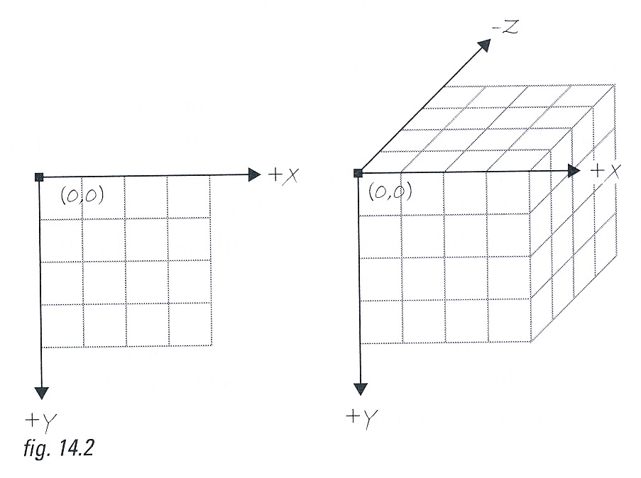
“Voxels” – pixels in 3D
You can draw things in 3D in Processing
You specify 3D positions with 3D co-ordinates, (x,y,z)
The x and y axes are the same as for 2D
x increases to the right
y increases downwards
The positive z-axis points out of the screen towards you
A voxel is the 3D equivalent of a pixel – it is an atomic cubic region in the 3D space
The properties of the space within a voxel must be the same throughout the voxel

Slide 5
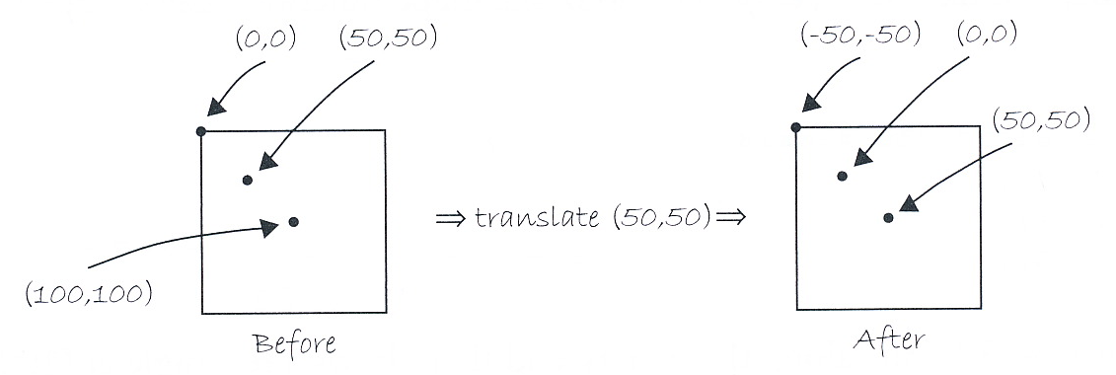
translate() in 2D
The translate(x,y) function moves the origin, (0,0), to position (x,y)
For example, translate(50,50) moves the origin, (0,0), to (50,50) so a point that was at (100,100) becomes (50,50)
A call to translate() only has effect until the end of the current frame
at the beginning of the next frame, the origin moves back to (0,0)

Slide 6
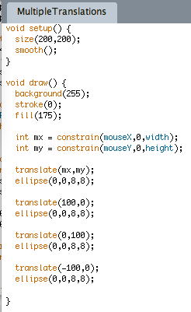
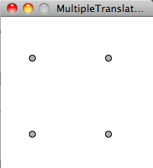
Using translate(x,y)

Slide 7
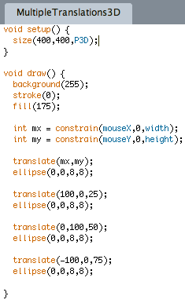
Translations in 3D
Use P3D renderer in size() function
Add 3rd co-ordinate to translate() function

Slide 8
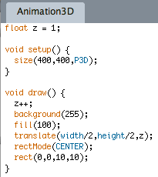
Simple animation in 3D
translate() only has effect until the end of the current frame (i.e., the end of the current call to draw())
So must reposition origin relative to (0,0,0) on every frame

Slide 9
Java2D, P3D or OpenGL
To render objects in 2D, Processing uses the Java2D renderer and libraries – this is what we’ve been doing all along!
To render objects in 3D, you have to tell Processing which renderer to use
There are two renderers:
P3D – developed especially for Processing
cannot use smooth() with P3D
OPENGL
Can use if you have an OpenGL graphics card
Uses hardware acceleration for rendering graphics faster
All graphics are smoothed (ignores smooth() and noSmooth())
To use P3D, put following line in setup():
size(x,y,P3D);
To use OpenGL
Put following line in setup():
size(x,y,OPENGL);
Import the Processing opengl library by putting following line at beginning of sketch
import processing.opengl.*;

Slide 10
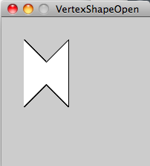
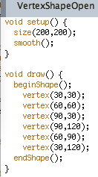
Vertex shapes - Open
Use beginShape() to start the vertex shape
Then use vertex(x,y) to specify a vertex at (x,y)
Use endShape() to end the vertex shape
Note that if endShape has no argument, then the shape is “open”

Slide 11
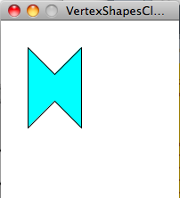
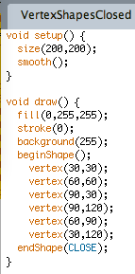
Vertex shapes - Closed
Use the CLOSE argument to close the vertex shape
Note that this shape is closed

Slide 12
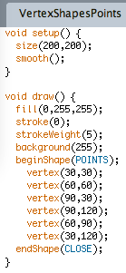
Vertex Shapes - POINTS
Use the POINTS argument to beginShape to get Processing to render each vertex in the vertex shape as a separate, unconnected point
If POINTS is given to beginShape, then it doesn’t matter if CLOSE is given to endShape or not

Slide 13
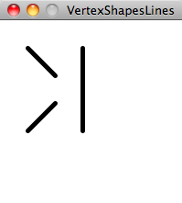
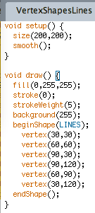
Vertex shapes - LINES
Use the LINES argument in beginShape to get processing to interpret each pair of consecutive vertices as the endpoints of a line
This vertex is the start of the first line
This vertex is the end of the first line
This vertex is the start of the second line

Slide 14
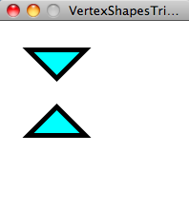
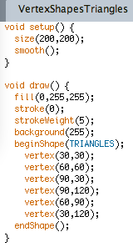
Vertex shapes - TRIANGLES
Use TRIANGLES as the argument to beginShape to make Processing interpret each set of 3 consecutive vertices as forming a triangle
These three points form the first triangle
These three points form the second triangle

Slide 15
Vertex shapes – Other beginShape arguments
beginShape can also take other arguments:
TRIANGLE_FAN
TRIANGLE_STRIP
QUADS
QUAD_STRIP
See the Processing reference for details

Slide 16
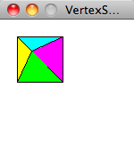
Vertex shapes in 3D
Position of apex depends on size of display
Can use TRIANGLES argument to beginShape to draw the triangular faces of a pyramid
Can change the fill colour of each face in between calling beginShape and endShape

Slide 17
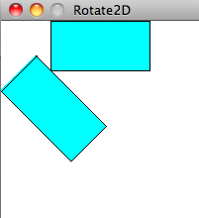
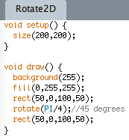
Rotation in 2D
rotate(theta) rotates theta radians clockwise around the origin (i.e., (0,0) )

Slide 18
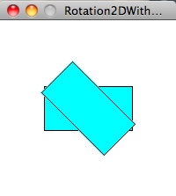
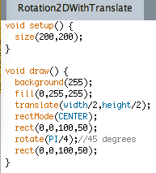
Rotation in 2D
Translate the origin to the desired centre of rotation
Change rectMode so that specify centre of rectangle
Rotate the co-ordinate system by 45 degrees clockwise around the new origin

Slide 19
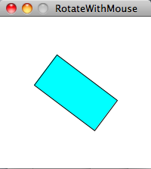
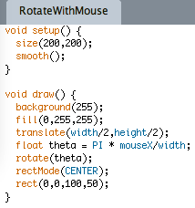
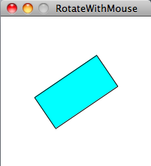
Rotate in response to mouse
Translate centre of rotation to centre of display
Find the angle of rotation based on horizontal mouse position
Rotate the co-ordinate system clockwise by theta radians

Slide 20
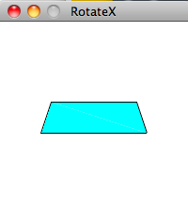
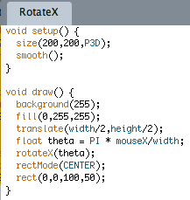
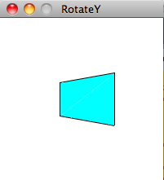
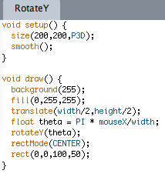
Changing the axis of rotation
rotate() and rotateZ() rotate around the z-axis
rotateX(theta) rotates around the x-axis
rotateY(theta) rotates around the y-axis

Slide 21
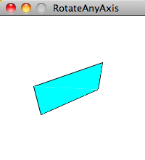
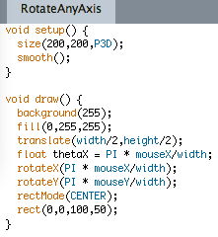
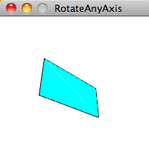
Combining rotateX and rotateY
Angle of rotation around X axis controlled by horizontal mouse position
Angle of rotation around Y axis controlled by vertical mouse position

Slide 22
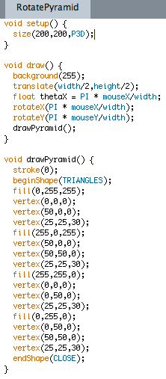
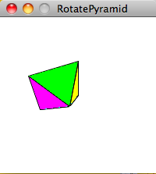
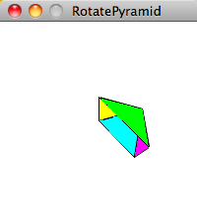
Rotating a 3D object

Slide 23
The scale() function
The scale(f) function shrinks or enlarges objects by the scale factor f, which is a float
For example,
scale(0.5) shrinks all objects drawn between this line and the end of the current frame to ½ of their specified size
scale(3.0) enlarges all objects drawn between this line and the end of the current frame to 3 times their specified size
The centre of enlargement is always (0,0), so if you want to change this, you have to use a call to translate (x,y) before calling scale

Slide 24
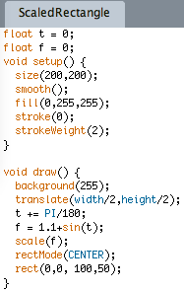
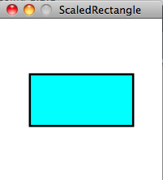
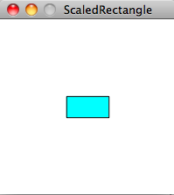
A shrinking and growing rectangle
Move centre of enlargement to centre of display
Increase t by 1 degree per frame
Set the scale factor to 1.1 added to the sine of t

Slide 25
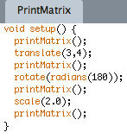
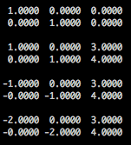
Transformation Matrices
Every time you apply scale(), rotate() or translate(), you transform the co-ordinate system
Such a transformation is stored as a table of 6 numbers called a matrix

Slide 26
pushMatrix() and popMatrix()
Sometimes we want to store the current co-ordinate system transformation so that we can temporarily use another transformation and then return to the stored one
We do this using pushMatrix() and popMatrix()
pushMatrix() stores the current matrix on the matrix stack
popMatrix “pops” the most recently stored matrix from the matrix stack
Think of pushMatrix() as pushing down a new plate onto a spring-loaded plate stacker
popMatrix() is like popping out the top plate on the stack of plates

Slide 27
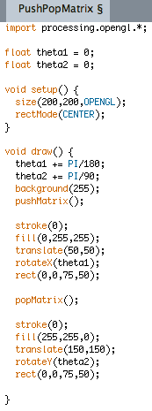
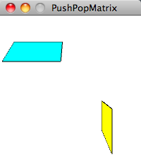
Using pushMatrix() and popMatrix()
pushMatrix() stores the untransformed co-ordinate system
Cyan rectangle rotates by 1 degree per frame around x axis
popMatrix() restores the untransformed co-ordinate system
Yellow rectangle rotates by 2 degrees per frame around y axis

Slide 28
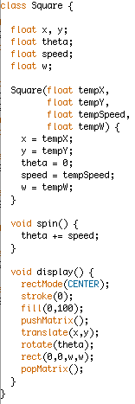
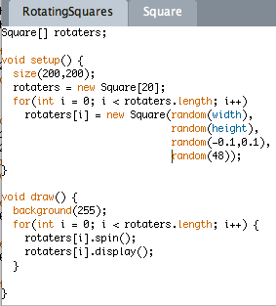
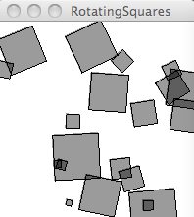
Independently rotating objects

Slide 29
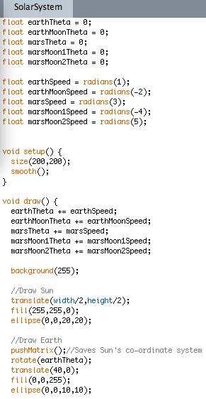
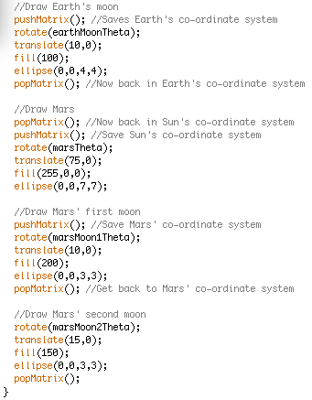
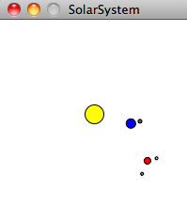
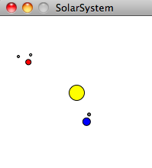
A simple solar system

