Slide 1
Some Maths
David Meredith
dave@create.aau.dk
Aalborg University

Slide 2
Source
This lecture is based on Chapter 13 of
Shiffman, D. (2008). Learning Processing. Morgan Kaufmann. ISBN: 978-0-12-373602-4.

Slide 3
Maths and programming
BAD NEWS:
You can’t build interesting image and sound systems without using some maths
You’ll need to be able to think logically in order to implement your creative ideas
GOOD NEWS:
You don’t have to know a lot of maths in order to be able to build interesting image and sound systems
The maths you need to know isn’t that hard
Your ability to think logically will improve quickly with practice!

Slide 4
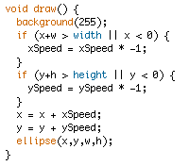
We’ve already used some maths
Making a ball move and bounce off the side of the display area
Checking if two circles intersect

Slide 5
Overview
We’re going to cover the following
Modulus
Random numbers
Probability
Perlin noise
Angles
Trigonometry
Oscillation
Recursion
Two-dimensional arrays

Slide 6
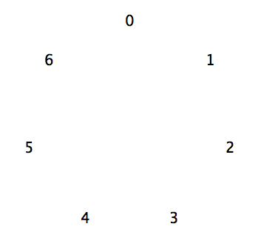
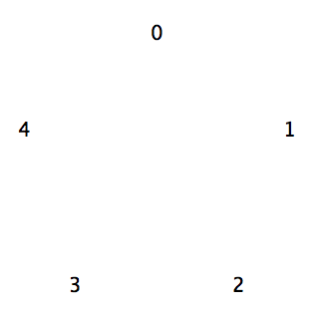
Modulus
This is just clock arithmetic
If y = x mod n then y is the number you land on if you count x steps clockwise around a circle with n numbers on it, starting at 0
x mod n is the remainder after you divide x by n
E.g.
10 mod 7 = 3
(12 - 6) mod 5 = 1
Also works when x and n are floats:
6.4 mod 2.5 = 1.4
In Processing, use % to do the mod operation
10 % 7 = 3
(12 - 6) % 5 = 1
6.4 % 2.5 = 1.4

Slide 7
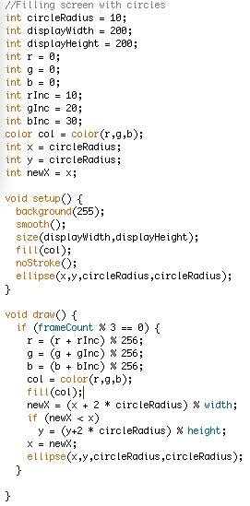
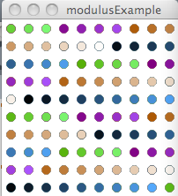
Modulus example

Slide 8
Random numbers
The random(x) and random(x,y) functions return a pseudo-random number
For example, random(10) returns a pseudo-random number between 0 (inclusive) and 10 (exclusive)
The random() function generates a random number over the desired range according to a uniform distribution
i.e., (int)random(10) generates
0, 10% of the time
1, 10% of the time
2, 10% of the time
…

Slide 9
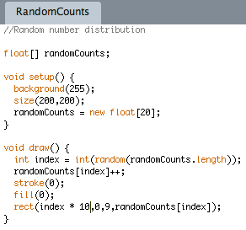
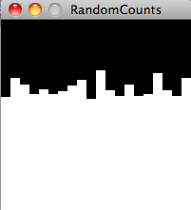
Distribution of random numbers

Slide 10
Probability review
To calculate the probability of an outcome having a desired property, you need to know
the total number of possible outcomes, N
the number of these possible outcomes that have the desired property, x
Probability is then x/N
For example, to calculate the probability of the number on a die being less than 3
total number of possible outcomes is 6 (1,2,3,…6)
number of outcomes with desired property is 2 (1,2)
So probability is 2/6 = 1/3

Slide 11
Compound probability
Probability of two sixes in a row is equal to the probability of getting a six the first time multiplied by the probability of getting a six the second time
1/6 * 1/6 = 1/36
All possible outcomes are
(1,1), (1,2), (1,3),…(2,1),(2,2),(2,3)…(6,4),(6,5),(6,6)
Therefore 36 possible outcomes
Only one of these 36 outcomes is 2 sixes in a row
Therefore probability of getting two sixes in a row is 1/36
What’s the probability of drawing 3 aces in a row from a pack of cards?

Slide 12
Drawing three aces in a row
Probability of drawing 3 aces in a row is equal to
probability of drawing first ace (4/52) multiplied by
probability of drawing second ace (3/51) multiplied by
probability of drawing third ace (2/50)
Therefore
4/52 * 3/51 * 2/50 = 0.00018 = 18/100000

Slide 13
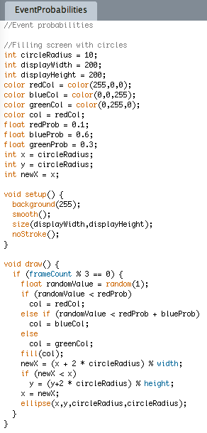
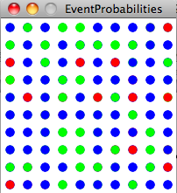
Controlling event probabilities
Generate a random number between 0 and 1
Partition the range into sizes that correspond to the desired probabilities of the different events
e.g.,
0-0.1 for a probability of 0.1
0.1-0.7 for a probability of 0.6
0.7-1.0 for a probability of 0.3

Slide 14
Perlin noise
We can get a “life-like” or “natural” effect by introducing noise into values
e.g., by adjusting mathematically computed values by small random amounts
To make an effect life-like, we don’t want too much randomness
Ken Perlin devised a function that generates noise that seems “natural” or “organic”
The random number generated by Perlin noise is constrained to being not too far away from the preceding value
This gives an “organic”, “natural” smooth, but unpredictable curve, in contrast to truly random noise, which is much more erratic

Slide 15
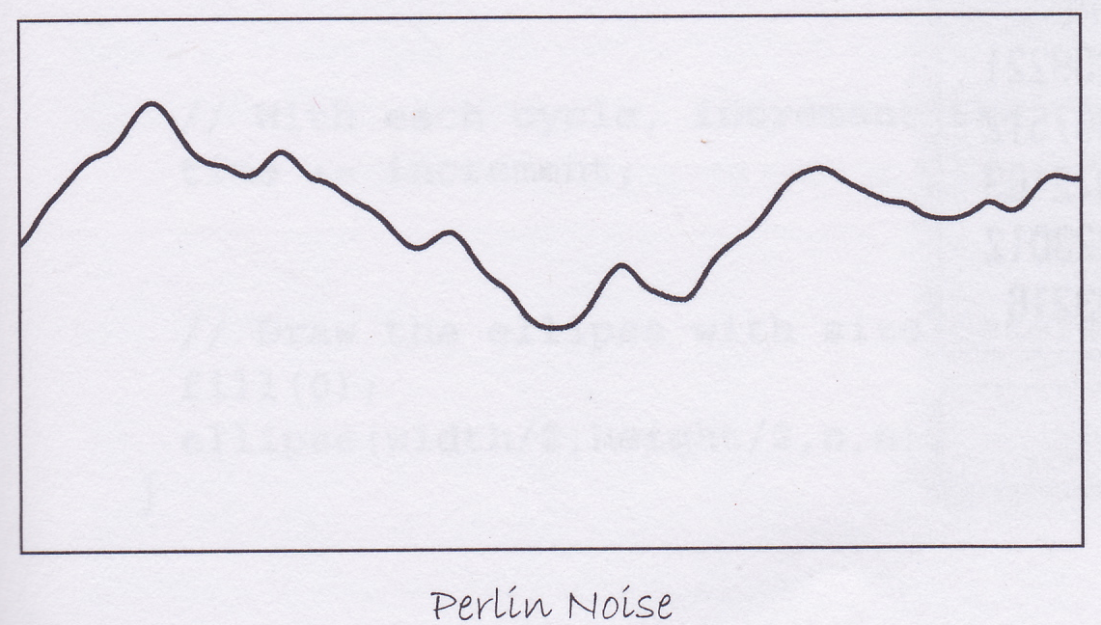
noise()
The Processing noise() function generates Perlin noise
It takes 1, 2 or 3 arguments, depending on the dimensionality of the noise to be generated
In 3 dimensions, the function generates a random 3d point
In 1d, the argument can be thought of as being “time”
The argument would be the value of the x axis in the graph above, and the value returned would be the y value
Typically, we start with a time value of 0 and then increment this value by a certain amount to generate the next noise value
The more we increment the time value on each step, the less smooth the curve looks

Slide 16
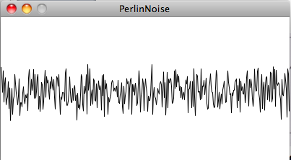
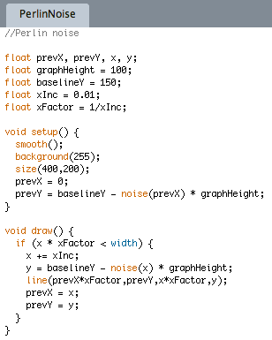
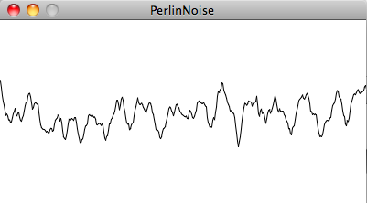
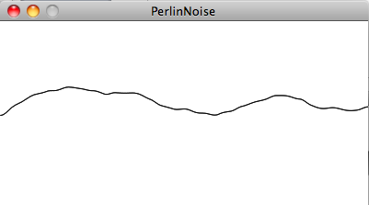
Using the noise() function

Slide 17
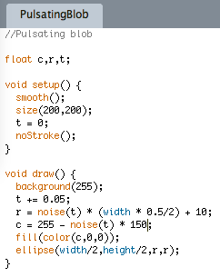
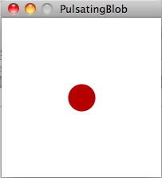
Pulsating blob

Slide 18
Angles
We need to understand angles in order to rotate things and draw things with circular symmetry
You are probably used to measuring angles in degrees
90 degrees is a quarter turn,
180 degrees is a half turn
270 degrees is a ¾ turn
360 degrees is a full turn
Usually measure angles anti-clockwise from the positive x-axis

Slide 19
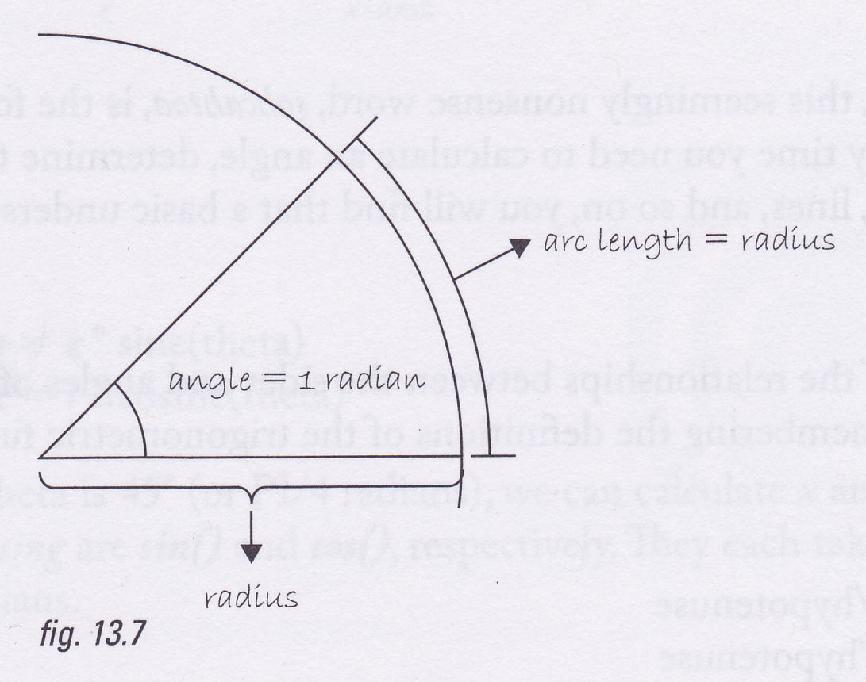
Radians
In maths and Processing, we measure angles in radians
1 radian is the angle for which the length of the circular arc is the same as the radius
Remember that the circumference of a circle of radius r is 2πr
Since 1 radian corresponds to travelling r along the circumference and a full trip round a circle is 2πr long, there are 2π radians in a full turn
2π radians = 360 degrees
π radians = 180 degrees
π/2 radians = 90 degrees
3π/2 radians = 270 degrees
? = 45 degrees
In general, Radians = 2π * (degrees/360)
In Processing, π is given by PI, so 2π would be “2 * PI”
In Processing, we can use the radians function to convert degrees to radians:
float angle = radians(60); //Returns the radian equivalent of 60 degrees

Slide 20
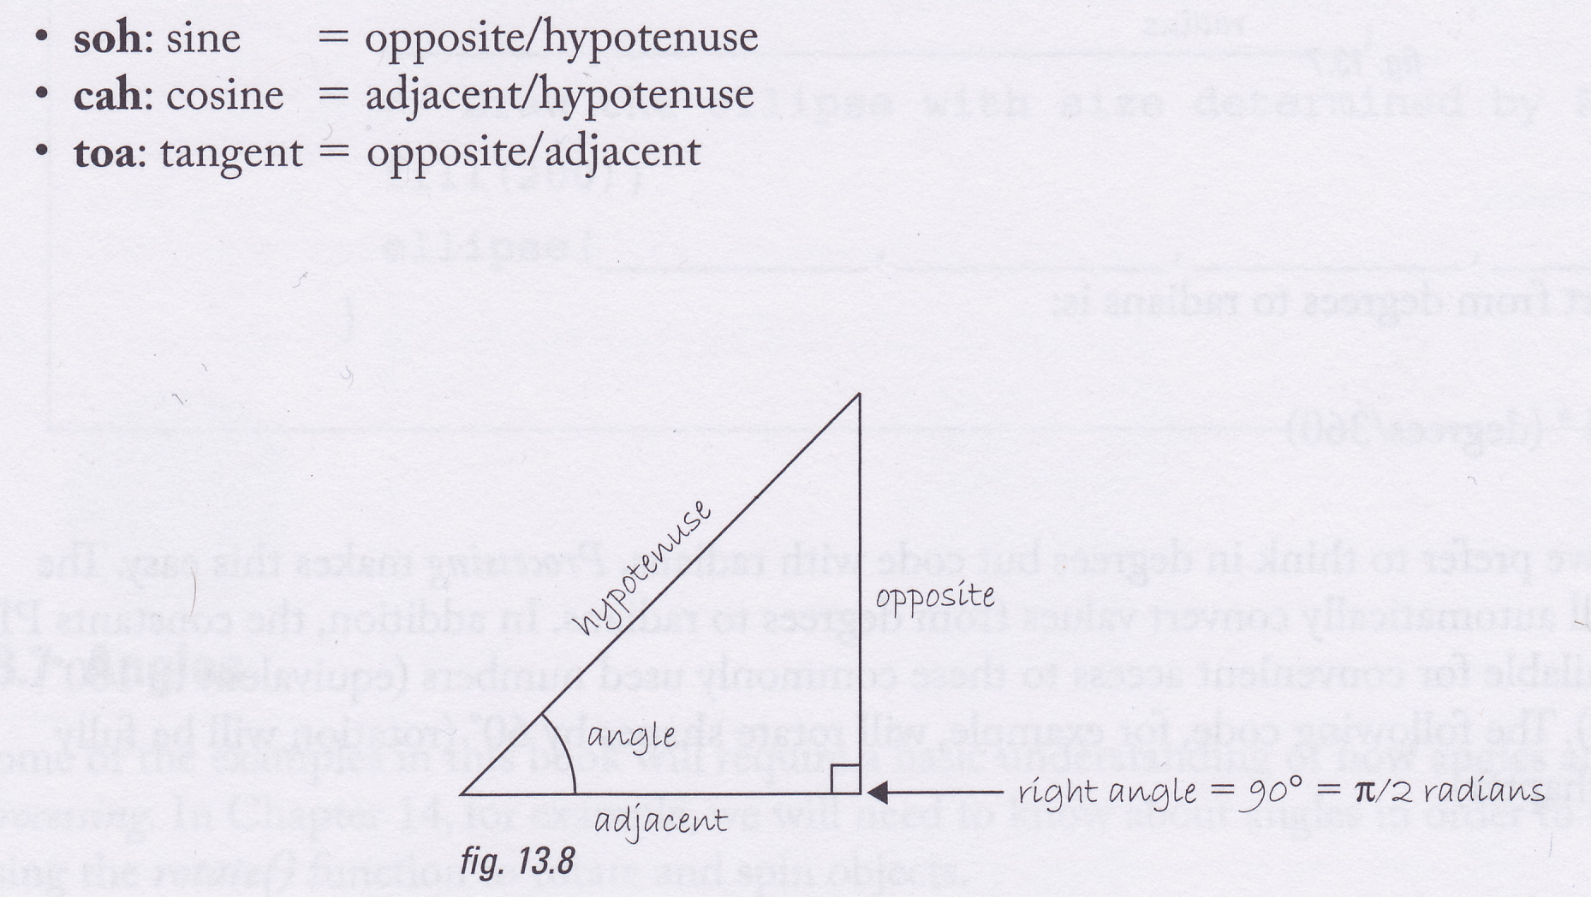
Trigonometry

Slide 21
Converting from polar to Cartesian co-ordinates
Processing uses Cartesian co-ordinates, so if you construct something with circular symmetry, you have to convert from polar to Cartesian co-ordinates

Slide 22
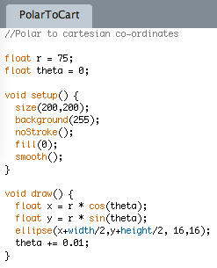
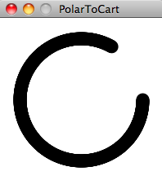
Polar to Cartesian (x,y) co-ordinates

Slide 23
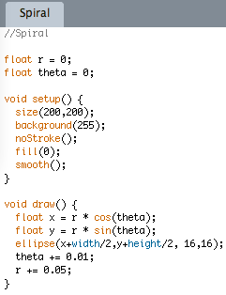
Spiral

Slide 24
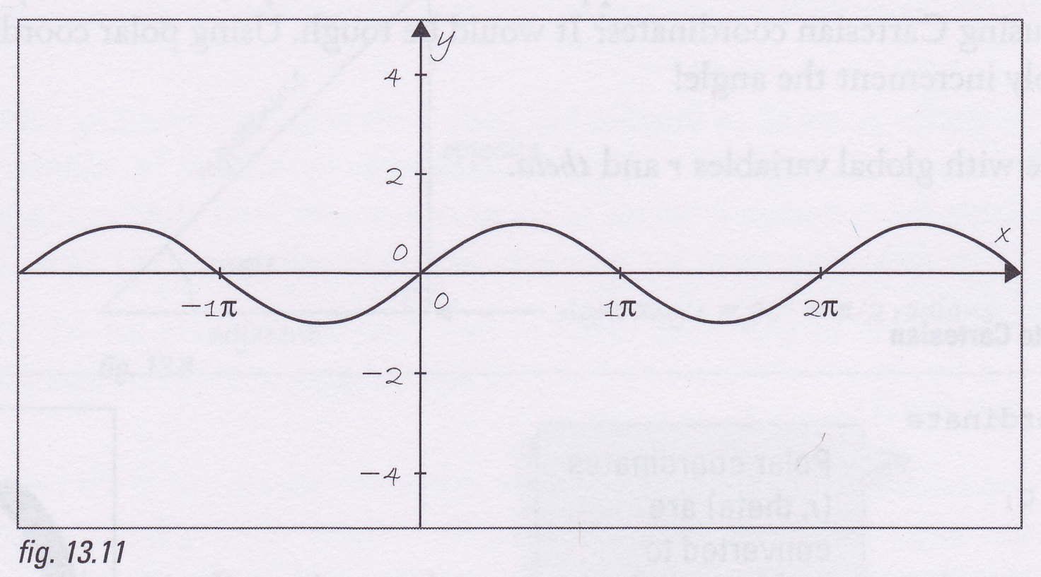
Oscillation
Graph shows sin(x) for various values of x
Physical objects oscillating due to gravity often move according to this curve
This is called simple harmonic motion
e.g., a pendulum

Slide 25
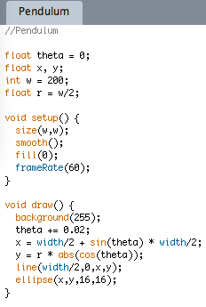
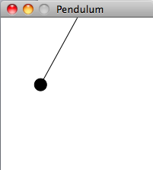
Pendulum

Slide 26
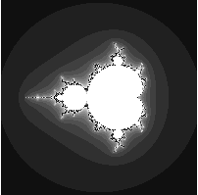
Fractals and recursion
Term, fractal, coined by Benoit Mandelbrot in 1975 to mean a form that looks the same at all scales (i.e., regardless of whether zoomed in or zoomed out)
Many natural forms resemble fractals
e.g., snow-flakes, mountains, coastlines
Can create fractals by using recursive functions

Slide 27
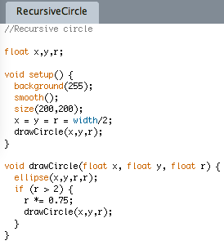
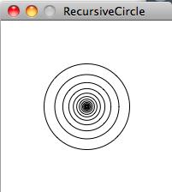
Recursion
A recursive function is one that calls itself
Every recursive function must have an exit condition such that when this is true, the function does not call itself

Slide 28
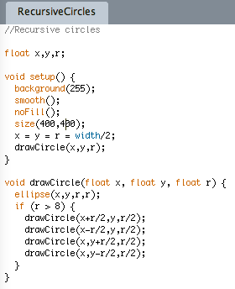
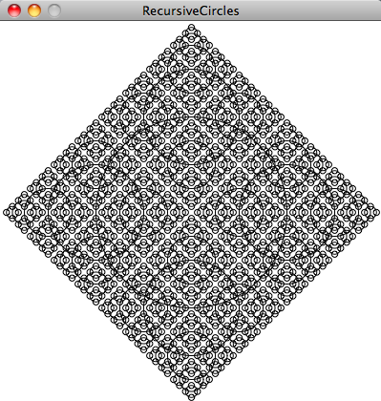
Don’t try drawing this with a for loop!

Slide 29
Two-dimensional arrays
We’ve already met 1-dimensional arrays
A two-dimensional array is just an array in which each box holds a 1-dimensional array
We iterate through a 1-dimensional array with a for loop
We iterate through a 2-dimensional array with a for-loop, nested inside another for-loop

Slide 30
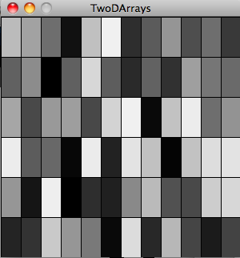
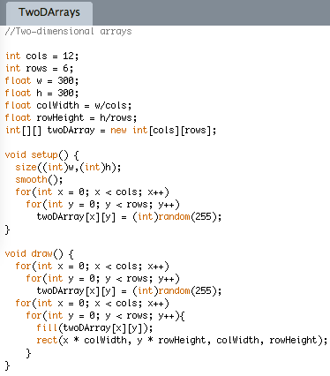
Two-dimensional arrays

