Slide 1
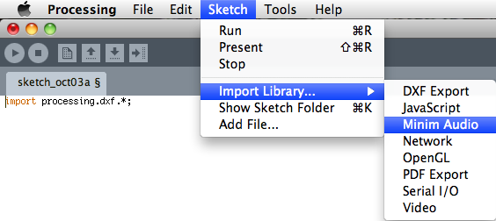
Libraries
David Meredith
dave@create.aau.dk
Aalborg University

Slide 2
Source
This lecture is based on Chapter 12 of
Shiffman, D. (2008). Learning Processing. Morgan Kaufmann. ISBN: 978-0-12-373602-4.

Slide 3
Libraries
Most of the functions you’ve used (e.g., line(), background(), stroke()) are defined in the core Processing library
A library is a collection of classes that provide pre-defined functions, variables, classes, etc.
Usually, if you want to use a class or a function defined in a particular library, you have to import the library into your program:
import com.mycompany.mylibrary.*;
This imports all the classes (“ .* ”) in the library called com.mycompany.mylibrary
Libraries are usually named using a “reverse URL”, so that the name gets more specific as you read from left to right

Slide 4
processing.core
The Processing development environment is written in Java and is provided with a number of libraries
The most important is a library called processing.core, which is stored in a file called core.jar
Processing assumes that any processing program you make will use processing.core
So you don’t have to manually import it!
If you did, you would have to write import processing.core.*; at the beginning of every sketch

Slide 5
Built-in libraries
Full list of libraries given at http://www.processing.org/reference/libraries
Built-in libraries include
Video Interface to Apple's QuickTime for using a camera, playing movie files, and creating movies
Network Sending data over a network from one program to another, possibly running on different devices
Serial Supports transfer of data between Processing and hardware via serial communication
PDF Export For creating high-resolution PDF files
OpenGL For rendering a sketch with graphics acceleration
Minim Uses JavaSound API to provide an easy-to-use audio library that is also flexible enough for advanced users
DXF Export For sending lines and triangles from P3D or OPENGL rendering modes to a DXF file
Arduino Allows direct control of an Arduino board through Processing
Netscape.JavaScript Methods for interfacing between Javascript and Processing Applets
Candy SVG Import For loading scalable vector graphics (now part of processing.core)
XML import For importing XML documents (now part of processing.core)

Slide 6
Using a built-in library
Include an import line at the top of your sketch:
import processing.video.*;
import processing.net.*;
You can also do this by going to the Sketch menu and choosing “Import library”

Slide 7
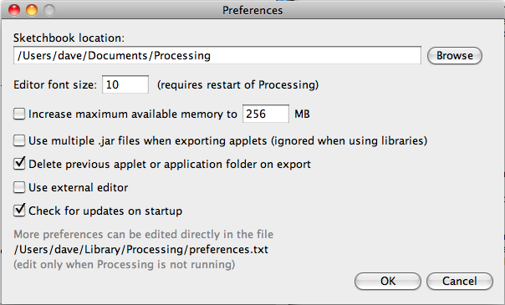
Installing a contributed library
Download and unzip the library. This will usually create a folder structure
Copy the unzipped folder to the “libraries” folder inside your Processing sketchbook folder
Sketchbook location is given in the Preferences dialogue
Restart Processing
Check the library appears in the Sketch -> Import library menu

Slide 8
Example
Download and install the simpleML library which is available here:
http://www.learningprocessing.com/tutorials/simpleml/

