Slide 1
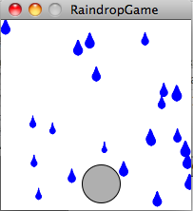
Building Bigger Programs: Software Analysis and Design
David Meredith
dave@create.aau.dk
Aalborg University

Slide 2
Source
This lecture is based on Chapter 10 of
Shiffman, D. (2008). Learning Processing. Morgan Kaufmann. ISBN: 978-0-12-373602-4.

Slide 3
Applying everything you’ve learnt in a bigger program
We now know all the basic elements involved in building a program
So far only built small programs that do basically one thing
We’ll now attack the problem of building a bigger program where you need to apply everything you’ve learnt

Slide 4
Modularity and problem analysis
Solve a bigger problem by combining smaller ones
Divide the big problem into smaller, more manageable ones
Conquer each of the smaller problems independently by producing a separate module for each
Combine the solutions to the simpler problems (modules) to produce a solution to the big problem (the finished program)
How do you eat an elephant?
One spoonful at a time!

Slide 5
Start with an idea…
Always start with the idea of what you want to end up with
The clearer an idea you have of your goal, the easier it will be to build the program that achieves that goal
Spend some time developing your idea so that it is detailed enough

Slide 6
Going from the idea to the code
Break the idea up into manageable sub-problems
For each sub-problem
Design a solution for each sub-problem (maybe using pseudo-code, flow charts, etc.)
Write a program for each sub-problem
Design a solution for combining the solutions of the sub-problems into a solution for the complete idea (maybe by using pseudo-code or diagrams)
Implement your solution for combining the programs that implement the solutions to the sub-problems

Slide 7
Example: Building a game
Start by expressing the initial idea by just writing a fairly short but clear description of it

Slide 8
Analyse the initial idea
Break the initial idea into manageable sub-problems
Think about the elements in the initial idea (e.g., raindrops, catcher)
Think about the behaviour and interaction between the elements (e.g., timing raindrops, catching raindrops)
Some sub-problems may be simple enough to solve directly (e.g., Parts 1 and 3)
Other sub-problems will need to be broken down further (e.g., Part 4)

Slide 9
Part 1: The Catcher
Sub-problem:
Develop a program with a circle controlled by the mouse. The circle will be the user-controlled “rain catcher”
Pseudo-code:
On each frame (i.e., in the draw() function)
Erase background
Draw a circle at the mouse position
We know how to implement this already!

Slide 10
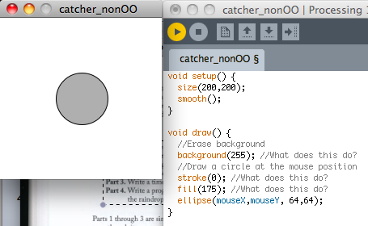
Catcher – non-OO solution

Slide 11
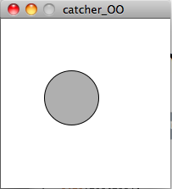
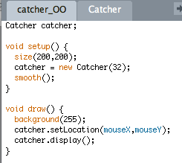
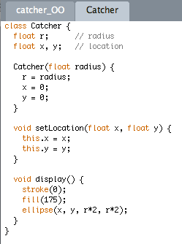
An OO solution: A Catcher Object
Create a Catcher object
On each frame, set its location and display it

Slide 12
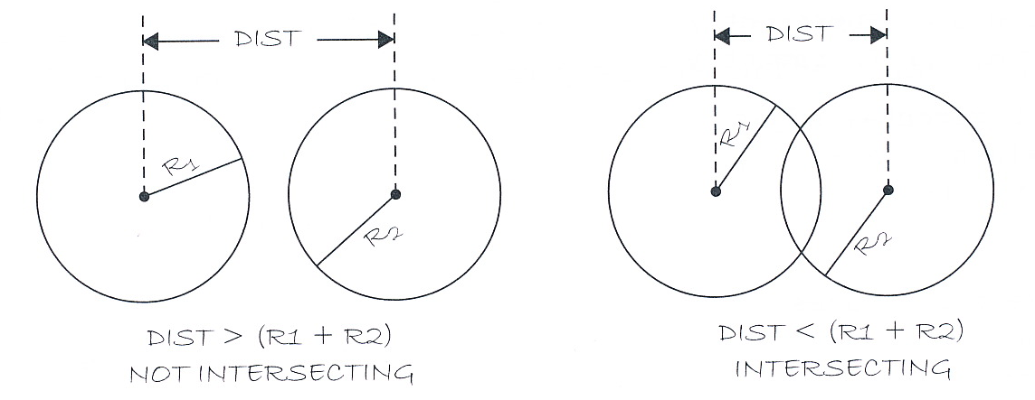
Part 2: Intersection of circles
Subproblem: Write a program to test if two circles intersect.
Catcher catches a raindrop when it intersects it
Therefore need to be able to calculate whether two circles are intersecting
Two circles intersect if the sum of their radii is greater than the distance between their centres

Slide 13
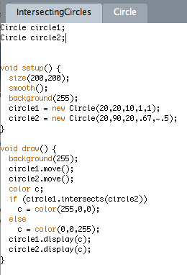
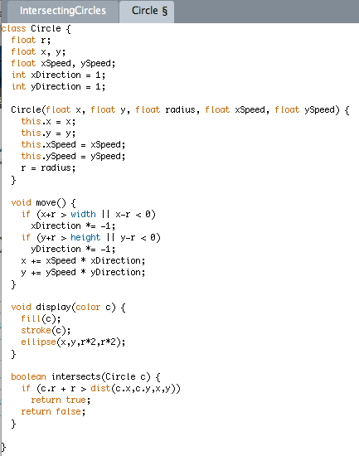
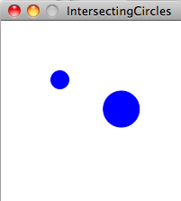
Intersecting circles sketch (OO)

Slide 14
Part 3: The Timer
Sub-problem: Write a timer program that executes a function every N seconds.
A new raindrop falls every n seconds
We therefore need to keep track of time and create a new object when the time passed is a multiple of some period
Can keep track of time using the millis() function which returns the number of milliseconds that have passed since the program started running
To experiment with the timer, let’s make a program (sketch) that changes the background colour every 5 seconds

Slide 15
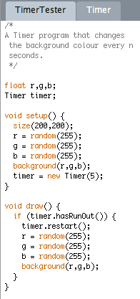
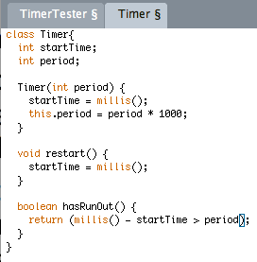
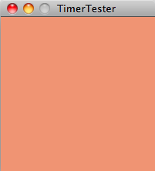
TimerTester

Slide 16
Part 4: Raindrops
Sub-problem: Write a program with raindrops falling from the top of the screen to the bottom.
Break this down into smaller sub-problems
A single moving raindrop
An array of raindrop objects
A flexible number of raindrops, appearing one at a time
Fancier raindrop appearance

Slide 17
Sub-problem 4.1: A single moving raindrop
This is easy!
For now, this should just be a circle falling from the top of the screen to the bottom
But let’s make this object-oriented by defining a Raindrop class

Slide 18
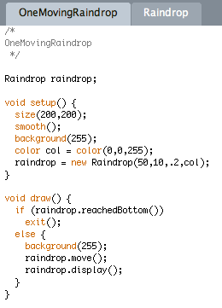
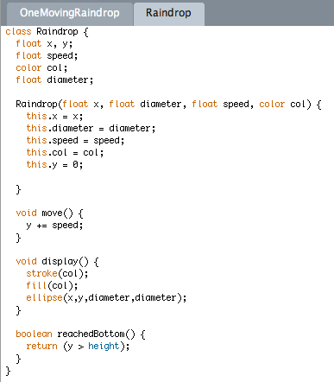
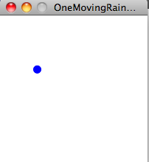
OneMovingRaindrop (OO)

Slide 19
Sub-problem 4.2: An array of moving raindrops
Now we try to make a program that creates a lot of raindrops, all moving at different speeds
We use an array to store the Raindrop objects
We initialize the array by making a new Raindrop for each box in the array and putting it into the array
On each frame, we move each raindrop in the array and display it

Slide 20
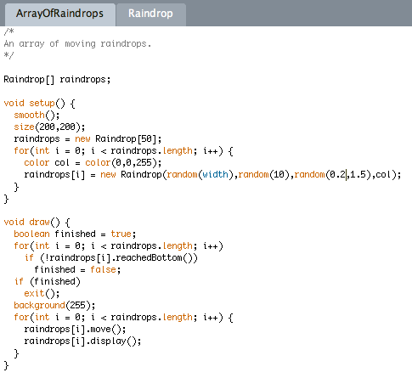
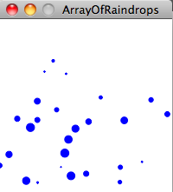
Array of raindrops

Slide 21
Sub-problem 4.3: A flexible number of raindrops appearing one at a time
We create and display a new raindrop on every frame and add it to the array
If a drop reaches the bottom, it is replaced with a new drop

Slide 22
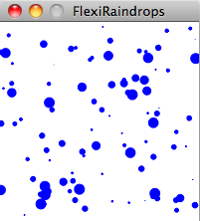
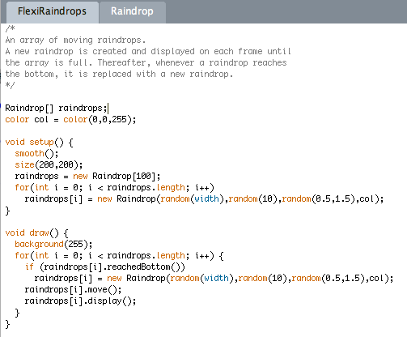
Flexible continuous raindrops

Slide 23
Sub-problem 4.4: Fancier raindrops
Raindrops shouldn’t be perfectly round (apart from in zero gravity)
We can get a better shape by superimposing circles of a whole range of sizes one on top of the other

Slide 24
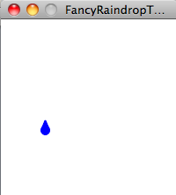
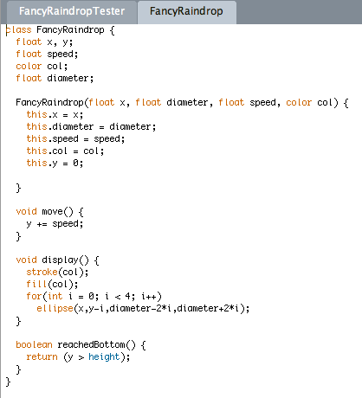
FancyRaindrop class

Slide 25
Putting it all together
In the setup function, we need to:
Create the catcher class
Create and initialize the array of raindrops
Create the timer and start it
In the draw function, we need to:
Move the catcher to the mouse position
Display the catcher
Create new drops if the timer has run out (and restart the timer if it has)
Move all the drops
Display all the drops that don’t intersect the catcher
If a drop intersects the catcher, then it is removed from the array

Slide 26
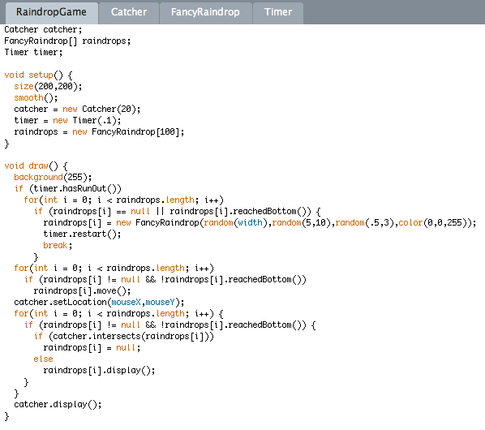
Raindrop game

