Slide 1
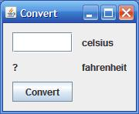
More on Creating GUIs in Java using Swing
David Meredith
dave@create.aau.dk
Aalborg University

Slide 2
Convert.java
Convert class extends JFrame
  run() method in GUI runnable simply instantiates the Convert class
  components stored as instance variables in the Convert class
  GUI created and shown in the Convert constructor
  uses GroupLayout as the LayoutManager
  layout.linkSize(Components... ) method used to make sizes of text field, fahrenheit value label and button the same

Slide 3
Convert.java
When button clicked, emits an ActionEvent that will be responded to by any object that
  implements the ActionListener interface
    has to implement the ActionPerformed method
  is registered as a listener with the button
    using button.addActionListener(listenerObject)
When press enter in the text field, also generates an ActionEvent which will be responded to by an ActionEventListener that is registered with the text field
  using textField.addActionListener(listenerObject)
uses java.awt.Frame.setResizable(boolean resizable) to define window to be not resizable
See Convert.java

Slide 4
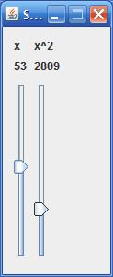
SquareSliders.java
Again, run() method of GUI Runnable simply instantiates the SquareSliders class which extends JFrame
All GUI setup done in SquareSliders constructor
Components stored as instance variables in SquareSliders object so that they can be accessed by event handlers defined in inner Event Listener classes
Two ChangeListeners required – one for each slider, because effect of moving one slider is different from effect of moving the other one
  implies different listeners must be registered with the different sliders
See SquareSliders.java

Slide 5
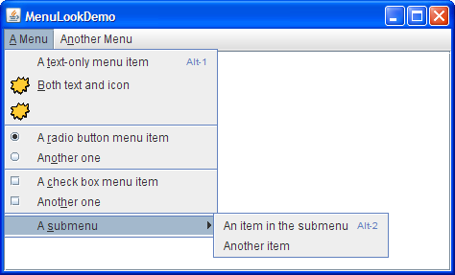
Menus
Menus aren’t placed with the other components in the UI
  either in the menu bar or popup menu
Menubar usually across the top of the main window
  though in Mac OS X, it’s across the top of the screen
Popup menus are invisible until user makes a platform-specific mouse action (e.g., right-click)
MenuLookDemo has
  a menu bar, menus, menu items, radio button menu items, checkbox menu items and separators
Menu item can have image, text or both
Can also specify font and colour

Slide 6
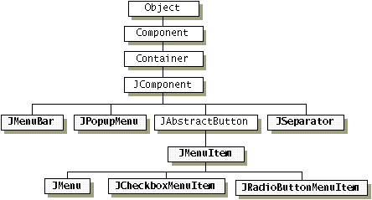
Menu Component Hierarchy
Menu items (JMenuItem) and menus (JMenu) are buttons
When a menu item is pressed, it brings up a popup menu (JPopupMenu) which contains the menu’s menu items

Slide 7
Creating Menus
See createMenuBar method in MenuLookDemo.java
To set menu bar for a JFrame, use
  frame.setJMenuBar(menuBar)
To add a JMenu to a JMenuBar, use
  menuBar.add(menu)
To add a JMenuItem to a JMenu, use
  menu.add(menuItem)
We’ll deal later with setAccelerator, setMnemonic and setAccessibleDescription

Slide 8
Handling Events from Menu Items
To detect when a user selects a JMenuItem, need to listen for action events (just as for a JButton), so register with an ActionListener:
  menuItem.addActionListener(this)
  define an actionPerformed method
JRadioButtonMenuItems emit either action events or item events
  have to register with an ActionListener:
  rbMenuItem.addActionListener(this)
  add an actionPerformed method
JCheckBoxMenuItems emit item events
  have to register with an ItemListener:
  cbMenuItem.addItemListener(this)
  need to define an itemStateChanged method
See MenuDemo.java

Slide 9
Enabling Keyboard Operation
Menus can use mnemonics and accelerators
  Mnemonics are usually single letter abbreviations for a menu item (e.g., “A” for the “Save As” menu item in the File menu),
    accessible only from within the menu hierarchy
  Accelerators are keyboard shortcuts that bypass the menu hierarchy
    allows access to menu item even if not visible (e.g., Ctrl-F for the Find dialog)
Specify mnemonic either in constructor:
  menuItem = new JMenuItem(“Save As...”,KeyEvent.VK_A);
  or using setMnemonic method:
  menuItem.setMnemonic(KeyEvent.VK_A);
Specify accelerator using setAccelerator method:
  menuItem.setAccelerator(KeyStroke.getKeyStroke(KeyEvent.VK_A, ActionEvent.ALT_MASK);
KeyEvent constant is a constant corresponding to a particular key (just static variables in the KeyEvent class)
Modifier key required for accelerator specified using a constant defined in ActionEvent class

