Slide 1


The
Slice-Group-Analyze Pipeline
Johannes Hentschel
johentsch
HCI International 2023
W1: Interactive Technologies for Analysing and Visualizing Musical Structure
July 23rd, 2023
@johentsch
@hostux.social

Slide 2
The
Slice-Group-Analyze Pipeline
Outline
Intro: Distant Listening
Motivation
The Slice-Group-Analyze Pipeline & DiMCAT
Johannes Hentschel
johentsch
HCI International 2023
W1: Interactive Technologies for Analysing and Visualizing Musical Structure
July 23rd, 2023
@johentsch
@hostux.social

Slide 3


I. Distant Listening
The Development of Harmony over Three Centuries (1700–2000)
Funded by the Swiss National Science Foundation (SNSF)
Duration: 04.2019 — 08.2023
Principal investigator: Prof. Dr. Martin Rohrmeier

Slide 4
Distant Listening
The Development of Harmony over Three Centuries (1700–2000)
epfl.ch/labs/dcml/projects/distant-listening/
Corpus research
Annotated scores
Tools & Infrastructure
Notes:
Model for music history: The corpus
Harmony latent entity (interest in interrelation between music theorists' analysis & surface of the score)
Annotation workflow
Data curation: Corpus Creation pipeline with focus on FAIR → metadata, paradata, versioning, identifiers, open formats
Chord models, using the corpus in many different ways

Slide 5
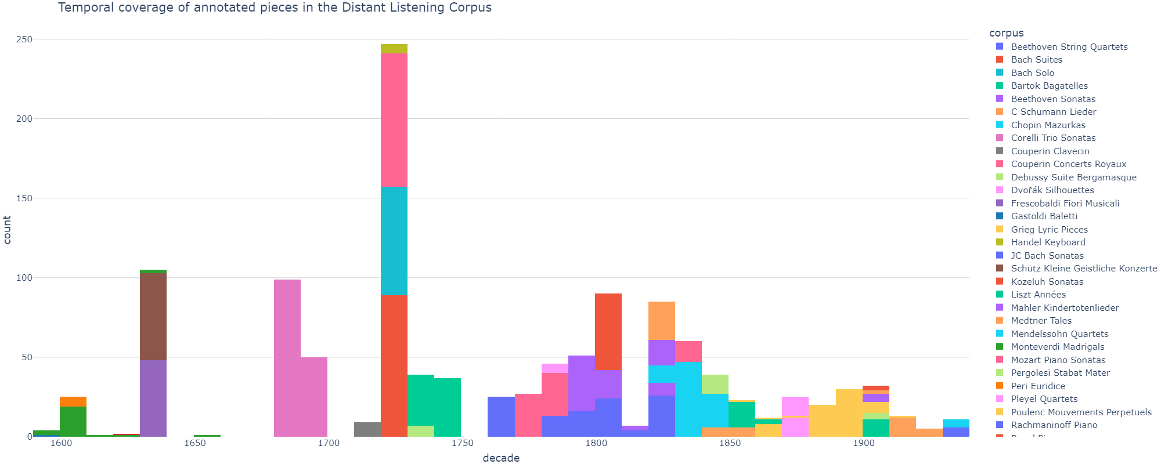
Distant Listening
The Development of Harmony over Three Centuries (1700–2000)
epfl.ch/labs/dcml/projects/distant-listening/

Slide 6
Distant Listening
The Development of Harmony over Three Centuries (1700–2000)
epfl.ch/labs/dcml/projects/distant-listening/
Corpus research
Annotated scores
Tools & Infrastructure
Best practices
Formal models
Notes:
Data curation: Corpus Creation pipeline with focus on FAIR → metadata, paradata, versioning, identifiers, open formats
Chord models, using the corpus in many different ways

Slide 7

II. Motivation
Commonplace operations
Shared concepts
Reproducibility
Notes:
1. Grouping & Slicing as commonplace operations
2. Processing symbolic data → potential stumbling blocks, offer a shared language
3. Make it easier to communicate decisions taken, and therefore to pick up and develop existing approaches
→ proceed by demonstrating relevance in corpus studies, with a focus on pitch and chord statistics

Slide 8
Commonplace operations
1. Slicing
“[…] cut the musical data […] into slices [of] which beginning and end are determined by the appearance of new events and the extinction of past events.”
Lartillot, O., Dubnov, S., Assayag, G., & Bejerano, G. (2001). Automatic modeling of musical style. Proceedings of the International Computer Music Conference.
Notes:
"pitch simultaneities", simultaneous notes, vertical intervals, sonorities, "chordify" → full expansion

Slide 9
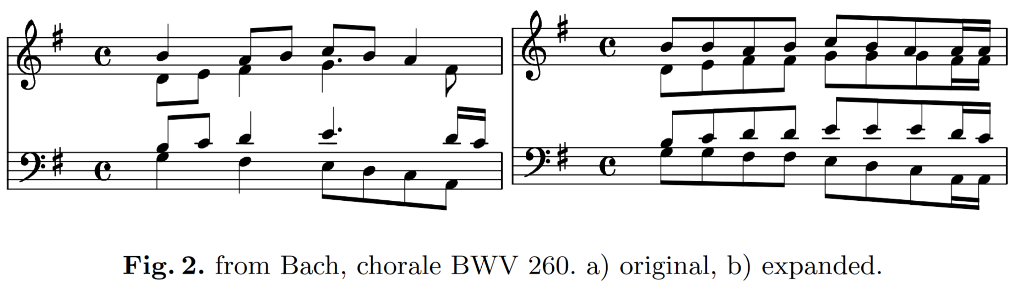
Commonplace operations
1. Slicing
“full expansion” (Conklin, 2002)
Conklin, D. (2002). Representation and Discovery of Vertical Patterns in Music. In C. Anagnostopoulou, M. Ferrand, & A. Smaill (Eds.), Music and Artificial Intelligence (Vol. 2445, pp. 32–42). Springer. https://doi.org/10.1007/3-540-45722-4_5

Slide 10
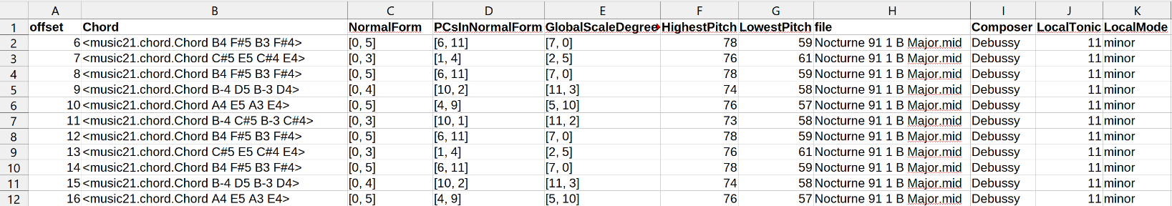
Commonplace operations
1. Slicing
Excerpt from the Yale-Classical Archives Corpus (YCAC) showing, in the column Chord, the first 11 slices from Claude Debussy's Nocturne L. 91/1 (Nuages) as music21 objects.
White, C. W., & Quinn, I. (2016). The Yale-Classical Archives Corpus. Empirical Musicology Review, 11(1), 50. https://doi.org/10.18061/emr.v11i1.4958
Notes:
Example: slices as base representation

Slide 11
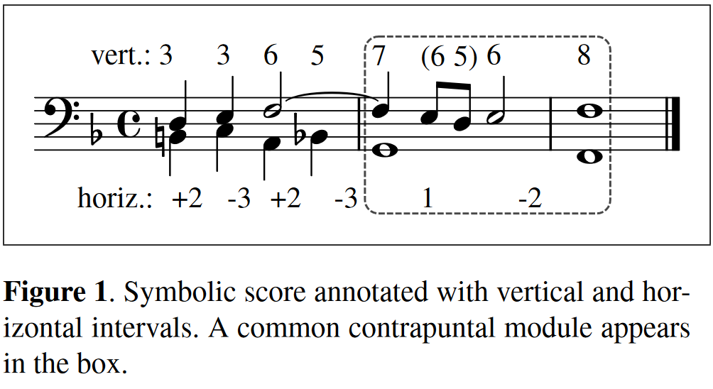
Commonplace operations
1. Slicing
Antila, C., & Cumming, J. (2014). The VIS framework. Analyzing counterpoint in large datasets. Proceedings of the 15th International Society for Music Information Retrieval Conference (ISMIR).
Notes:
Example for slicing a score for analysis:
ELVIS Electronic Locator of Vertical Interval Successions @ McGill
→ SIMSSA project

Slide 12
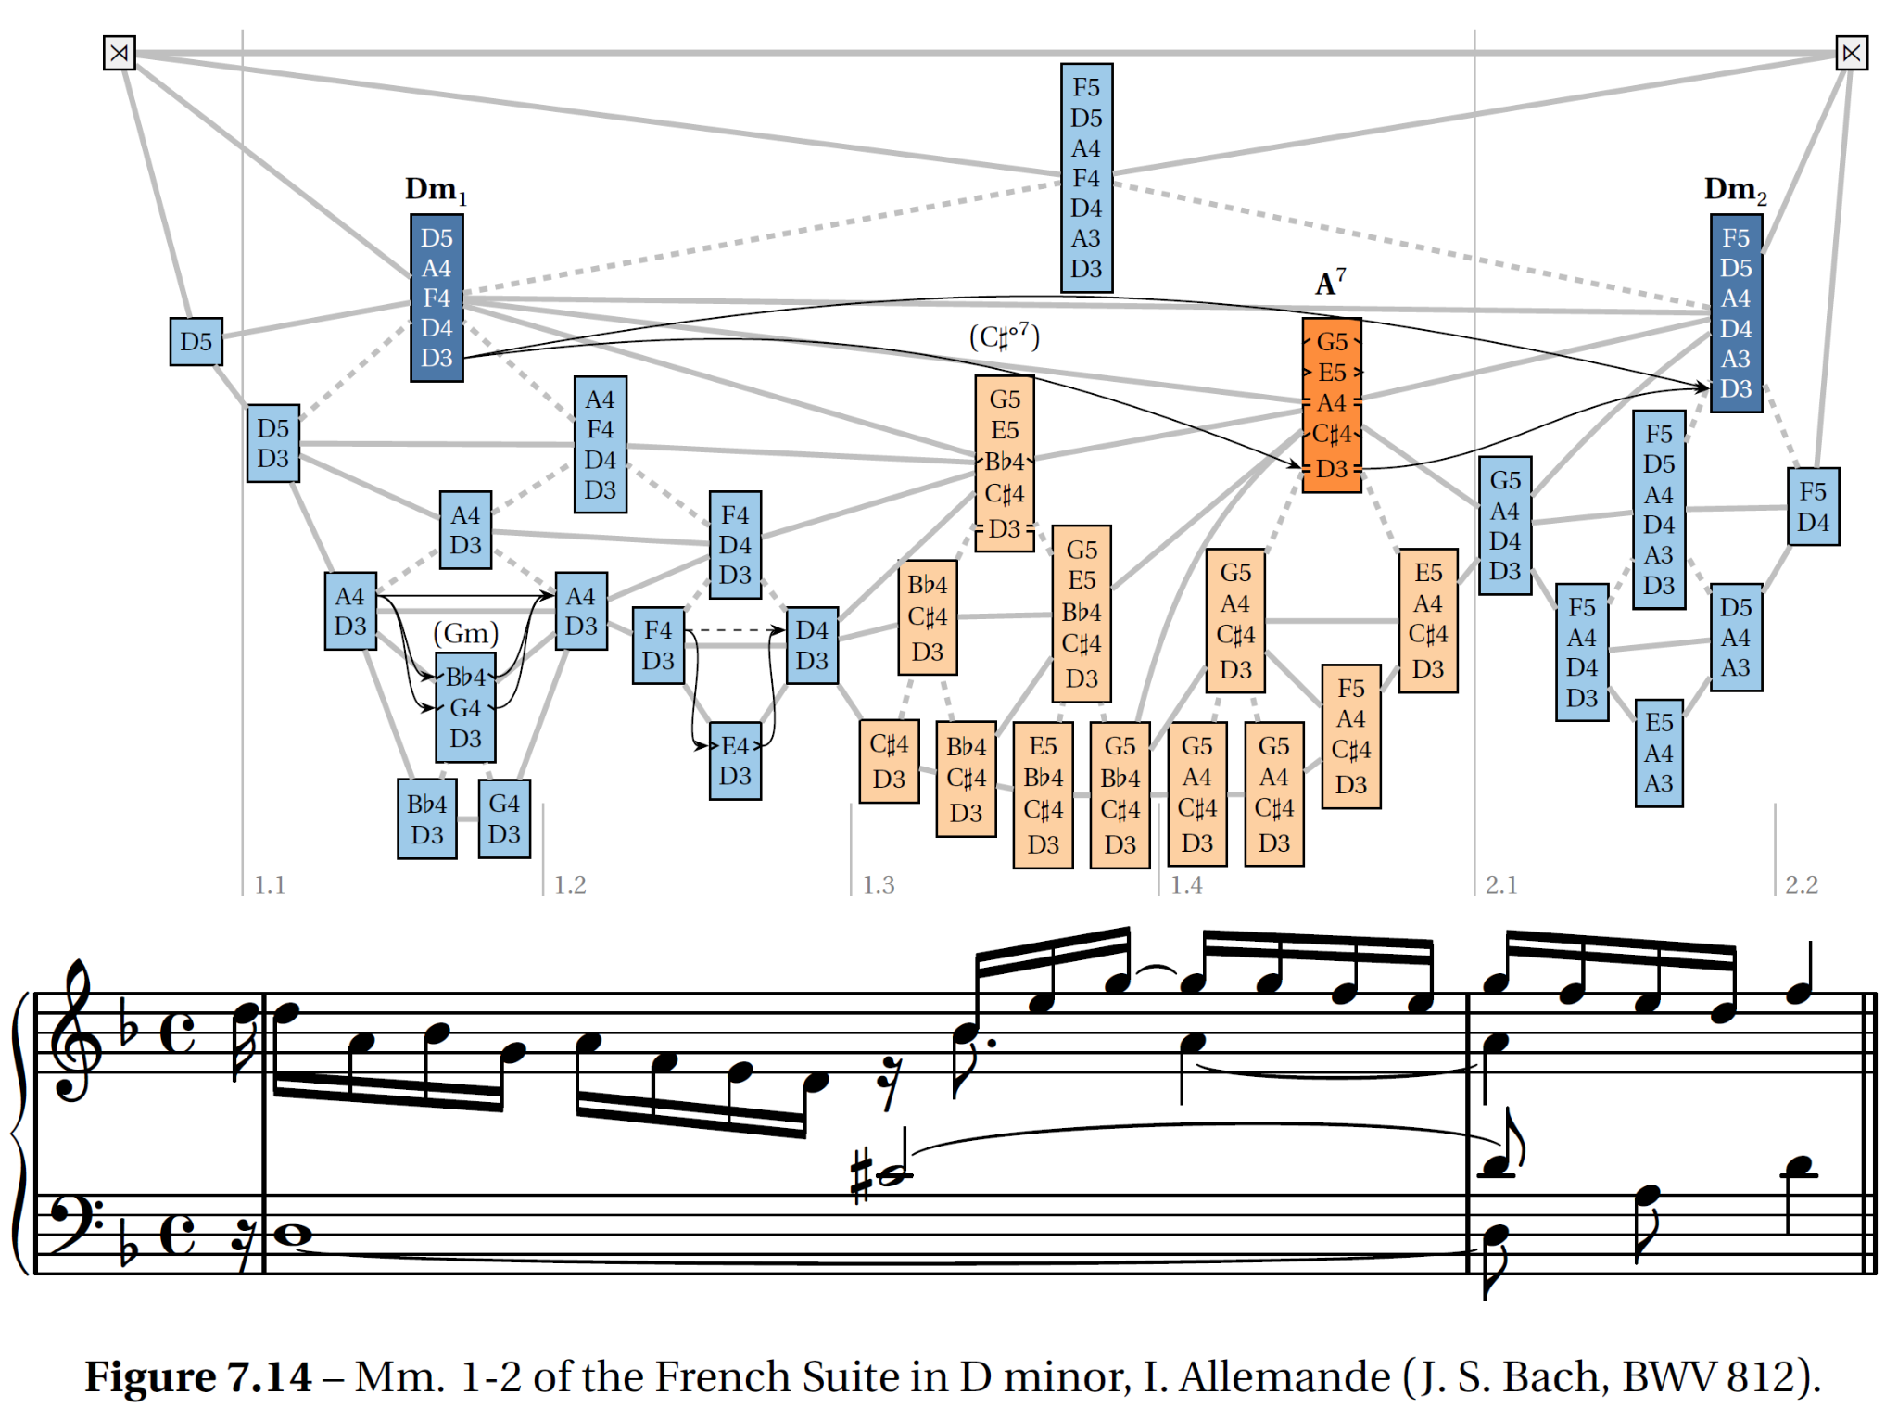
Commonplace operations
1. Slicing
Finkensiep, C. (2023). The Structure of Free Polyphony [Doctoral Dissertation, École Polytechnique Fédérale de Lausanne]. https://doi.org/10.5075/EPFL-THESIS-9403
Notes:
Example for slicing a score for analysing the latent polyphonic structure

Slide 13
Commonplace operations
1. Slicing
“full expansion” (Conklin, 2002)
quantization
Notes:
fixed-size window, for example to create one-hot encodings for machine learning.

Slide 14
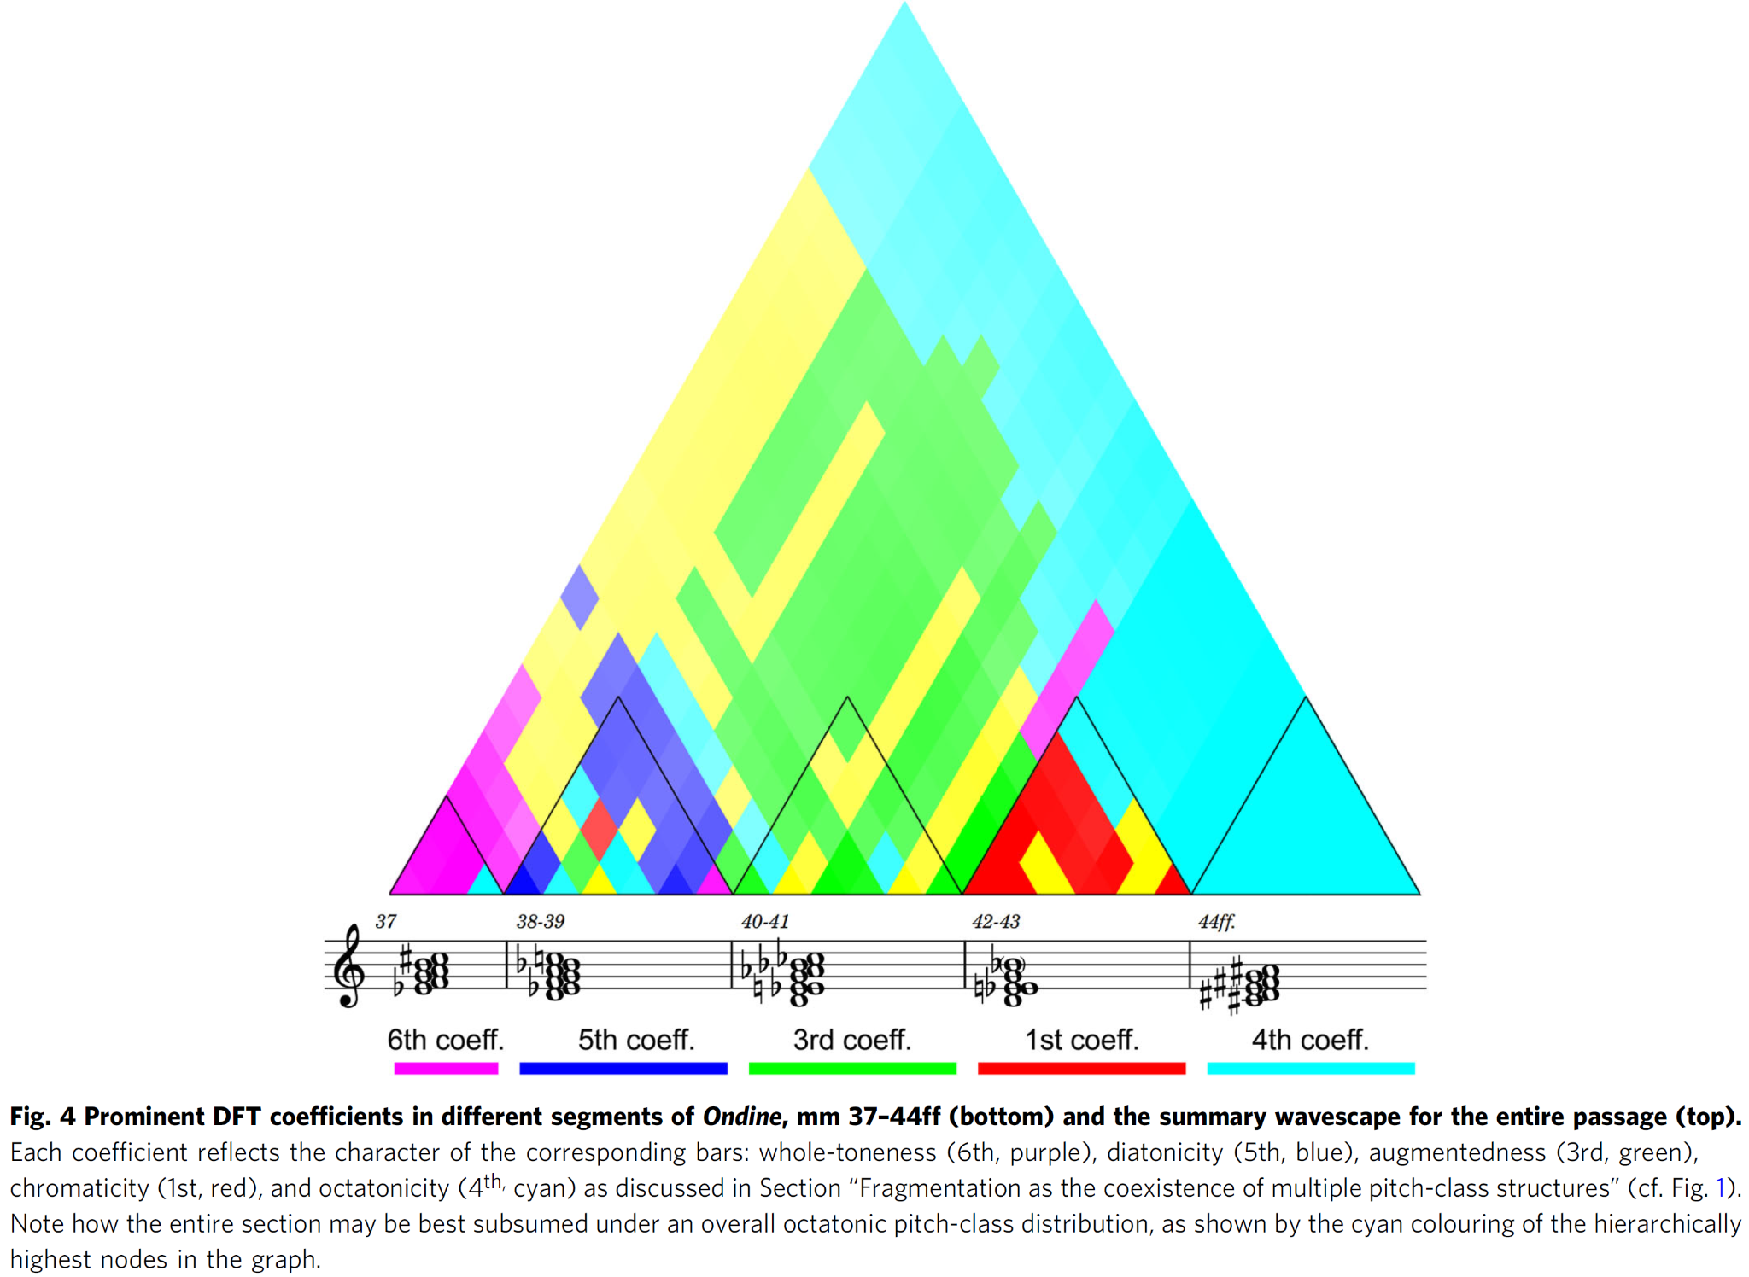
Laneve, S., Schaerf, L., Cecchetti, G., Hentschel, J., & Rohrmeier, M. (2023). The diachronic development of Debussy’s musical style: A corpus study with Discrete Fourier Transform. Humanities and Social Sciences Communications, 10(1), 289. https://doi.org/10.1057/s41599-023-01796-7
Notes:
fixed-size window, for example to create one-hot encodings for machine learning (will see an example later).

Slide 15
Commonplace operations
1. Slicing
“full expansion” (Conklin, 2002)
quantization
sliding windows

Slide 16
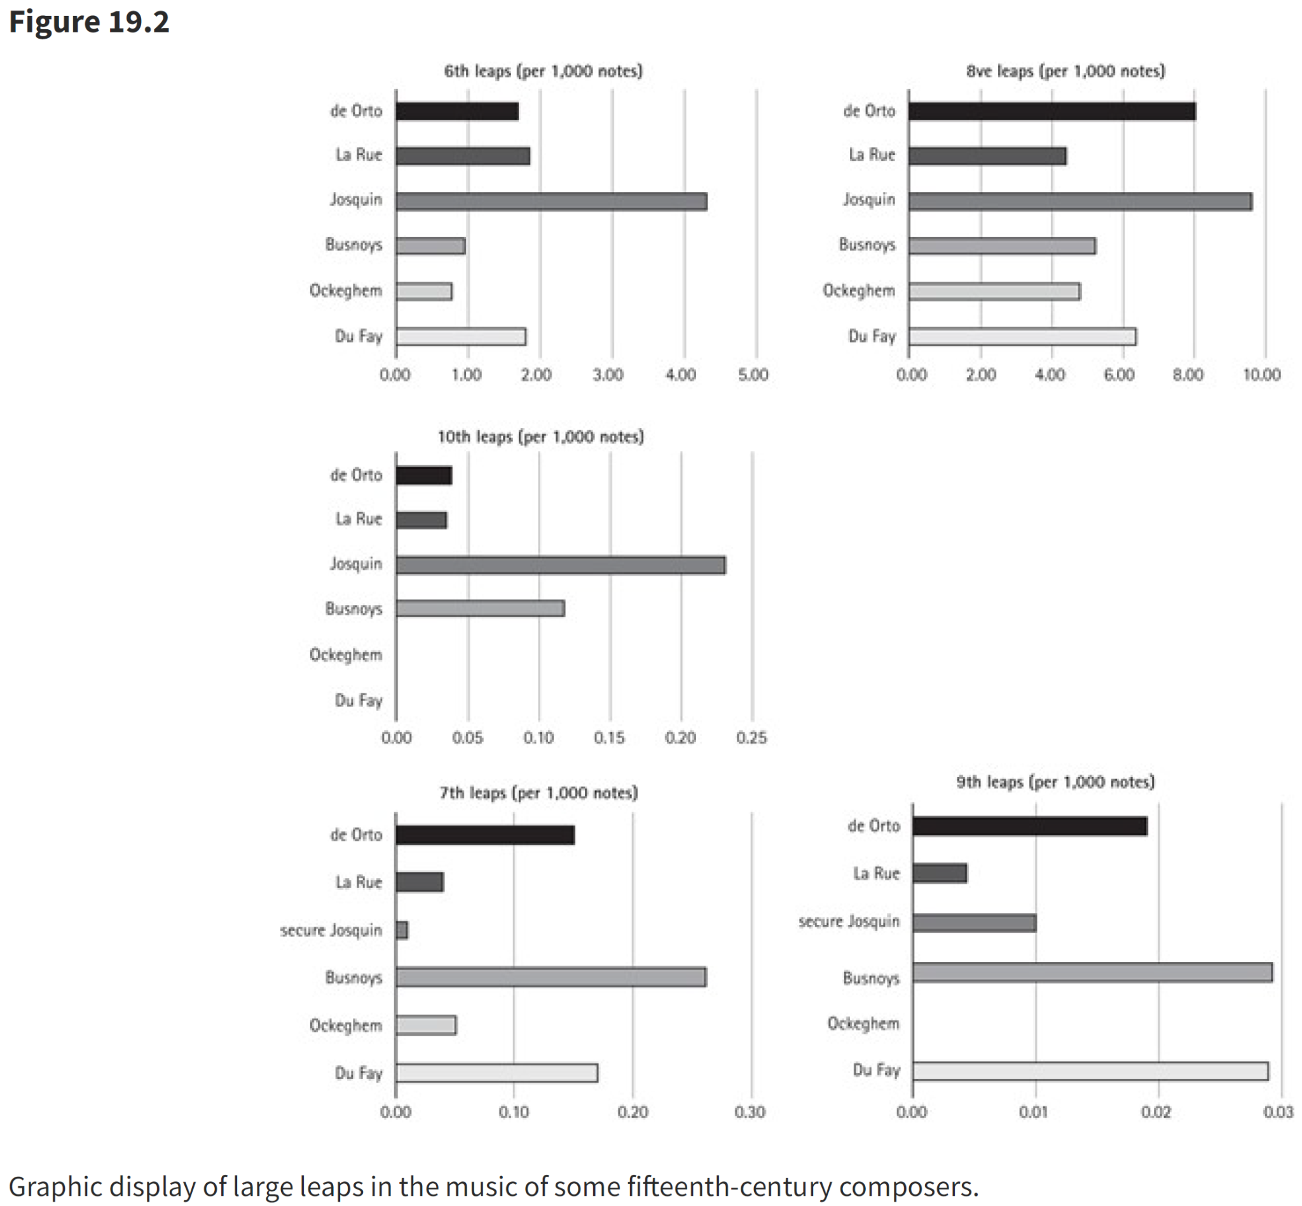
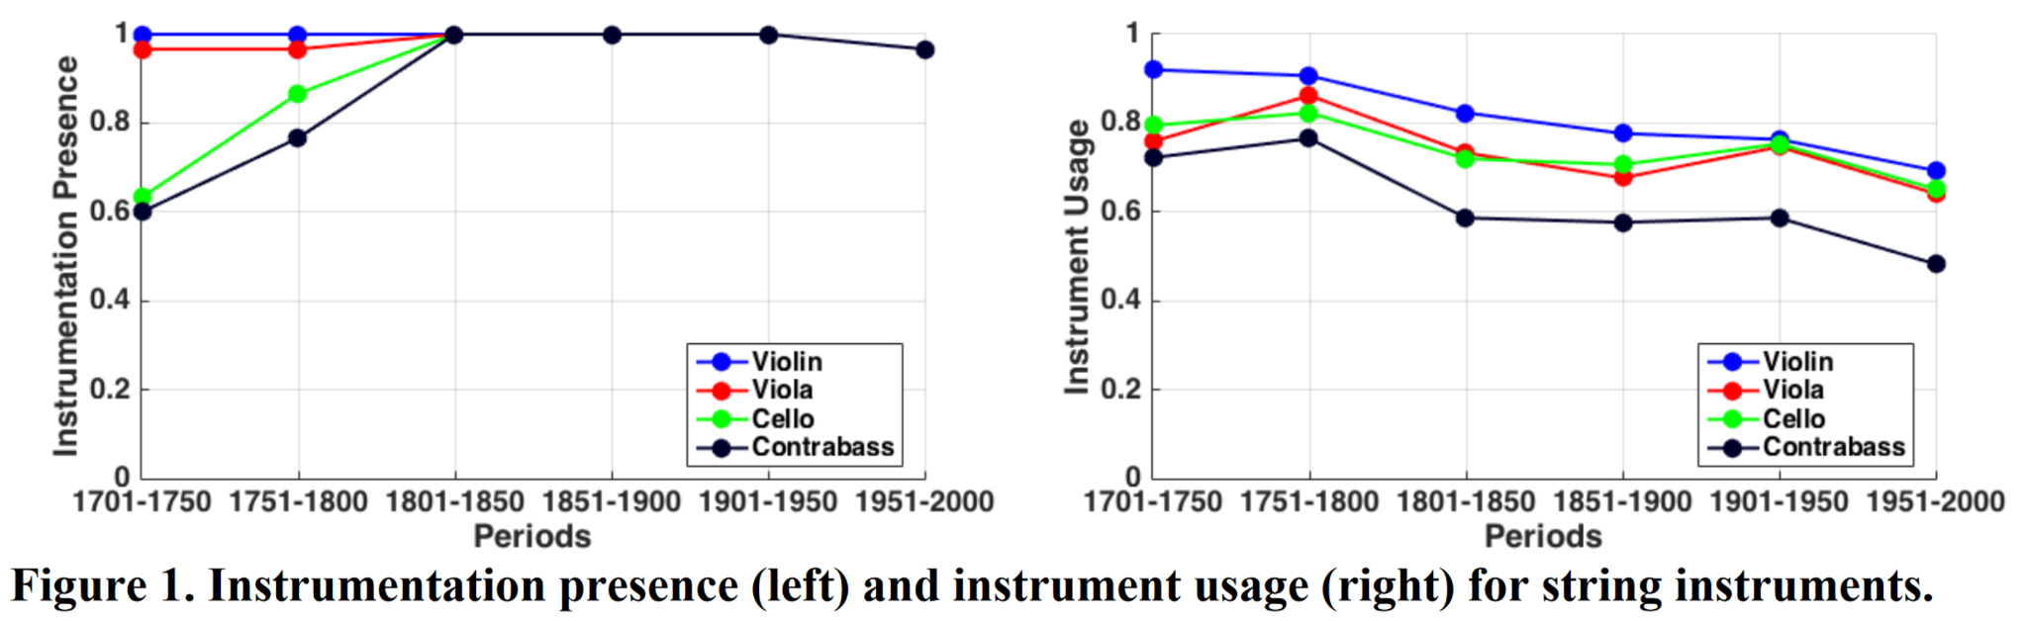
Commonplace operations
2. Grouping pieces
Chon, S. H. (2022). Corpus approaches to orchestration.
Rodin, J. (2022). Searching the Notes—All of Them: The Josquin Research Project.
Shanahan, D., Burgoyne, J. A., & Quinn, I. (Eds.). (2022). The Oxford handbook of music and corpus studies (1st ed.). Oxford University Press. https://doi.org/10.1093/oxfordhb/9780190945442.001.0001
Notes:
Grouping pieces

Slide 17
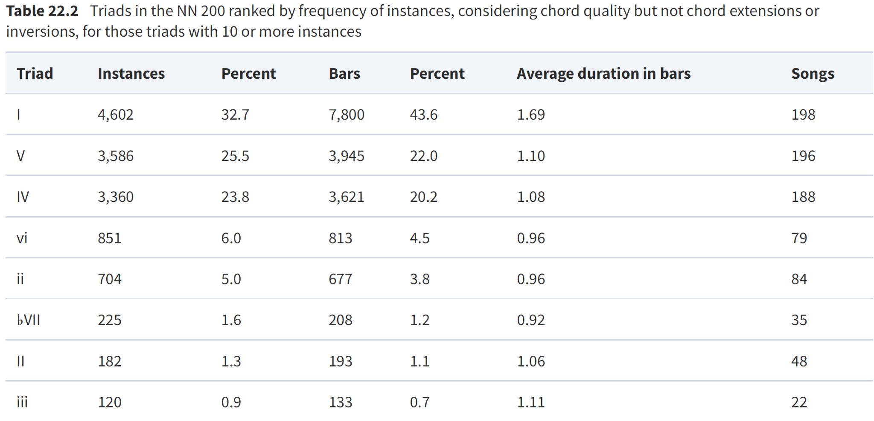
Commonplace operations
2. Grouping labels
de Clercq, T. (2022). A Corpus Analysis of Harmony in Country Music. In D. Shanahan, J. A. Burgoyne, & I. Quinn (Eds.), The Oxford Handbook of Music and Corpus Studies (1st ed.). Oxford University Press. https://doi.org/10.1093/oxfordhb/9780190945442.013.22
Notes:
Grouping chords

Slide 18
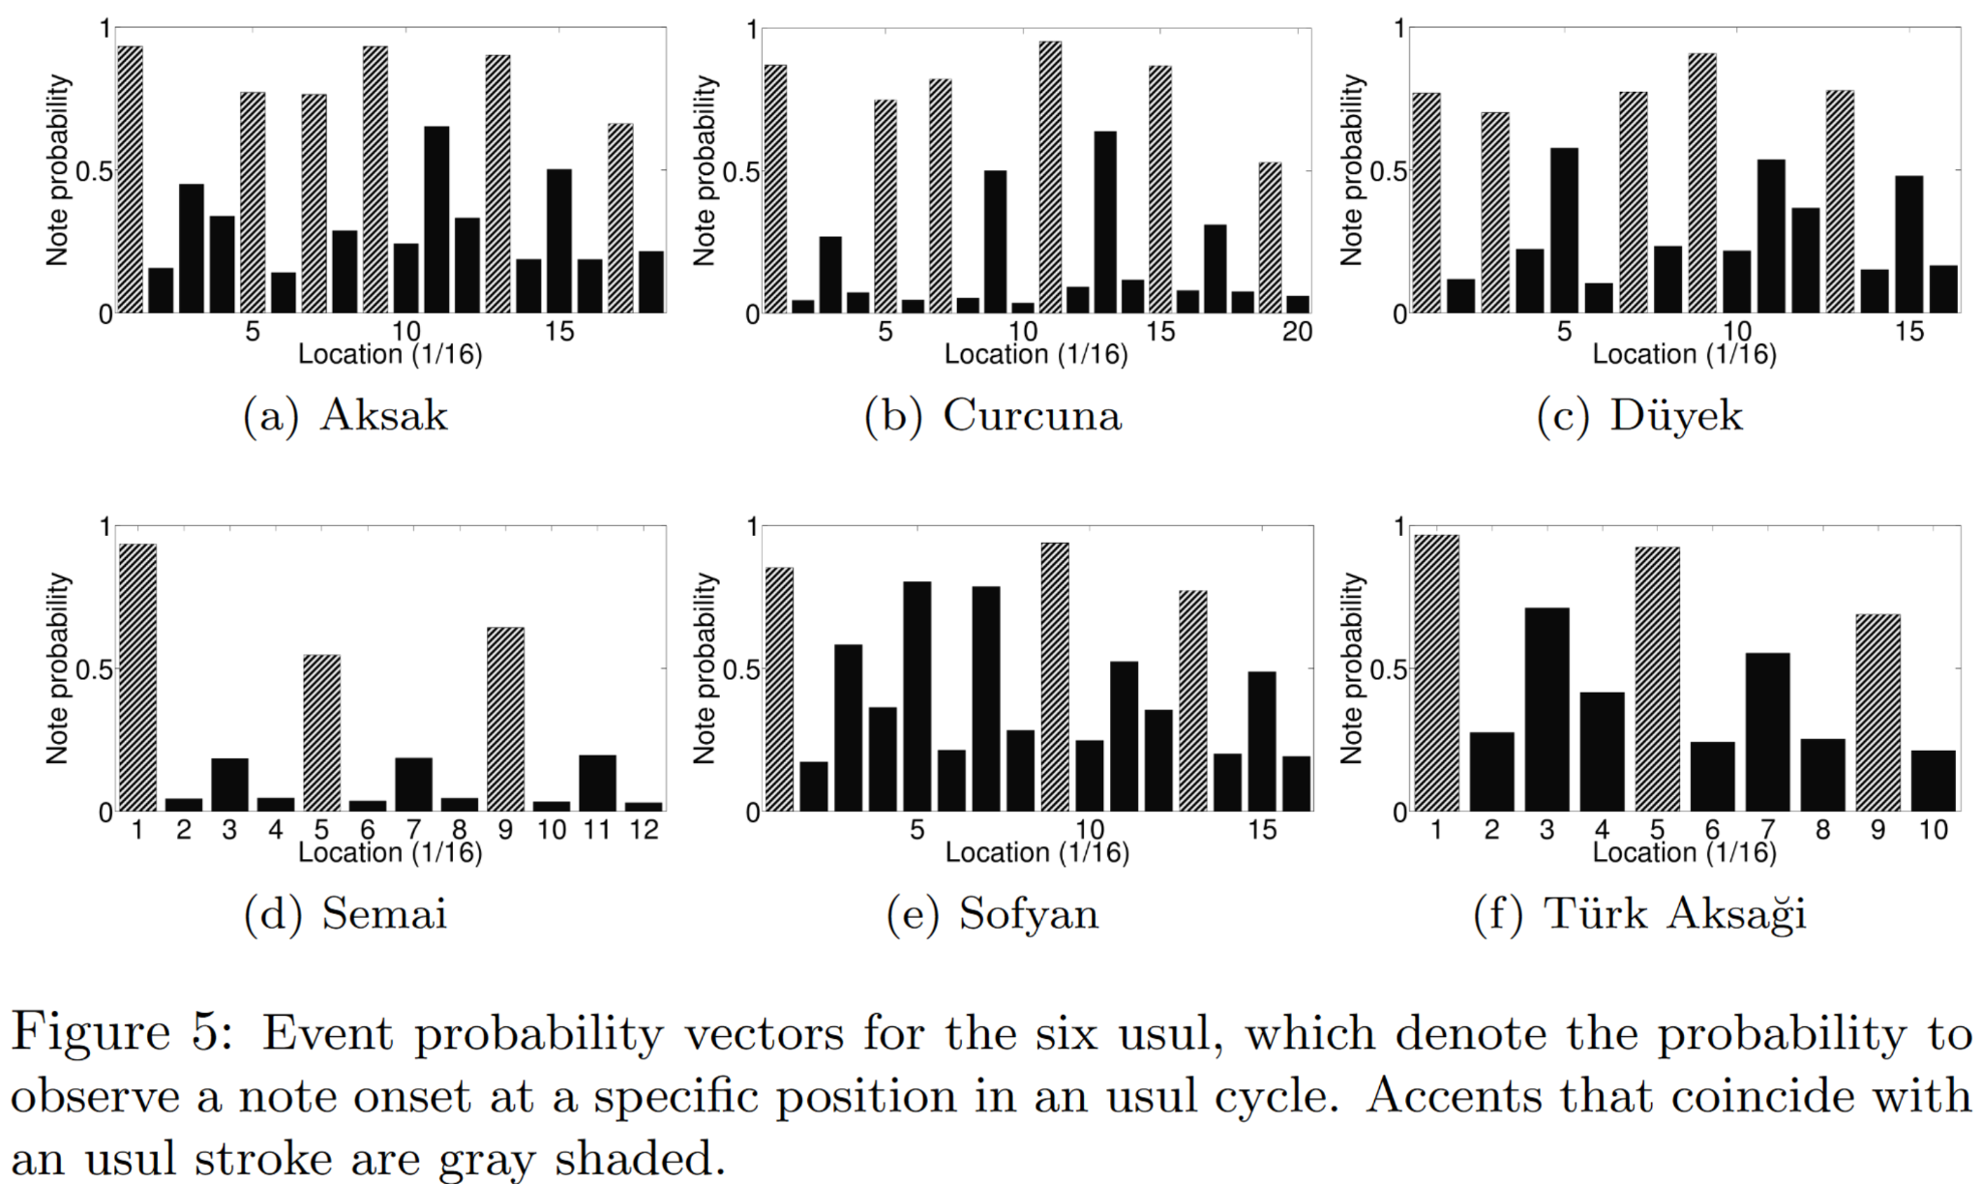
Commonplace operations
2. Grouping of slices
Holzapfel, A. (2015). Relation Between Surface Rhythm and Rhythmic Modes in Turkish Makam Music. Journal of New Music Research, 44(1), 25–38. https://doi.org/10.1080/09298215.2014.939661

Slide 19
Shared concepts
note heads vs. sounding events
overlapping notes
grace notes and ornaments
Notes:
When slicing scores, a few decisions need to be taken depending on the research context. In practice, such decisions are rarely communicated in the supplementary material, let alone in the papers.

Slide 20
Shared concepts
note heads vs. sounding events → erroneously introduced boundaries
overlapping notes
grace notes and ornaments

Slide 21
Shared concepts
note heads vs. sounding events → erroneously introduced boundaries
overlapping notes → diverging occurrences/durations
grace notes and ornaments

Slide 22

Shared concepts
note heads vs. sounding events → erroneously introduced boundaries
overlapping notes → diverging occurrences/durations
grace notes and ornaments
→

Slide 23
III. The Pipeline
DiMCAT
Slice-Group-Analyze
Examples

Slide 24
DiMCAT
The Digital Musicology Corpus Analysis Toolkit
II. Motivation
github.com/DCMLab/dimcat
(Yet another) Python library
Processing and analyzing notated music
Pipeline steps operating on datasets
Reproducibility
Commonplace operations
Shared concepts
Reproducibility

Slide 25
The Pipeline
Analyzer
“Based on its configuration, an analyzer will take one particular or all available features from the Dataset, perform the analysis on the minimal unit provided by the Dataset (slice or piece), and return an AnalyzedDataset.”
Hentschel, J., McLeod, A., Rammos, Y., & Rohrmeier, M. (2023). Introducing DiMCAT for processing and analyzing notated music on a very large scale. Proceedings of the 24th International Society for Music Information Retrieval Conference.

Slide 26
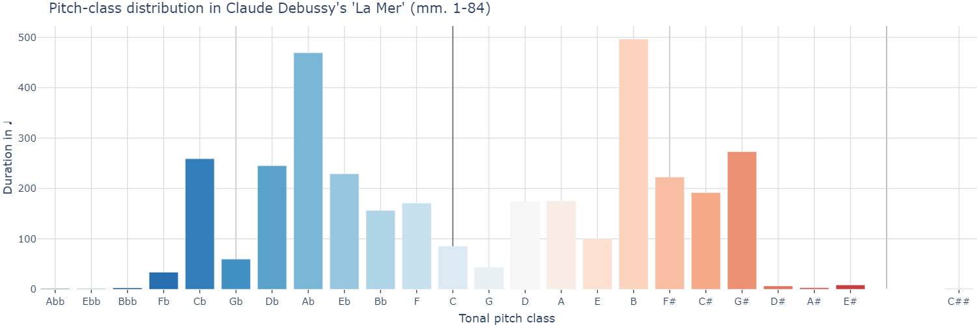
The Pipeline
Analyzer (single piece)

Slide 27
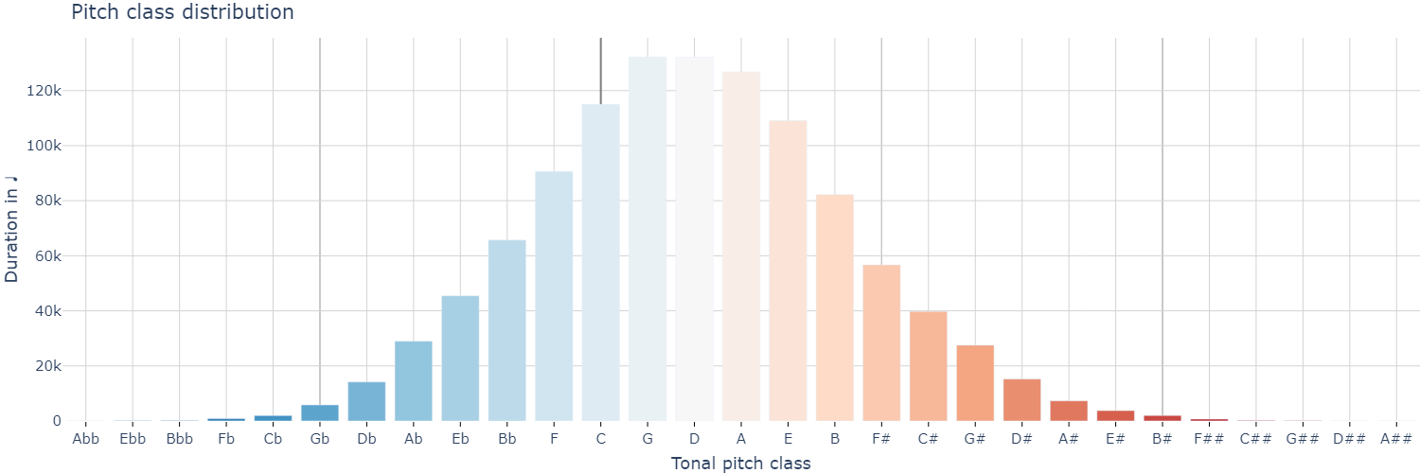
The Pipeline
Analyzer (entire Distant Listening Corpus)

Slide 28
The Pipeline
Grouper
“Applying a Grouper to a dataset is tantamount to binning pieces or slices based on a membership criterion.”
Hentschel, J., McLeod, A., Rammos, Y., & Rohrmeier, M. (2023). Introducing DiMCAT for processing and analyzing notated music on a very large scale. Proceedings of the 24th International Society for Music Information Retrieval Conference.

Slide 29
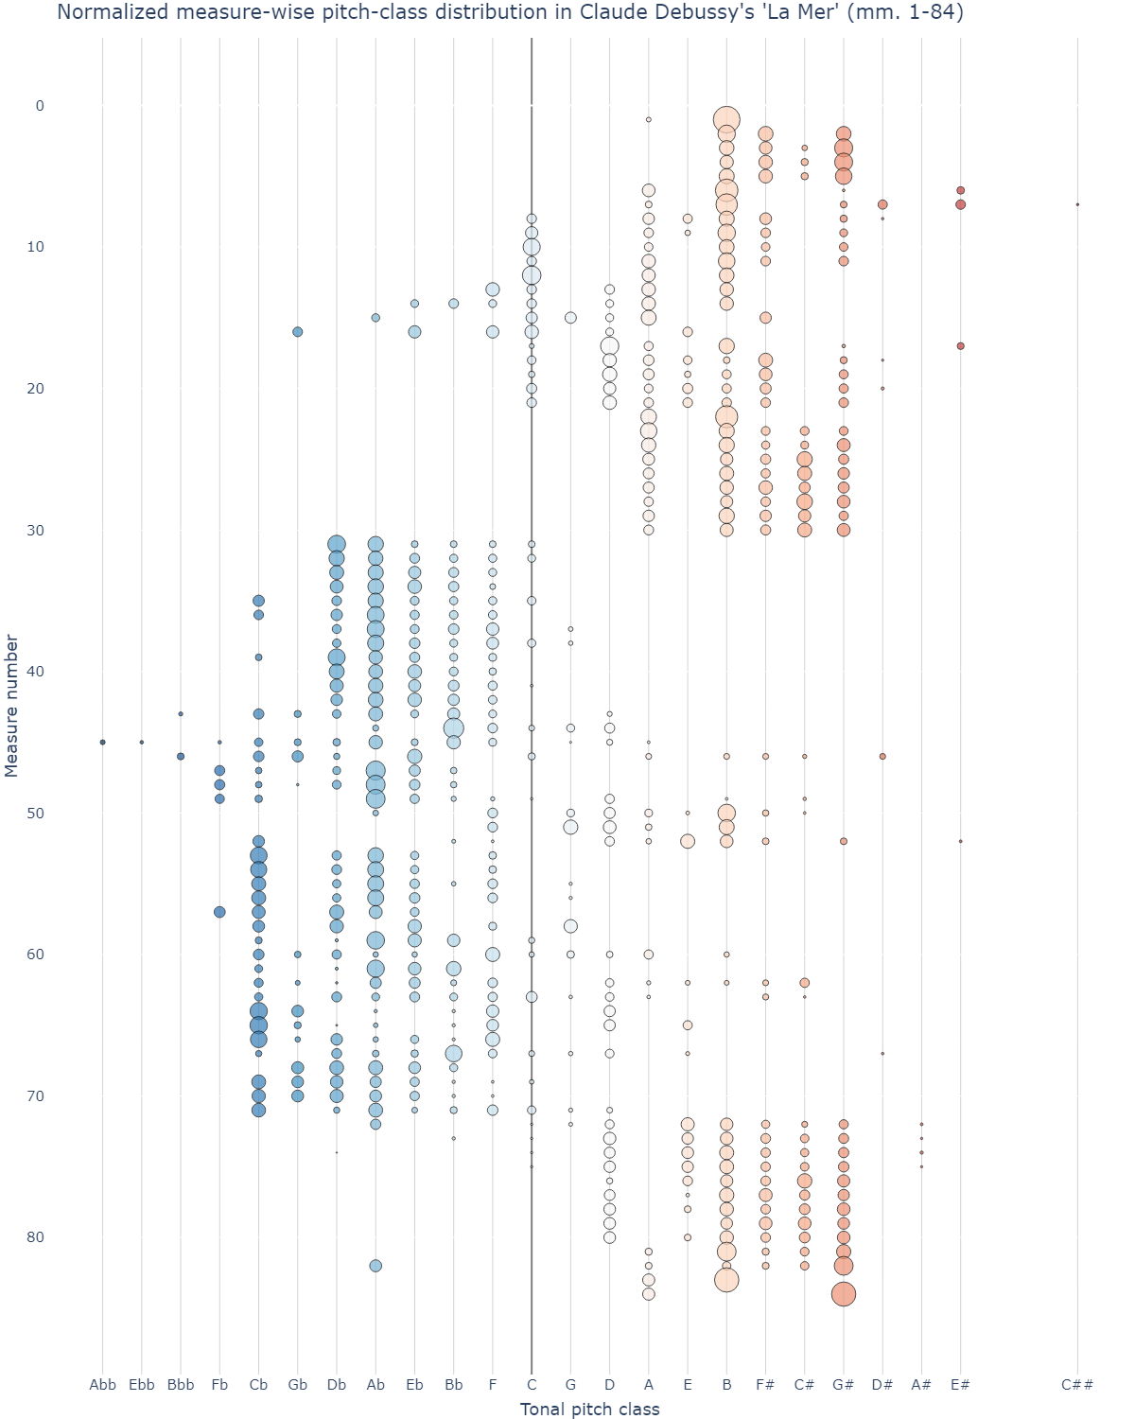
The Pipeline
MeasureGrouper
Analyzer (single piece)

Slide 30
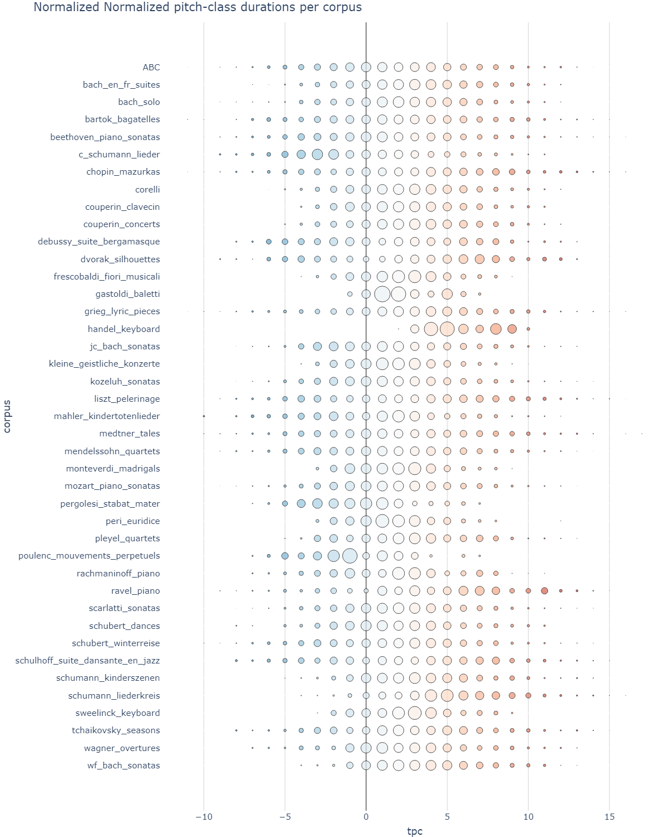
The Pipeline
CorpusGrouper
Analyzer

Slide 31
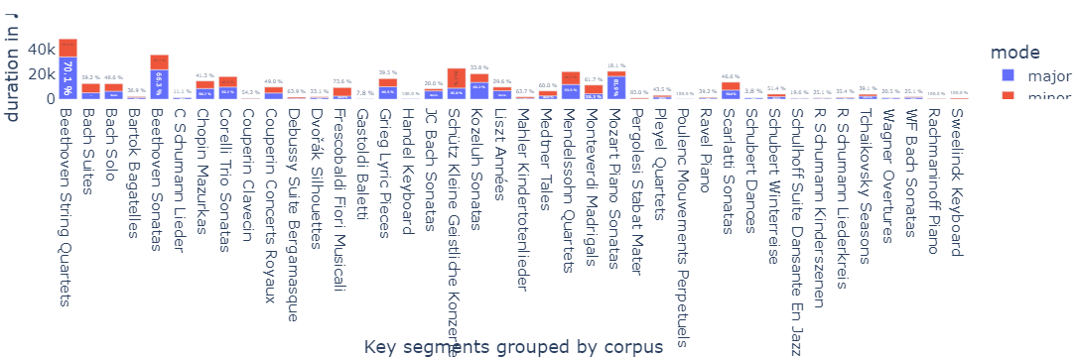
The Pipeline
ModeGrouper
CorpusGrouper
Notes:
Did not manage to clean up these figure but thought they might be of interest

Slide 32
The Pipeline
Slicer
“Slicer objects invoke one particular feature to compute segmentation boundaries. […] The newly returned [SlicedDataset] will slice any facet or feature subsequently requested, inserting an additional index level or column for slice boundaries (any element spanning over a slice boundary will be split or duplicated).”
Hentschel, J., McLeod, A., Rammos, Y., & Rohrmeier, M. (2023). Introducing DiMCAT for processing and analyzing notated music on a very large scale. Proceedings of the 24th International Society for Music Information Retrieval Conference.
Notes:
Not new functionality, but now we have specific settings that can be systematically applied and communicated.
Answer to sounding events vs. tied notes: segmentation based on note heads likely not slicing, but grouping.

Slide 33
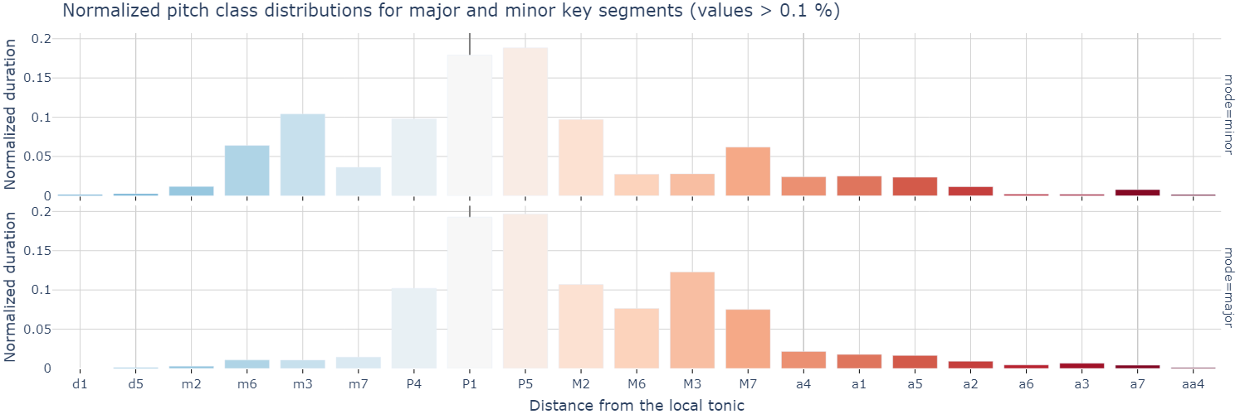
The Pipeline
LocalKeySlicer ModeGrouper
Analyzer

Slide 34
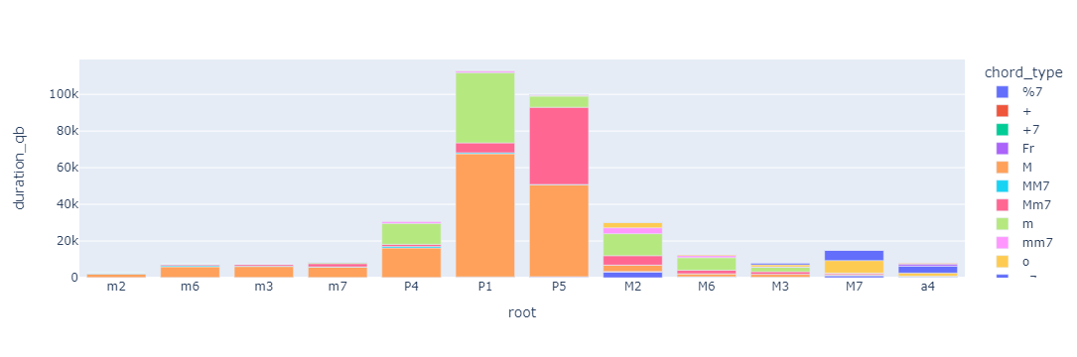
The Pipeline
ChordFeatureGrouper

Slide 35
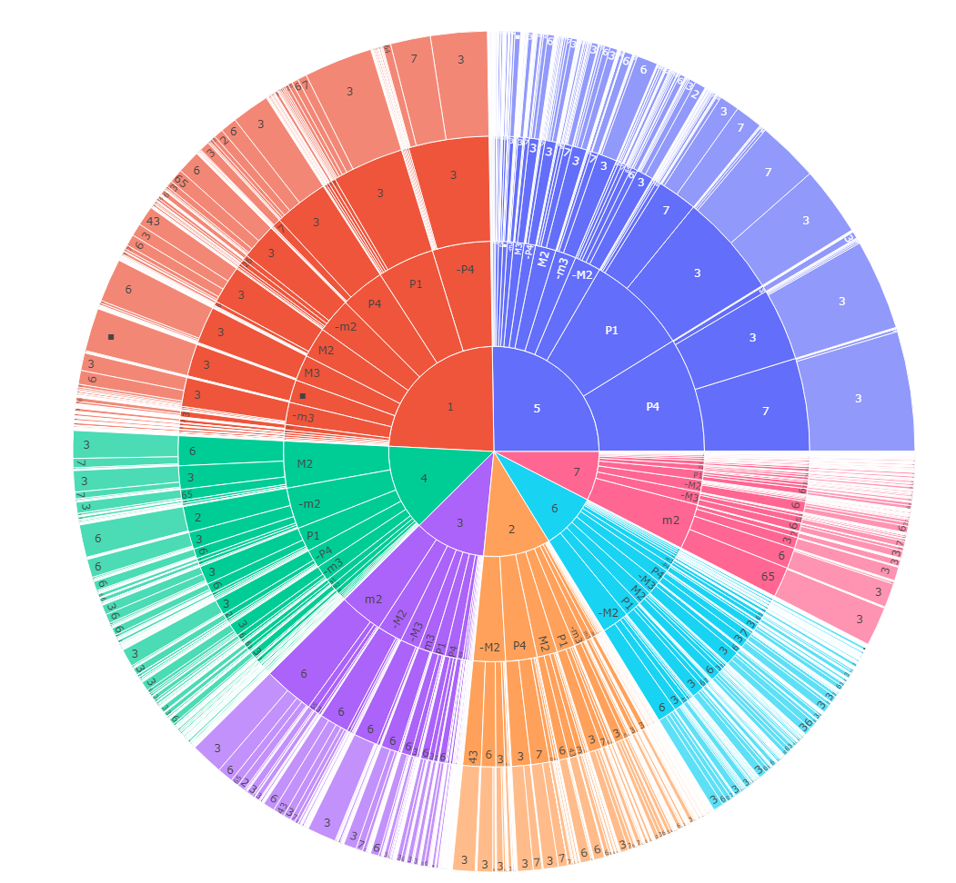

Slide 36
The
Slice-Group-Analyze Pipeline
Thank you!
Johannes Hentschel
johentsch
HCI International 2023
W1: Interactive Technologies for Analysing and Visualizing Musical Structure
July 23rd, 2023
@johentsch
@hostux.social

