Slide 1



Music Visualisation and its
Short-term Effects on Appraisal Skills
Ali Nikrang,^{1,2} Maarten Grachten,³ Martin Gasser,⁴ Harald Frostel,³ Gerhard Widmer,⁵ and Tom Collins^{6,7}
¹ Ars Electronica Futurelab, Austria ² University of Music and Theatre, Germany
³ Independent Machine Learning Consultant ⁴ Muse Group, Cyprus
⁵ Institute of Computational Perception, Austria ⁶ University of Miami, USA ⁷ MAIA, Inc.
Notes:
Hi, I’m Tom Collins, I run the Music Computing and Psychology Lab, and am just moving to the Frost School of Music at University of Miami.
In the lab, we specialize in the automatic analysis and generation of music and sound, both symbolic and audio representations of music, and, beyond music, we investigate game audio and podcasting. We also develop a lot of web and VR interfaces for music, using the Web Audio API.
Today I’ll be presenting some research that I collaborated on with Ali Nikrang, Maarten Grachten, Martin Gasser, Hari Frostel, and Gerhard Widmer, on “Music visualisation and its short-term effects on appraisal skills”.

Slide 2
Contents
Research question
Hierarchical repetition, and tonality
Music appraisal, ScoreViewer and PatternViewer
Experimental Hypotheses, Method, and Results
Discussion

Slide 3
Contents
Research question
Hierarchical repetition, and tonality
Music appraisal, ScoreViewer and PatternViewer
Experimental Hypotheses, Method, and Results
Discussion

Slide 4
Research question
Music psychologists concerned with phenomena such as repetition (e.g., Deutsch & Feroe, 1981) and tonality (e.g., Krumhansl & Kessler, 1982).
  Internal representations formed via exposure
  How representations vary with expertise
Can less expert listeners gain proficiency in perception, via representations well-known to be employed by more expert listeners?
Deutsch, D. & Feroe, J. (1981). The internal representation of pitch sequences in tonal music. Psychological Review, 88(6), 503-522.
Krumhansl, C. L. & Kessler, E. J. (1982). Tracing the dynamic changes in perceived tonal organization in a spatial representation of musical keys. Psychological Review, 89(4), 334-368.

Slide 5
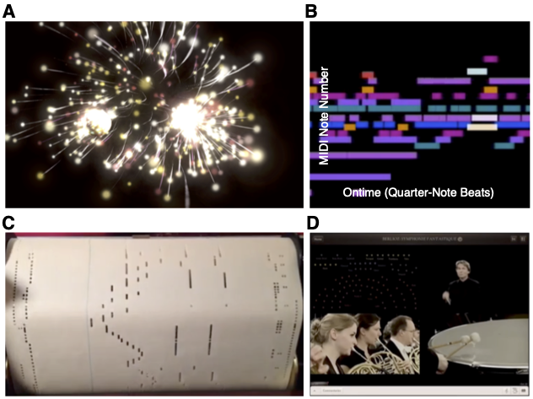
More general version of this question
What does one look at when listening to music,
And does it make any difference?

Slide 6
Contents
Research question
Hierarchical repetition, and tonality
Music appraisal, ScoreViewer and PatternViewer
Experimental Hypotheses, Method, and Results
Discussion

Slide 7
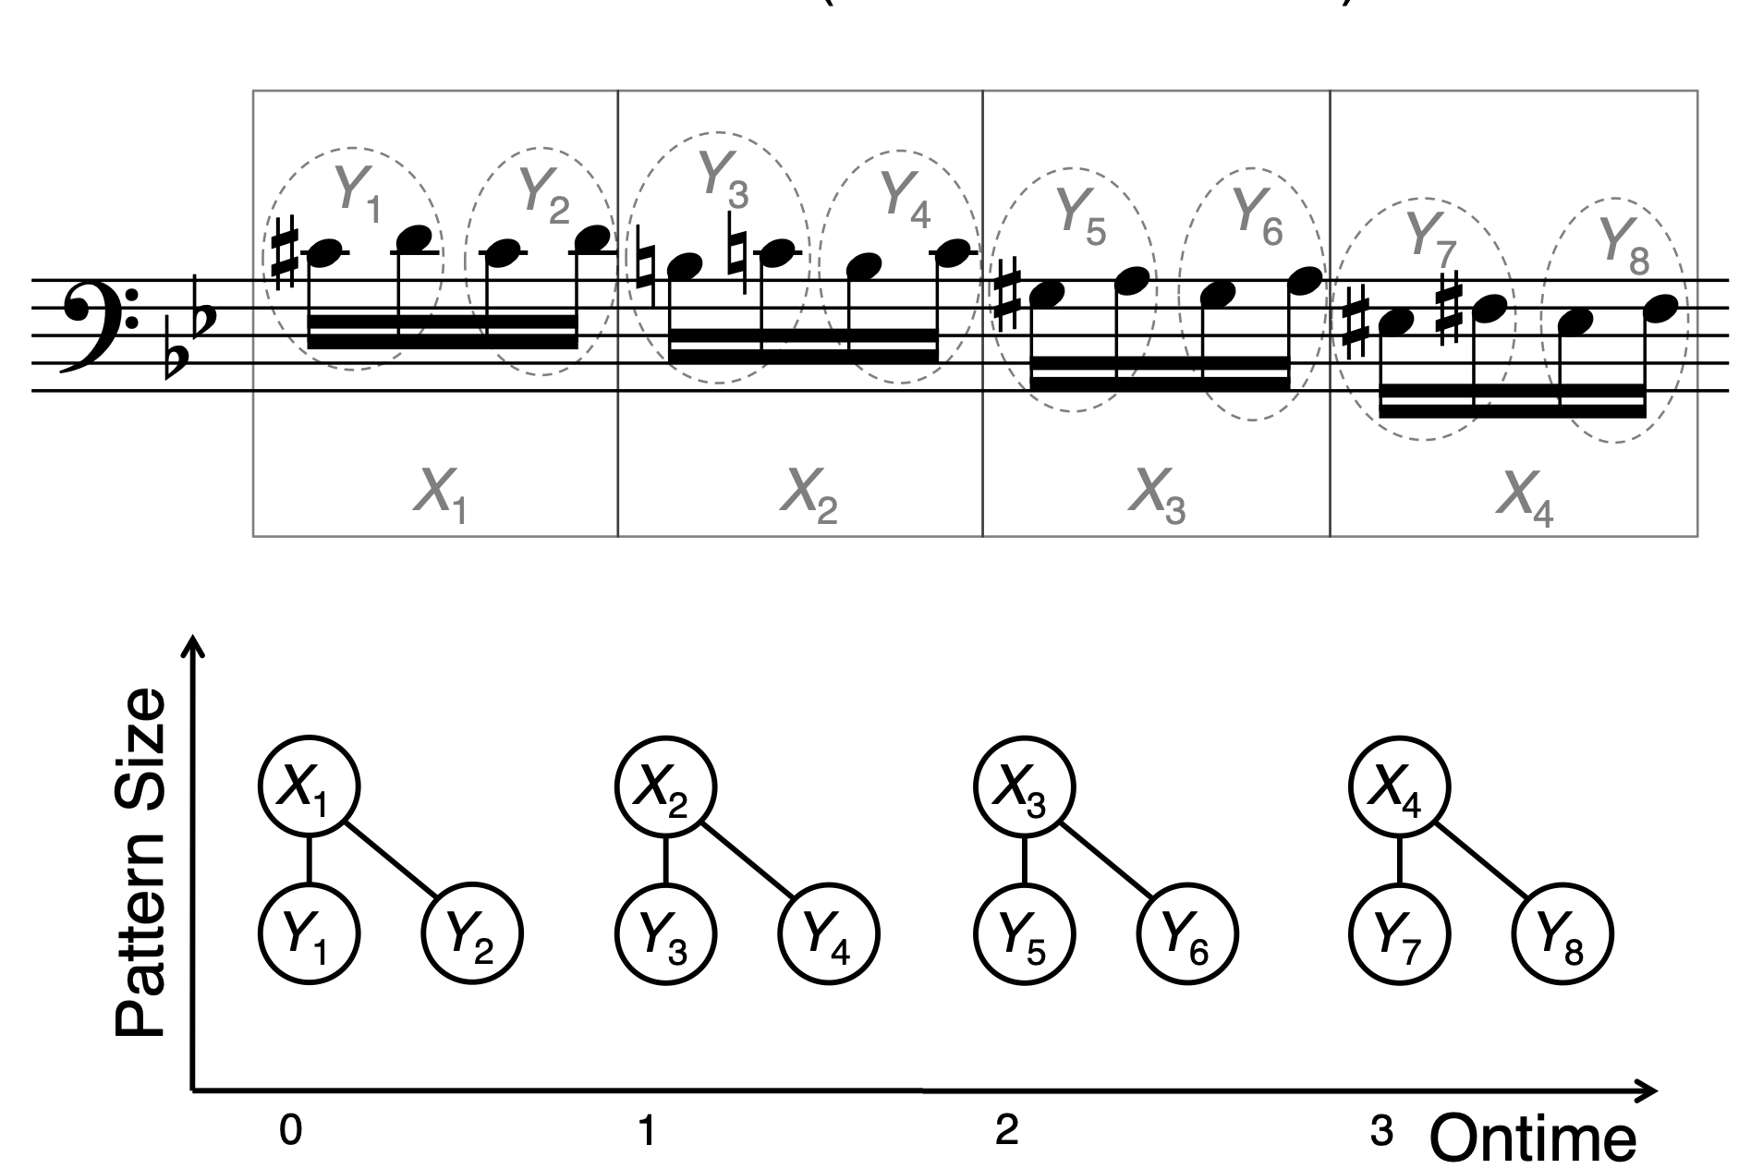
Hierarchical repetition in music
Music tends to be full of hierarchical repetitions.
Deutsch, D. & Feroe, J. (1981). The internal representation of pitch sequences in tonal music. Psychological Review, 88(6), 503-522.
Collins, T. (2011). Improved methods for pattern discovery in music, with applications in automated stylistic composition. PhD thesis, Open University.

Slide 8
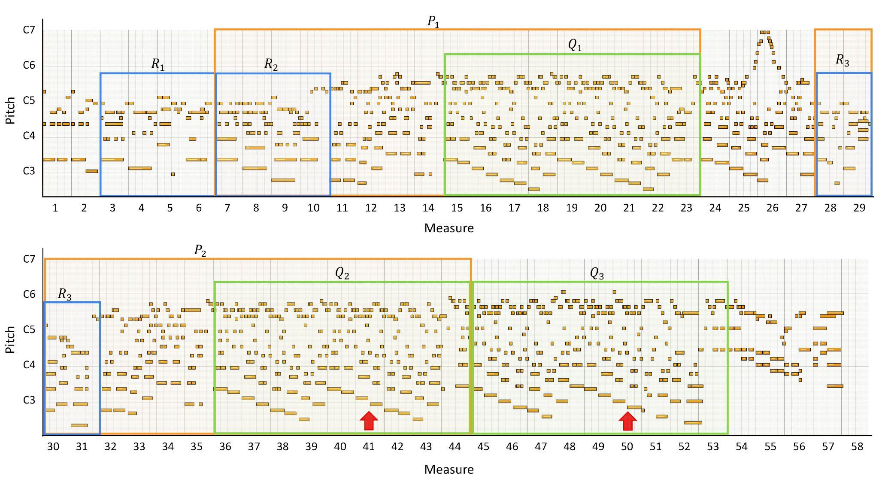
Hierarchical repetition in music
Repetitions exist in nested (and overlapping) relationships
P₁
P₂
Q₁
Q₂
Q₃
R₁
R₂
R₃
”Passerby”, A-Han in piano roll format, in which repetitive patterns are highlighted in bounding boxes with the same colour.

Slide 9
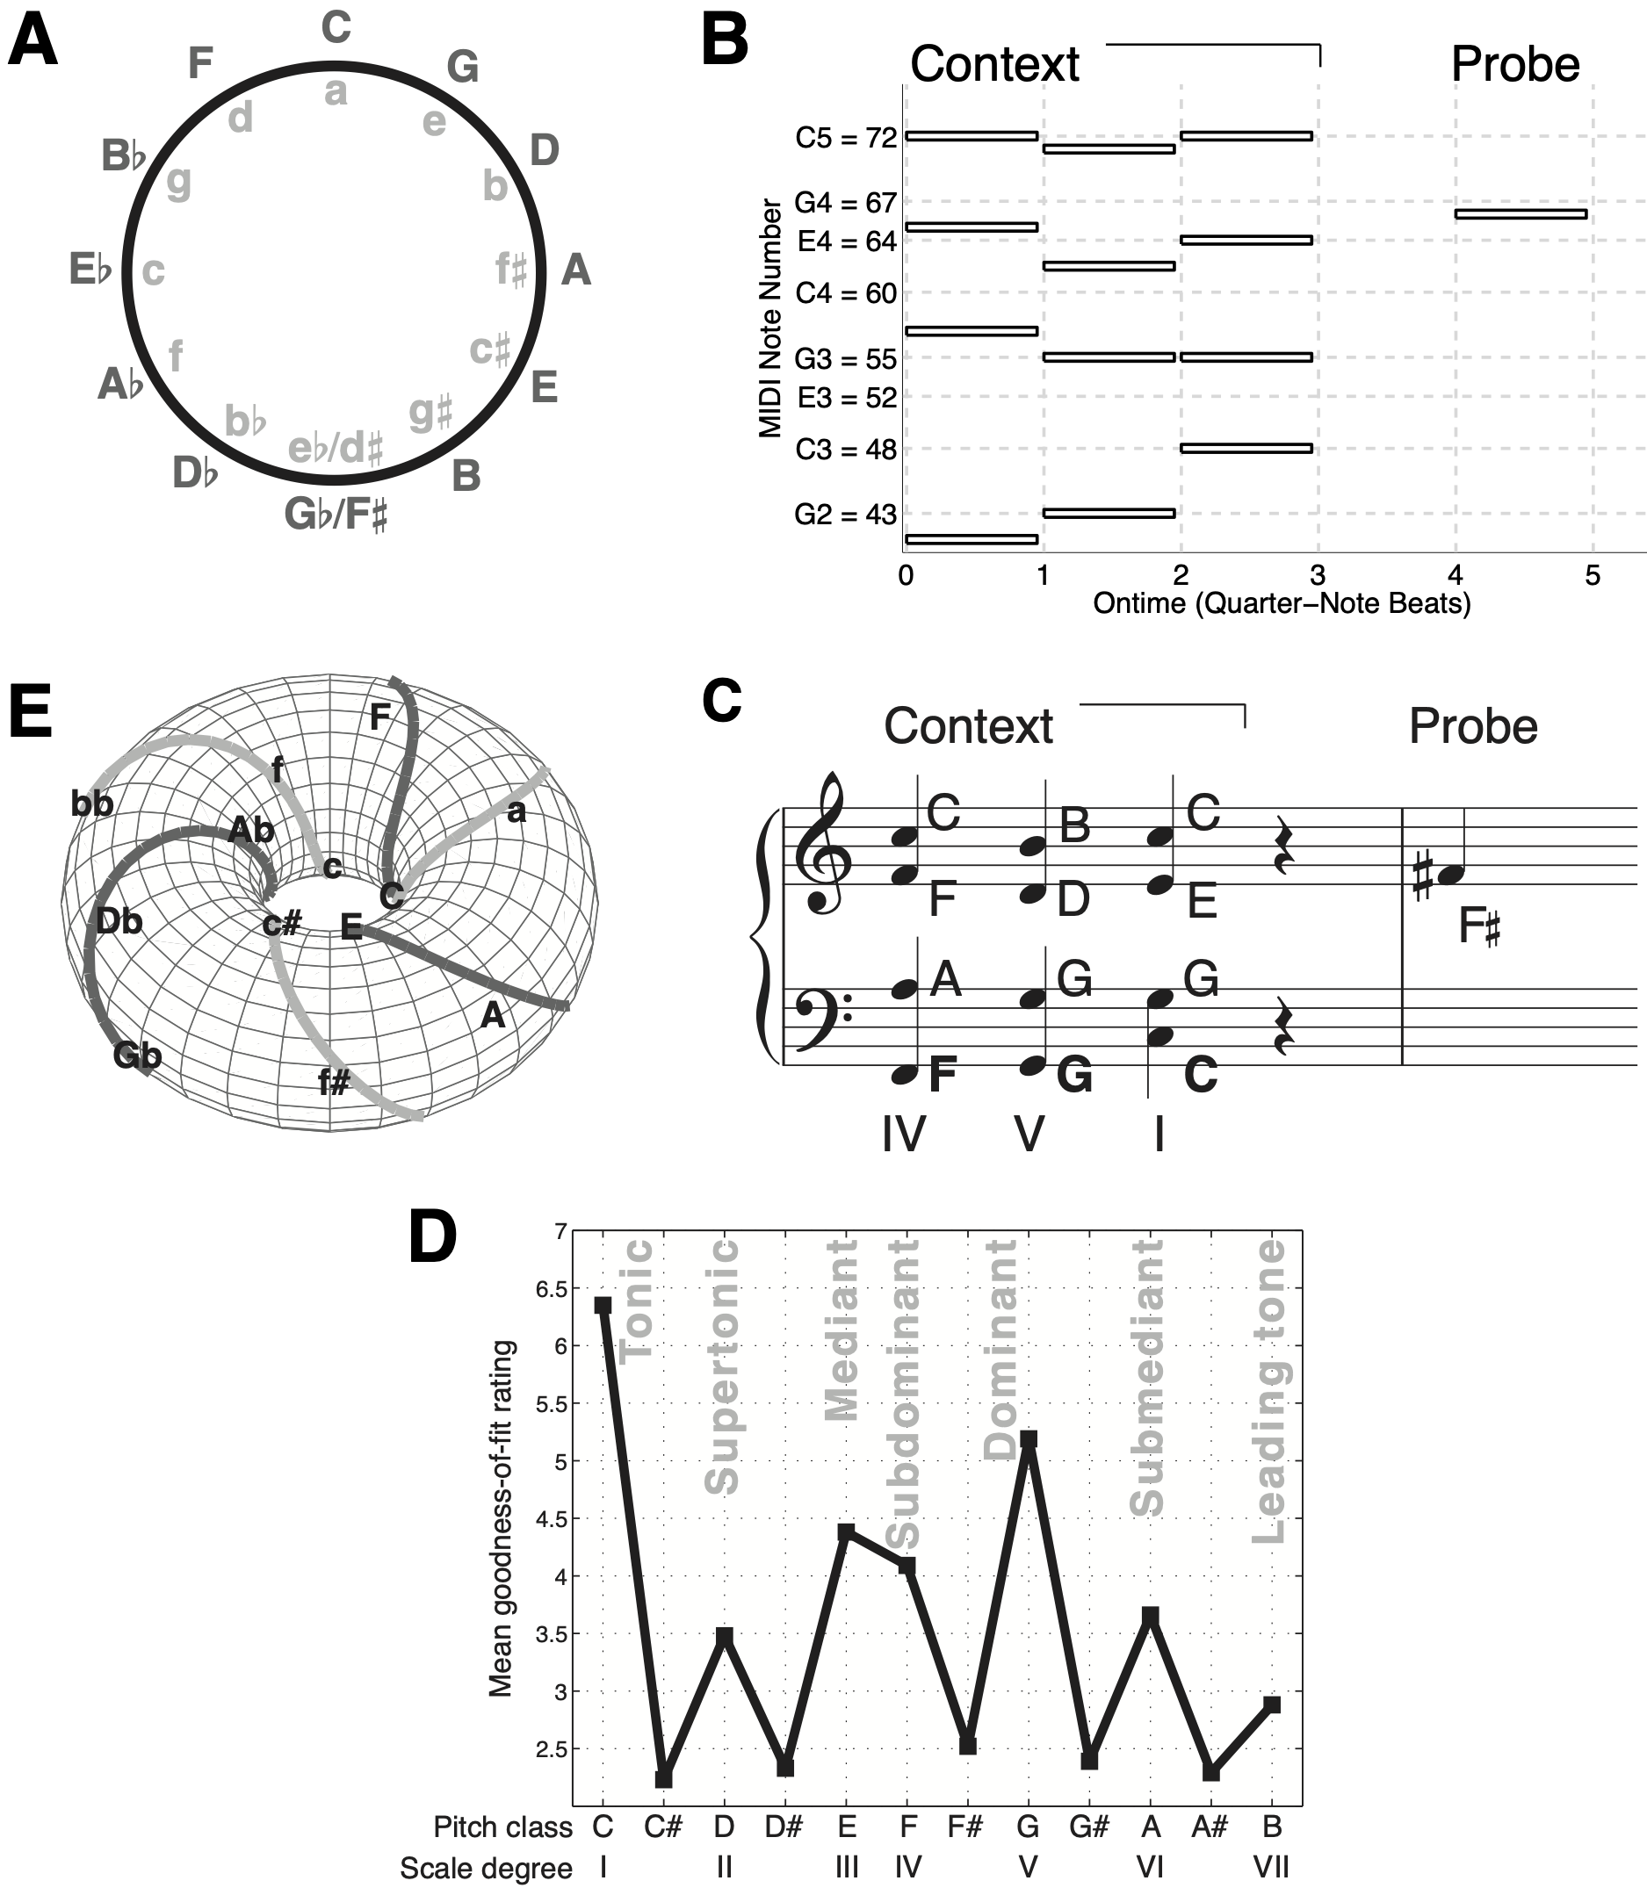
Perception of tonality
Collins, T., Tillmann, B., Barrett, F. S., Delbé, C., & Janata, P. (2014). A combined model of sensory and cognitive representations underlying tonal expectations in music: From audio signals to behavior.. Psychological Review, 121(1), 33-65.
Krumhansl, C. L. & Kessler, E. J. (1982). Tracing the dynamic changes in perceived tonal organization in a spatial representation of musical keys. Psychological Review, 89(4), 334-368.

Slide 10
Contents
Research question
Hierarchical repetition, and tonality
Music appraisal, ScoreViewer and PatternViewer
Experimental Hypotheses, Method, and Results
Discussion

Slide 11
Music appraisal
Definition. To evaluate or assess something in a piece of music.
Can an interactive visualisation application – based on psychological research into listeners' cognition of repetitive and tonal structure – enhance music appraisal skills?

Slide 12
Experiment addressing enhancement of music appraisal
Listeners interact with two visualisation applications in order to answer questions.
  Questions adapted from music-appraisal examinations.
  Music excerpts come from Beethoven Symphonies I and III.
One visualisation application, called the ScoreViewer, presents the staff notation of the music synchronised to audio.
Other, called PatternViewer, is also synchronised to audio and presents piano-roll, as well as representations of repetitive and tonal structure.

Slide 13
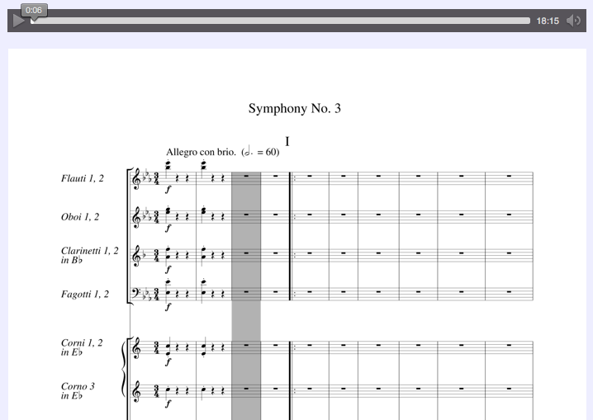
ScoreViewer

Slide 14
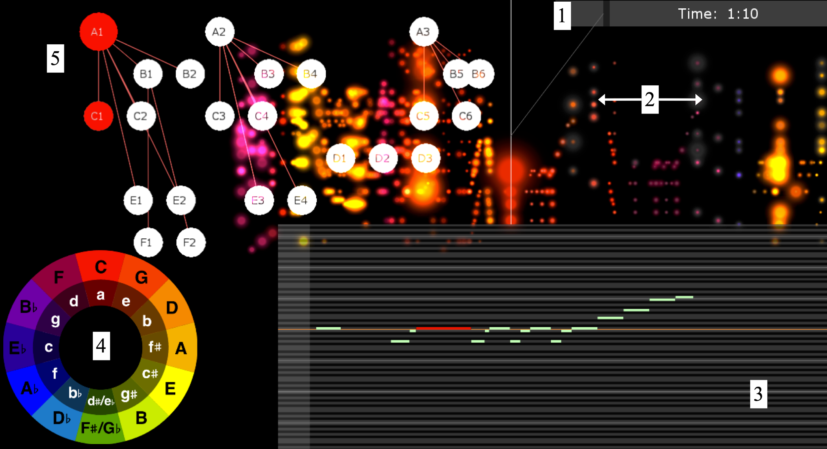
PatternViewer
Demo video

Slide 15
Contents
Research question
Hierarchical repetition, and tonality
Music appraisal, ScoreViewer and PatternViewer
Experimental Hypotheses, Method, and Results
Discussion

Slide 16
Experimental hypotheses
How appraisal of repetitive and tonal structure varies with use of ScoreViewer and PatternViewer:
  H₀: No significant difference
  H₁: Interacting with the PatternViewer improves appraisal of Reptn.Tonal, compared to ScoreViewer.
How appraisal of instrumentation and dynamics varies with use of ScoreViewer and PatternViewer:
  H₀: No significant difference
  H₁: Interacting with the ScoreViewer aids appraisal of Instr.Dynam compared to PatternViewer.

Slide 17
Method: Participants
Eighteen students from JKU Linz
Recruited from general student email list
  Compensated €20 for 1 hr of their time
  mentions interest (but not proficiency) in classical music desirable
Mean age 26.3 yrs, SD = 3.8 yrs
Mean formal musical training (instrumental or vocal) 6.0 yrs, SD = 4.7 yrs

Slide 18
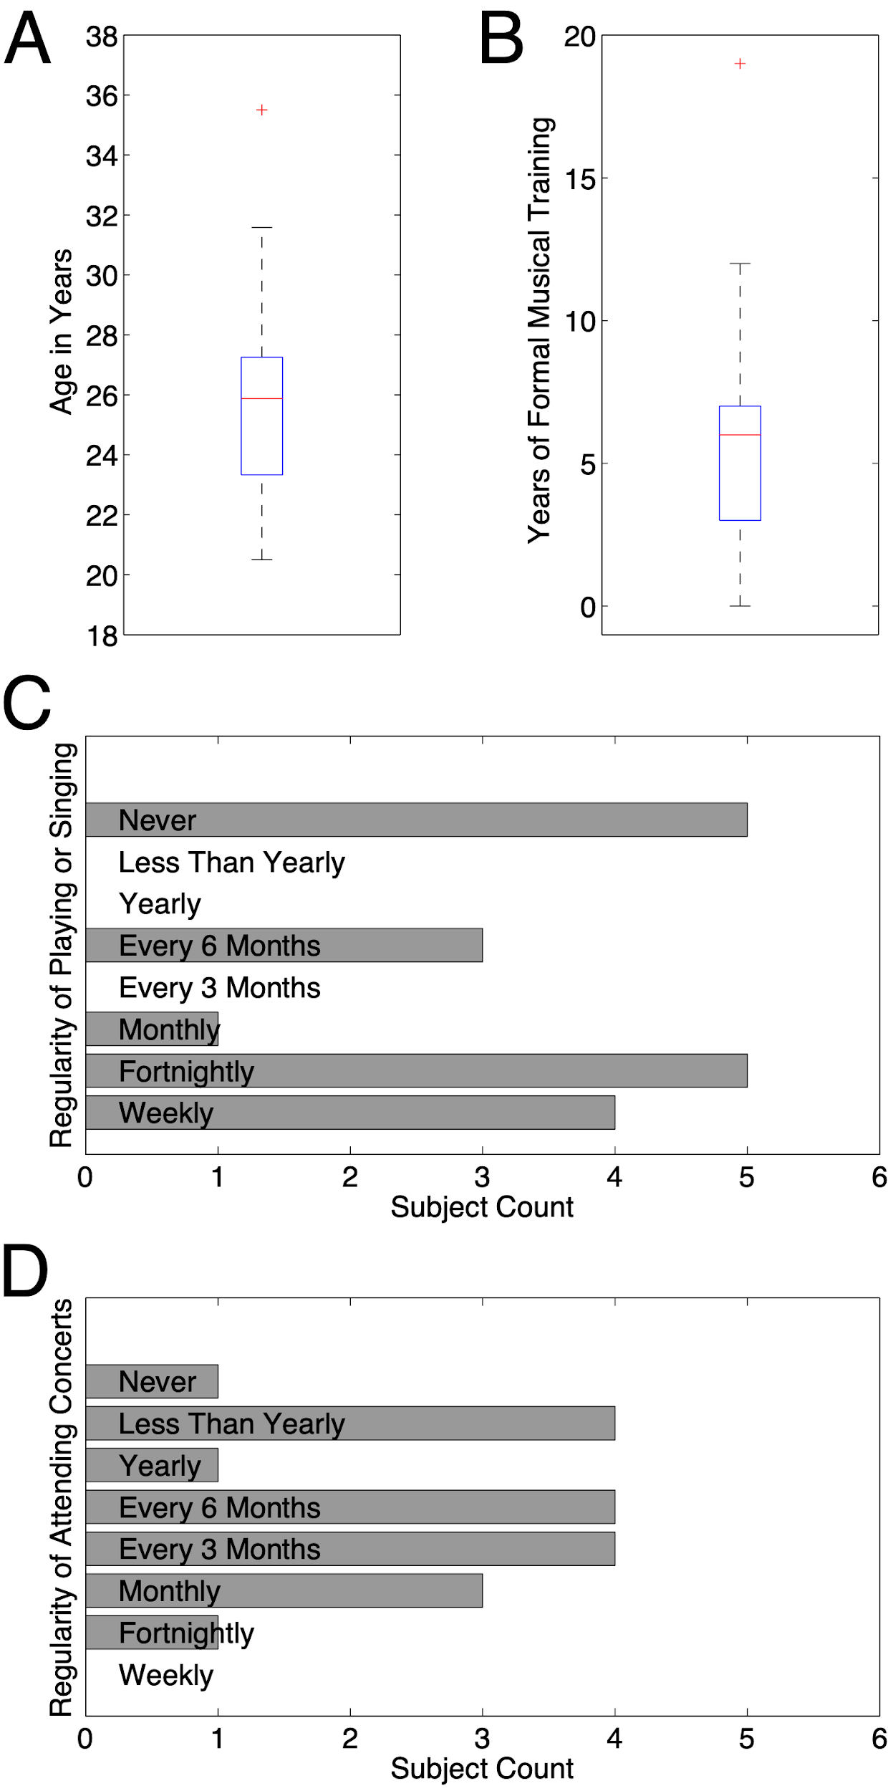
Method: Participants

Slide 19
Method: Stimuli
Excerpt A from Symphony no.1 in C major op.21, the opening 6:40 of the first movement (bars 1–225).
Excerpt B from Symphony no.3 in E-flat major op.55, the opening 6:40 of the first movement (bars 1–158).
Recordings of the Royal Concertgebouw Orchestra, conducted by David Zinman and Iván Fischer, respectively.
Excerpts matched on tempo, key, familiarity. Most questions focused on exposition section.

Slide 20
Method: Stimuli
Questions based on UK GCSE Music qualification
20 questions for each excerpt, covering 4 categories (Instr, Dynam; Reptn, Tonal), so 5 questions per category.
Multiple choice with 3 possible answers.
E.g.,...

Slide 21
Method: Stimuli
Instr. Which of the following instruments is playing in the time window 1:46-1:49?
Dynam. Which time window contains the most powerful (loudest) occurrence of the main theme?
Reptn. Typically the first movement of a symphony begins with a large section called the exposition, which is repeated. In the current piece, at what time does the repeat of the exposition begin?
Tonal. To which key is there a brief modulation at 2:58?

Slide 22
Method: Procedure
Consent, instructions,
training
Excerpt A Q's
w ScoreViewer
Excerpt B Q's
w PatternViewer
Debrief
Consent, instructions,
training
Excerpt A Q's
w PatternViewer
Excerpt B Q's
w ScoreViewer
Debrief

Slide 23
Method: Apparatus
Participants sat at a laptop in an 12 m² room, and read and answered the question sets on this machine.
Laptop was connected to a projector, which showed visualisations on a
2 × 3 m wall section.
Audio was presented by stereo speakers at a level of −20 dB.

Slide 24
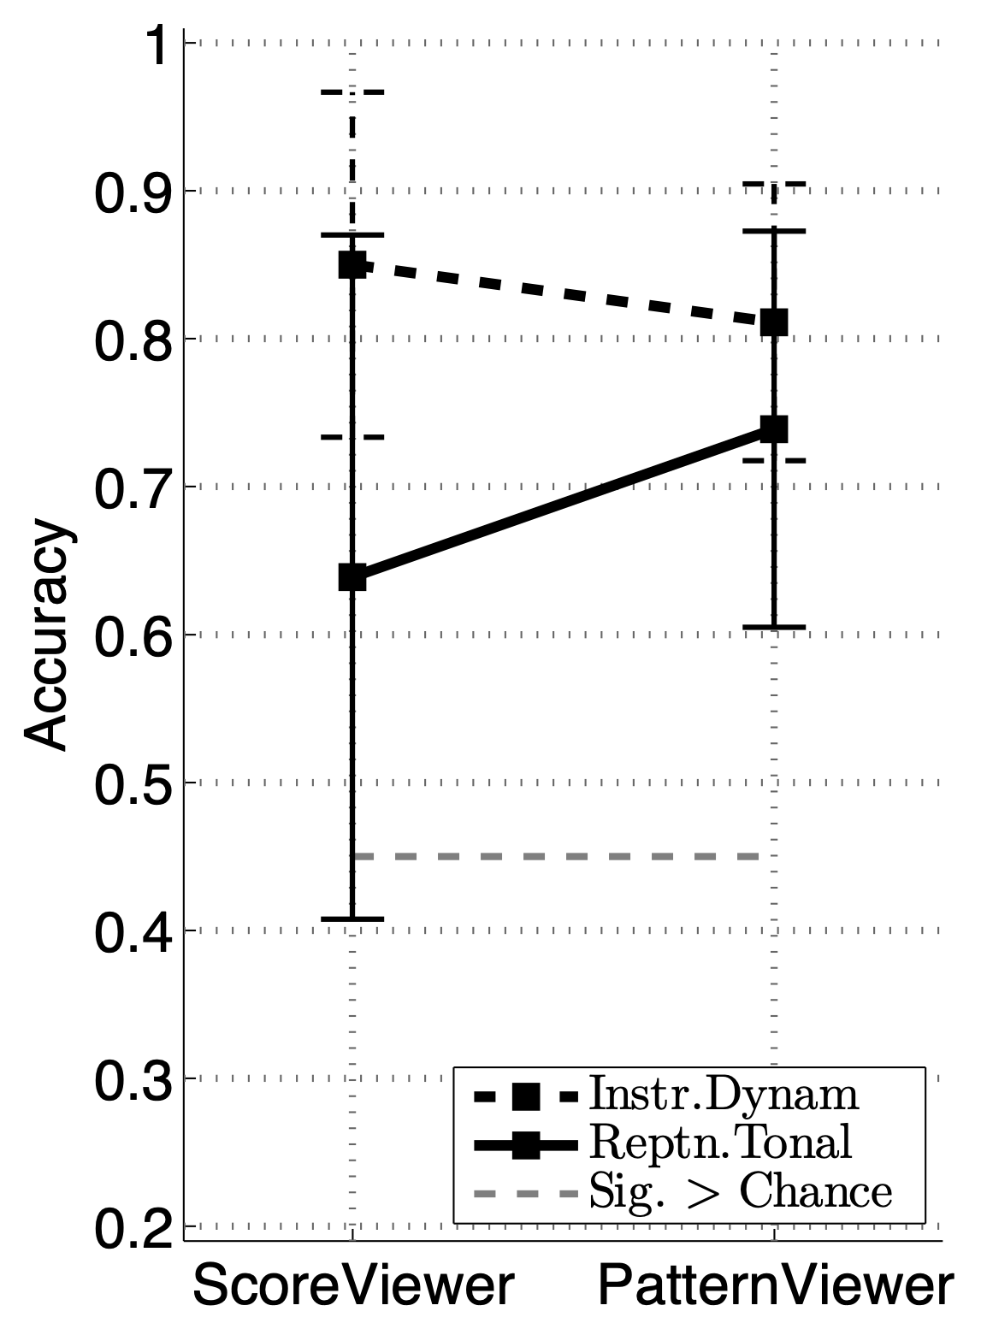
Results
Two-way ANOVA on Accuracy (% correct) with factors for Topic (levels of Instr.Dynam and Reptn.Tonal) and Visualisation (ScoreViewer and PatternViewer) reveals:
  Main effect of Topic (F_{1,17} = 22.64, p < .001)
  Interaction of Topic and Visualisation (F_{1,17} = 6.84, p < .05)
Interaction indicates Reptn.Tonal Q’s answered more accurately in PatternViewer; Instr.Dynam Q’s answered more accurately in ScoreViewer.
Notes:
(lines in plot having different gradients)

Slide 25
Results
Planned comparison on Accuracy of Reptn.Tonal answers in PatternViewer compared to ScoreViewer is significant (t₁₇ = 1.77, p < .05).
We can reject our main null hypothesis in favour of the alternative – using the PatternViewer visualisation leads to a significant improvement in listeners’ appraisal of the repetitive and tonal structure of a piece of music, compared to interacting with the corresponding, audio-synchronized staff notation (as in the ScoreViewer).

Slide 26
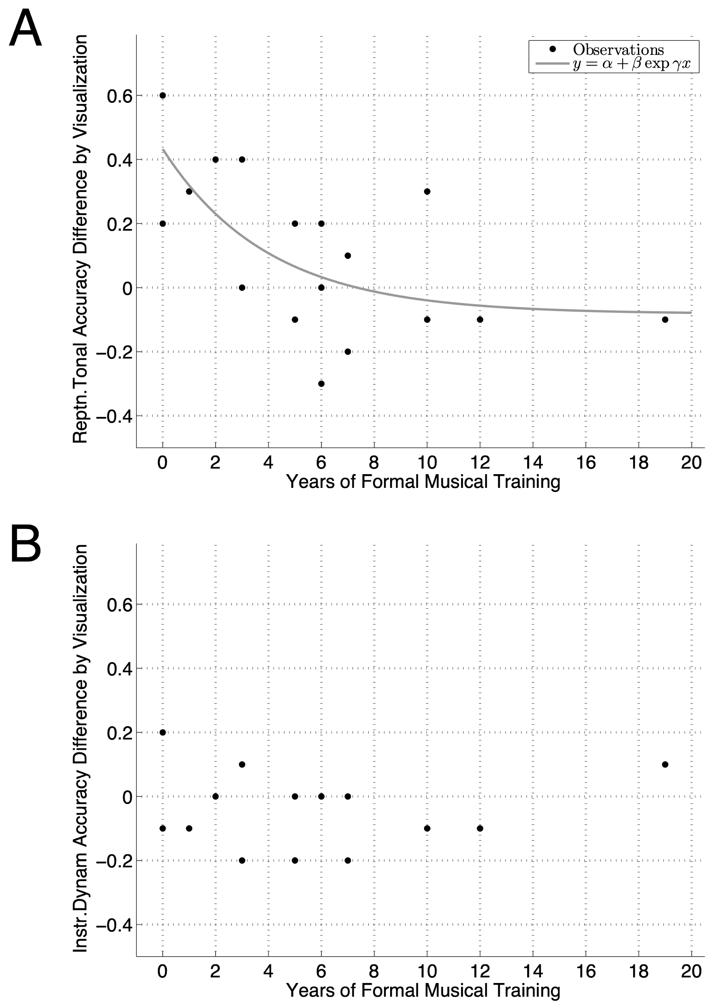
Results
Effect size appears to be a function of musical training:
  Participants’ Accuracy on Reptn.Tonal higher in PatternViewer than ScoreViewer (+ve diff.) if received < 5 yrs musical training.
  Small or –ve diff. if > 5 yrs training.
The data provide a significant fit to the exponential curve shown on the right.

Slide 27
Results
Switching to secondary hypothesis (how appraisal of Instr.Dynam varies with Visualisation), there was not a significant difference (t₁₇ = −1.51, ns).
We cannot reject null hypothesis of no difference between PatternViewer and ScoreViewer when appraising instrumentation and dynamics.
The data shown on the right do not provide a significant fit to any exponential curve.

Slide 28
Contents
Research question
Hierarchical repetition, and tonality
Music appraisal, ScoreViewer and PatternViewer
Experimental Hypotheses, Method, and Results
Discussion

Slide 29
Discussion
Of long-standing interest in psychology and neuroscience
  representations transformed by, and transforming, mind and brain
This paper provides evidence that “visualizing the structure of musical works can play a fundamental role in facilitating and enhancing the understanding and appreciation of those works among listeners”.
Underlines the importance of careful design when developing the views and controls (from Model-View-Controller) that are presented to users who choose to look while listening to music.
Nikrang, A. et al. (2023). Music Visualisation and its short-term effects on appraisal Skills . Accepted by 25th International Conference in Human-Computer Interaction (HCII 2023 Conference) - Late Breaking Work.

Slide 30
Future work
1
  2
3
Nikrang, A. et al. (2023). Music Visualisation and its short-term effects on appraisal Skills . Accepted by 25th International Conference in Human-Computer Interaction (HCII 2023 Conference) - Late Breaking Work.

Slide 31
Thanks for listening!
https://tomcollinsresearch.net

