Slide 1
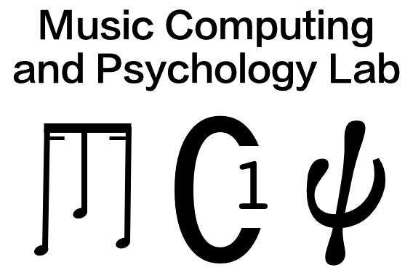
The Pendular Graph: Visualising Hierarchical Repetitive Structure in Point-set Representations of the POP909 Music Dataset
Chenyu Gao¹, Tom Collins^{2, 3}
¹ University of York, UK ² University of Miami, USA ³ MAIA, Inc.

Slide 2
Contents
Introduction & motivation
Contributions of this paper
The pendular graph
Hierarchicalisation of the POP909 annotations
Limitations and future work

Slide 3
Repetition in music
It has long been suggested that composers introduce repetitions carefully to emphasise music ideas (Schoenberg, 2010).
Recognising repetitive patterns is also an important step for understanding music (Meyer, 2008; Lerdahl and Jackendoff, 1996).
Schoenberg, A. (2010). Style and idea: Selected writings. Univ of California Press.
Meyer, L. B. (2008). Emotion and meaning in music. University of chicago Press.
Lerdahl, F., & Jackendoff, R. S. (1996). A Generative Theory of Tonal Music, reissue, with a new preface. MIT press.
Notes:
Visualising the structure of music can enhance audiences’ understanding of music, especially when they are listening to a piece of music for the first time [13].

Slide 4
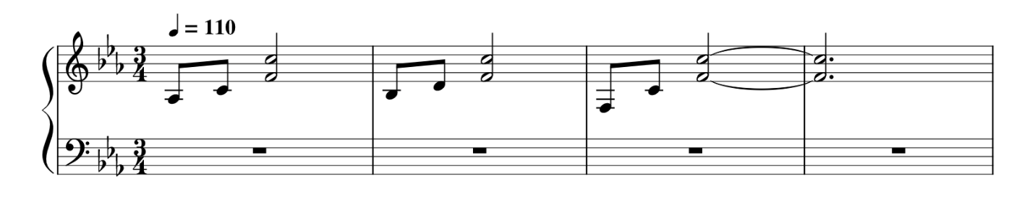
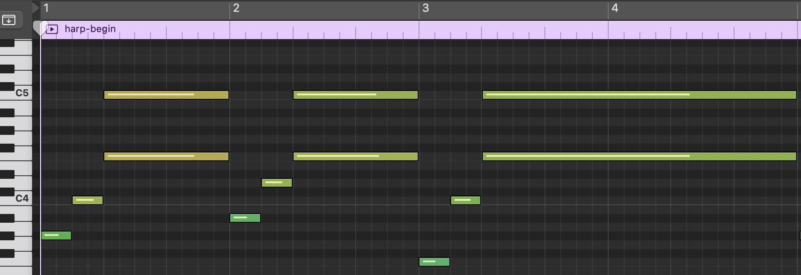
Repetition in music
Music tends to be full of hierarchical repetitions.
Four bars piano reduction of ”Waltzing in the Rain” from Sky, composed by Vincent Diamante, and an example of piano-roll format.
Notes:
I need to mention piano-roll in the video.
For LB session, you might say more to carefully introduce piano roll. Pitch against time, oblong width indicating note length. We talk about these representations as point sets, where each note is a point in space consisting of start time, pitch, duration, and potentially other musical dimensions.
For W1 session, you might say: we utilise a geometric representation of the music, similar to piano roll.

Slide 5
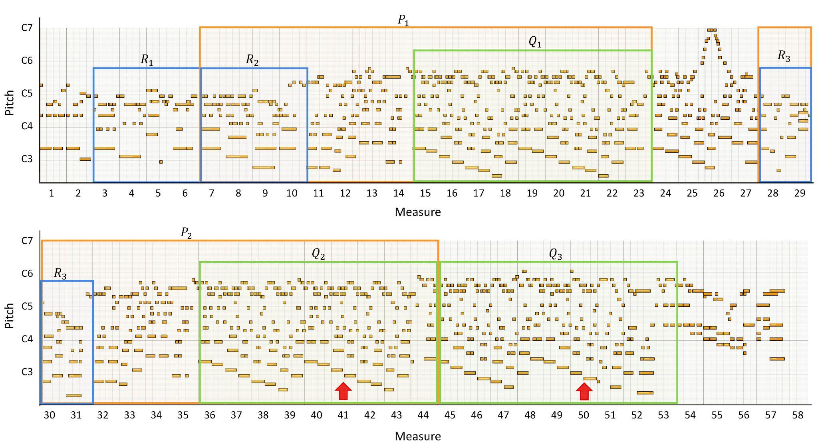
Repetition in music
Music tends to be full of hierarchical repetitions.
”Passerby”, A-Han in piano roll format, in which repetitive patterns are highlighted in bounding boxes with the same colour.
Notes:
Here is a piano-roll plot again, this time more "zoomed out".
For example, there are sections (verses, choruses, etc.) that repeat within a song, in which there may be a phrase or riff that recurs multiple times within a verse. If a piece of music is annotated as “intro, verse, verse, chorus, verse, chorus, chorus” (or, more succinctly, “ABBCBCC”), this is a linear an- notation (not hierarchical), because it contains no indication of smaller-scale repetition of phrases within a verse, and the existence of a larger section is only implicit (e.g., the substring “BC” occurs twice).

Slide 6
Contents
Introduction & motivation
Contributions of this paper
The pendular graph
Hierarchicalisation of the POP909 annotations
Limitations and future work

Slide 7
Limitations of existing music structure visualisation tools
Comprehending musical structure has been shown to help people remember or understand music better (Deutsch, 1980).
A lot of music structure visualisation tools have been developed but many of these tools suffer either from a lack of interactivity (Wattenberg, 2002), or are now unusable due to software dependency or maintenance issues (Nikrang et al., 2014).
Deutsch, D. (1980). The processing of structured and unstructured tonal sequences. Perception & psychophysics, 28(5), 381-389.
Wattenberg, M. (2002). Shape of song. http://www.turbulence.org/Works/song/
Nikrang, A., Collins, T., & Widmer, G. (2014). PatternViewer: An application for exploring repetitive and tonal structure. J.-SR Jang, M. Goto, & JH Lee (Chairs.), Late-Breaking demo. ISMIR.
Notes:
and could be especially useful for people listening to a piece for the first time.
Visualised structure also provides a way to communicate intepretations of music, as different people may annotate the same song with different structural labels [3].
The Shape of Song [30] is an application of arc diagrams [31]

Slide 8
Contributions
Introduce a web-based interface where hierarchical annotations of 909 songs can be explored and played back.
Gao, C., & Collins, T. (2023). The Pendular Graph: Visualising Hierarchical Repetitive Structure in Point-set Representations of the POP909 Music Dataset. Accepted by 25th International Conference in Human-Computer Interaction (HCII 2023 Conference) - Late Breaking Work.
Notes:
we 1) develop a method for taking a linear annotation as input, and converting it to a hierarchical annota- tion as output, where such hierarchies exist in the input, and 2) introduce a web-based interface4 where hierarchical annotations of 909 songs can be explored and played back, in synchrony with a visual representation of note content.

Slide 9
Limitations of existing datasets with structure annotations
Existing music structure visualisation tools are highly relied on annotated data, while existing music datasets with structural annotations tend to be either
a) small in terms of items in the corpus, but with detailed annotations (Collins, 2013, Tomašević et al, 2021)or
b) larger as a corpus, but with linear annotations only (Dai et al., 2020)
E.g., "intro, verse 1, verse 2, chorus,..." or "iAAB..." for short
Collins, T. (2013). Discovery of repeated themes and sections. Retrieved 4th May, http://www. musicir. org/mirex/wiki/2013: Discovery of Repeated Themes & Sections.
Tomašević, D., Wells, S., Ren, I. Y., Volk, A., & Pesek, M. (2021). Exploring annotations for musical pattern discovery gathered with digital annotation tools. Journal of Mathematics and Music, 15(2), 194-207.
Dai, S., Zhang, H., & Dannenberg, R. B. (2020). Automatic analysis and influence of hierarchical structure on melody, rhythm and harmony in popular music. In Proceedings of the Joint Conference on AI Music Creativity.
Notes:
So, we define hierarchical structural annotations from an existing set of 909 linear-annotated popular Chinese songs.
But there's a problem with linear annotations. For example, a riff may occur several times in an intro, and recur within the verse or chorus. In other words, we know music has hierarchical structure and linear annotations are useful but fall short of describing music in all its complexity.

Slide 10
Contributions
Introduce a web-based interface where hierarchical annotations of 909 songs can be explored and played back.
Develop a method for taking a linear annotation as input, and converting it to a hierarchical annotation as output
Gao, C., & Collins, T. (2023). The Pendular Graph: Visualising Hierarchical Repetitive Structure in Point-set Representations of the POP909 Music Dataset. Accepted by 25th International Conference in Human-Computer Interaction (HCII 2023 Conference) - Late Breaking Work.
Notes:
we 1) develop a method for taking a linear annotation as input, and converting it to a hierarchical annota- tion as output, where such hierarchies exist in the input, and 2) introduce a web-based interface4 where hierarchical annotations of 909 songs can be explored and played back, in synchrony with a visual representation of note content.

Slide 11
Contents
Introduction & motivation
Contributions of this paper
The pendular graph
Hierarchicalisation of the POP909 annotations
Limitations and future work

Slide 12
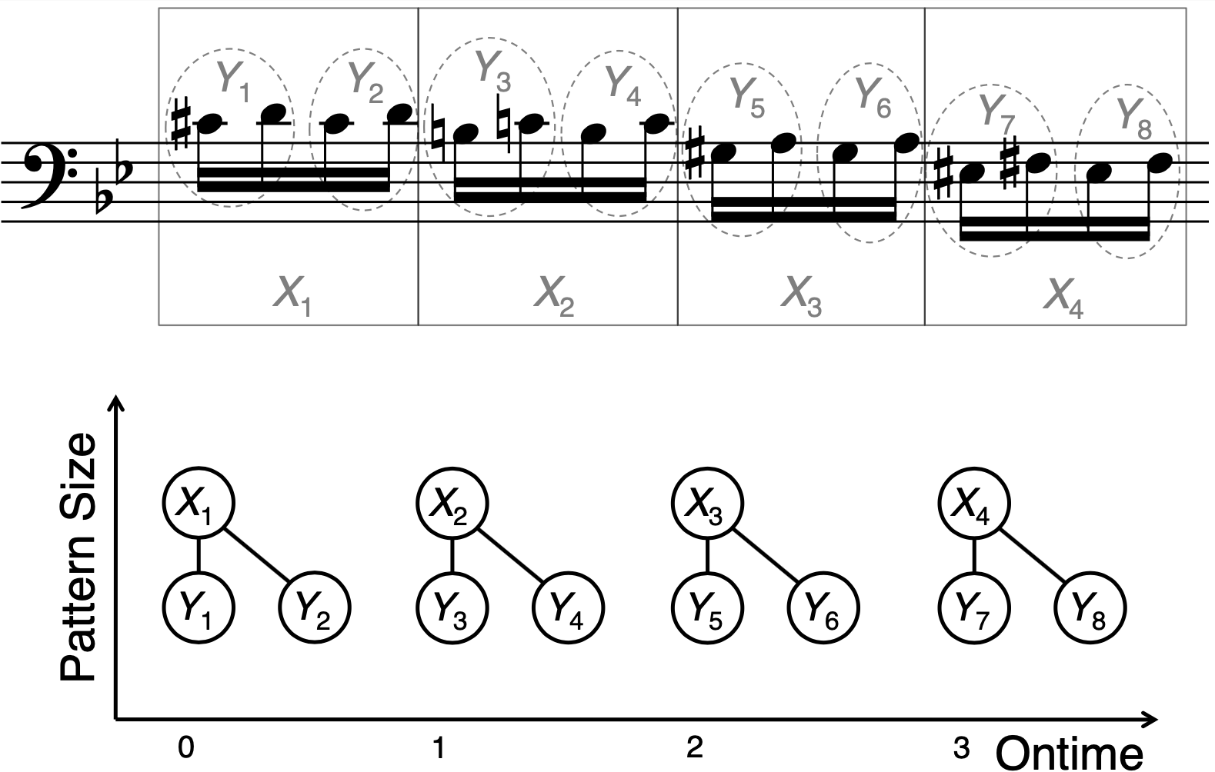
POP909 Pendular Graphs
Deutsch, D., & Feroe, J. (1981). The internal representation of pitch sequences in tonal music. Psychological review, 88(6), 503.
Collins, T. E. (2011). Improved methods for pattern discovery in music, with applications in automated stylistic composition. Open University (United Kingdom).
Notes:
Mention historical use of pendular graph, and give definition.
Historical use is Deutsch & Feroe (1981), Collins (2011).
Defn: a graph-like structure; nodes represent note collections; two nodes with the same label contain exact repetitions of note material, or perceptually very similar note material; link from node X down to node Y indicates that all notes belonging to Y belong also to X.
Beethoven Piano Sonata op.22

Slide 13
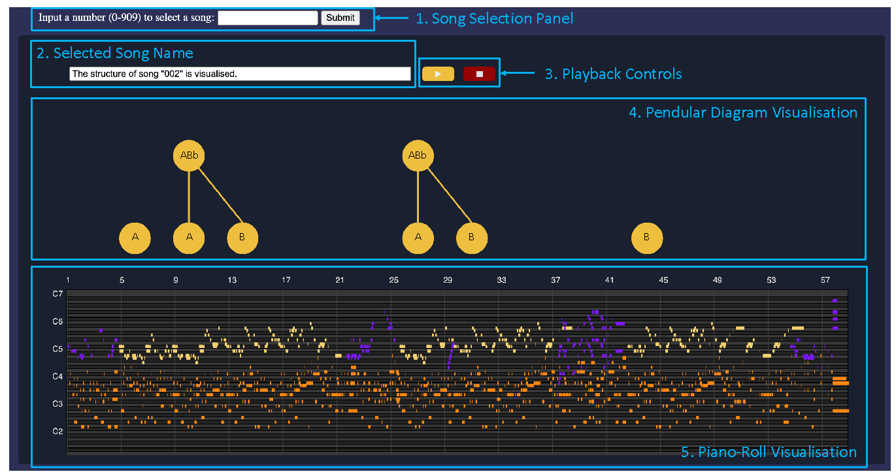
POP909 Pendular Graphs
https://pendular-graph.glitch.me/
Gao, C., & Collins, T. (2023). The Pendular Graph: Visualising Hierarchical Repetitive Structure in Point-set Representations of the POP909 Music Dataset. Accepted by 25th International Conference in Human-Computer Interaction (HCII 2023 Conference) - Late Breaking Work.
Notes:
1. Song selection panel at the top of the page. A user can enter a number between 1 and 909 in the text input box to select a song to visualise. Once the user clicks “Submit”, the server side will read and process data of the selected song, and send it to the client side. Then, content related to the song structure visualisation will be updated.
2. Selected song name panel below the song selection panel, which tells the user which song is selected and visualised.
3. Playback controls can be clicked to start/pause and stop a song. 4. Pendular graph visualisation is the main component of our interface, so- called because the vertices/nodes resemble pendulums. The code behind this component parses the hierarchical structure labels annotated by our algo- rithm (Section 3), and draws them as a pendular graph, where each vertex represents a repetitive pattern. Horizontal location is determined by appear- ance in the piece; patterns containing more points are visualised vertically higher up, while patterns containing fewer points are lower down. An edge will connect two vertices if one pattern’s point-set representation is a sub- set of that of another. Users can click nodes in the graph to listen to the
corresponding part of the music. 5. Piano-roll visualisation at the bottom of this page, in which the melody
is coloured in yellow, the secondary melody/lead instruments is coloured in purple, and the accompaniment is coloured in orange.

Slide 14
Contents
Introduction & motivation
Contributions of this paper
The pendular graph
Hierarchicalisation of the POP909 annotations
Limitations and future work

Slide 15
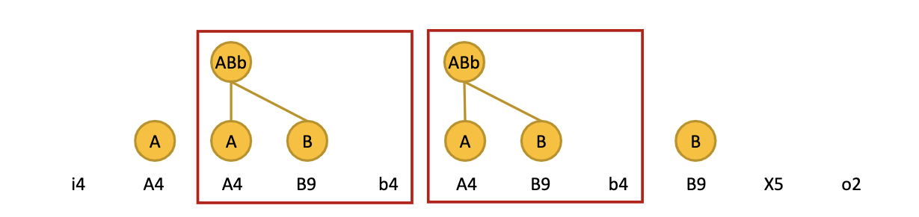
The POP909 dataset
Piano arrangements of 909 popular Chinese songs in MIDI format.
Phrase-level repetitive structure labels are provided (Dai et al., 2020).
Hierarchical structure analysis of “123 Pinocchio”, Hey Girl. The smallest repetitive phrase is labelled by a letter followed by the number of bars. Phrases labelled with the same letter are repetitive, and larger repetitive patterns are highlighted by bounding boxes
Dai, S., Zhang, H., & Dannenberg, R. B. (2020). Automatic analysis and influence of hierarchical structure on melody, rhythm and harmony in popular music. In Proceedings of the Joint Conference on AI Music Creativity.
Notes:
Structure' in music can mean many things. Here, we are concerned mainly with hierarchical repetition (e.g., within a verse, there may be a phrase or riff that recurs multiple times)
f a piece of music is annotated as “intro, verse, verse, chorus, verse, chorus, chorus” (or, more succinctly, “ABBCBCC”), this is a linear an- notation (not hierarchical), because it contains no indication of smaller-scale repetition of phrases within a verse, and the existence of a larger section is only implicit (e.g., the substring “BC” occurs twice)

Slide 16
Linear vs Hierarchical
A linear annotation (not hierarchical) :
If a piece of music is annotated as “intro, verse, verse, chorus, verse, chorus, chorus” (or, more succinctly, “ABBCBCC”), this is a linear annotation.
Hierarchical annotation:
Phrases that appear together will be grouped.
Hierarchical structure analysis of “123 Pinocchio”, Hey Girl. The smallest repetitive phrase is labelled by a letter followed by the number of bars. Phrases labelled with the same letter are repetitive, and larger repetitive patterns are highlighted by bounding boxes
Notes:
Structure' in music can mean many things. Here, we are concerned mainly with hierarchical repetition (e.g., within a verse, there may be a phrase or riff that recurs multiple times)
if a piece of music is annotated as “intro, verse, verse, chorus, verse, chorus, chorus” (or, more succinctly, “ABBCBCC”), this is a linear annotation (not hierarchical), because it contains no indication of smaller-scale repetition of phrases within a verse, and the existence of a larger section is only implicit (e.g., the substring “BC” occurs twice)

Slide 17
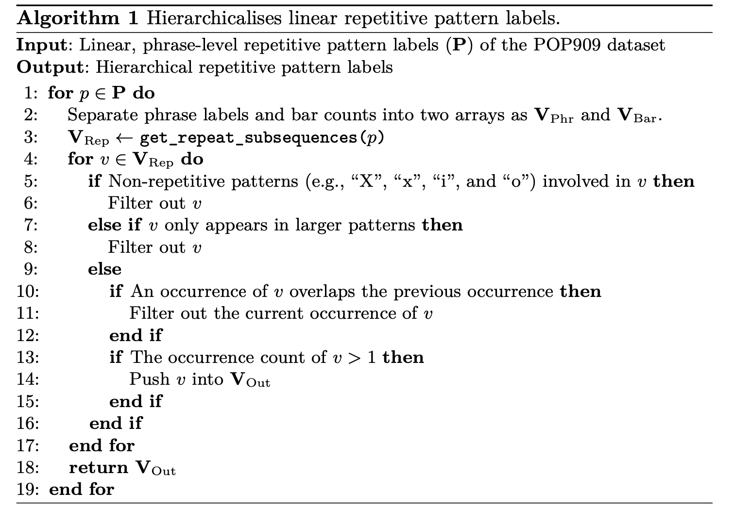
Hierarchicalisation of the POP909 Annotations
An algorithm to convert phrase-level repetitive pattern labels into a hierarchical labelling:
The function get_repeat_subsequences() will return repetitive substrings.
The following steps filter out repetitive patterns that involve non-repetitive phrases or appear only in larger patterns.
Notes:
The function get_repeat_subsequences() will return substrings of VPhr that repeat at least once, in descending order of length, as well as the index arrays where the first letter of these substrings occur in the entire string as VRep. For example, when inputting “abcabda”, the function get_repeat_subsequences() outputs repetitive substrings “ab”, and “a”, and “b” and the index arrays of occurrences [0, 3], [0, 3, 6], and [1, 4].

Slide 18
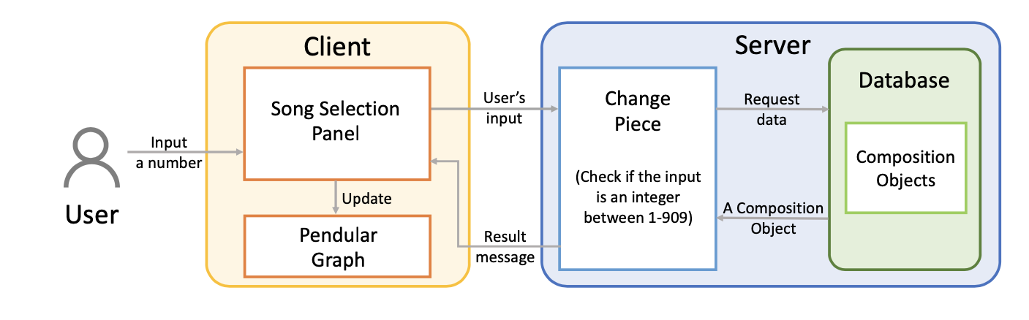
Interface
The web interface is developed by using JavaScript packages, e.g., p5.js.
The server side is developed with Fastify and the Node Fetch APIs.
The MAIA Util package (Collins and Coulon, 2019) is used when processing music data, and Tone.js (Mann, 2015) enables the songs to be played back dynamically in the browser.
Collins, T., & Coulon, C. (2019, December). MAIA Util: an NPM package for bridging web audio with music-theoretic concepts. In Proceedings of the web audio conference (pp. 47-52).
Mann, Y. (2015, January). Interactive music with tone. js. In Proceedings of the 1st annual Web Audio Conference. Citeseer.

Slide 19
Contents
Introduction & motivation
Contributions of this paper
The pendular graph
Hierarchicalisation of the POP909 annotations
Limitations and future work

Slide 20
Why do we need pattern discovery algorithms¹?
Pattern occurrences begin/end at bar beginnings/endings in hierarchical annotations for 909 songs.
Visualisation is restricted to the labelled POP909 dataset
Given a point set D, return subsets p_{1,1}, p_{2,1},..., p_{m,1} of D such that each p_{i,1} is musically noticeable or important due partly or wholly to its recurrence in more or less exact form elsewhere in D.
For each p_{i,1}, these more or less exact occurrences p_{i,2}, p_{i,3},..., p_{i,n_i} should also be returned.
Notes:
While deriving and sharing hierarchical annotations for 909 songs represents an order-of-magnitude increase in the availability of such annotations, it is at the expense of relatively coarse levels of definition – i.e., pattern occurrences begin/end at bar beginnings/endings, and they are defined temporally, meaning all notes existing between two time points are assumed members of a pattern occurrence. This is less precise than with the PatternViewer visualisations [24].
Pattern discovery problem statement.
1. Given a point set $D$, return subsets $p_{1,1}, p_{2,1},\ldots, p_{m,1}$ of $D$ such that each $p_{i,1}$ is \emph{musically noticeable or important} due partly or wholly to its recurrence in more or less exact form elsewhere in $D$.
2. For each $p_{i,1}$, these more or less exact occurrences $p_{i,2}, p_{i,3},\ldots, p_{i,n_i}$ should also be returned.

Slide 21
The potential usage of the pendular graph
As useful software tools for music analysts and composers.
Music without well-organised hierarchical structure sounds incoherent and aimless, which is quite a common problem that exists in AI music generation. (Dai et al., 2022)
Visualise if music generated by AI has hierarchical repetitive structure.
Dai, S., Zhang, H., Dannenberg, R.B. (2020). Automatic analysis and influence of hierarchical structure on melody, rhythm and harmony in popular music. In Proceedings of the 2020 Joint Conference on AI Music Creativity, 2020.

Slide 22
Thanks!
chenyu.gao@york.ac.uk
Notes:
That’s the end of my pre. I am interested in hearing any questions.

