Slide 1
A Virtual Guide to the Makam Universe
Dr. Ozan Baysal, Dr.Recep Gül, Yusuf Can Şeftali
HCI – New Technologies for Analysing and Visualizing Musical Structure
23.08.2023 - Copenhagen

Slide 2
MakamNetz
MakamNetz is a web-based application developed by our team at Istanbul Technical University. This innovative platform aims to construct a visual topography of Turkish makam music, effectively illustrating the intricate connections between various melodic units crucial to the concept of makam. Our primary focus is to create an analytical and pedagogical tool, enabling users to teach, learn, and comprehend the rich tapestry of this longstanding traditional practice.

Slide 3
Introduction
Music theory scholars have long sought to understand the harmonic connections within different musical structures.
Visual models of pitch-set relationships have emerged as a useful tool in this pursuit.
Network models offer a panoramic perspective that allows for a holistic view of the musical universe.

Slide 4
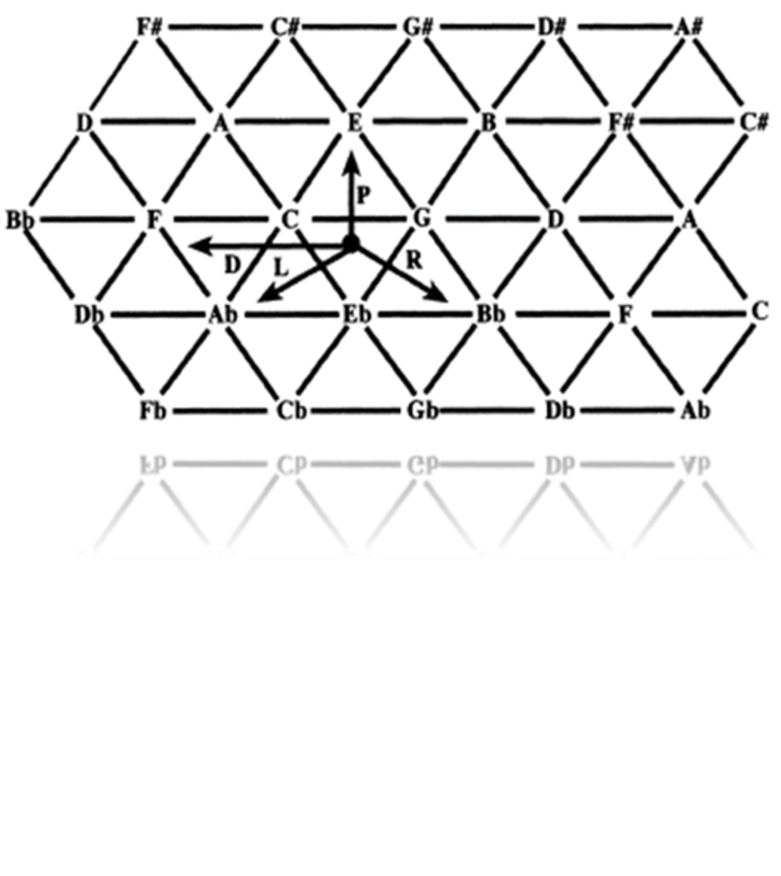
The Tone-Network 'Tonnetz'
Leonhard Euler proposed the tone network 'tonnetz' in the 18th century.
The 'tonnetz' became the foundational framework for many theoreticians, including Hugo Riemann.
It provides a conceptual basis for understanding harmonic motion and transformational models.

Slide 5
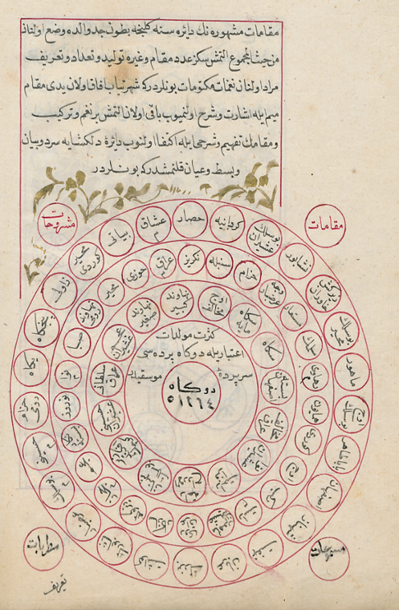
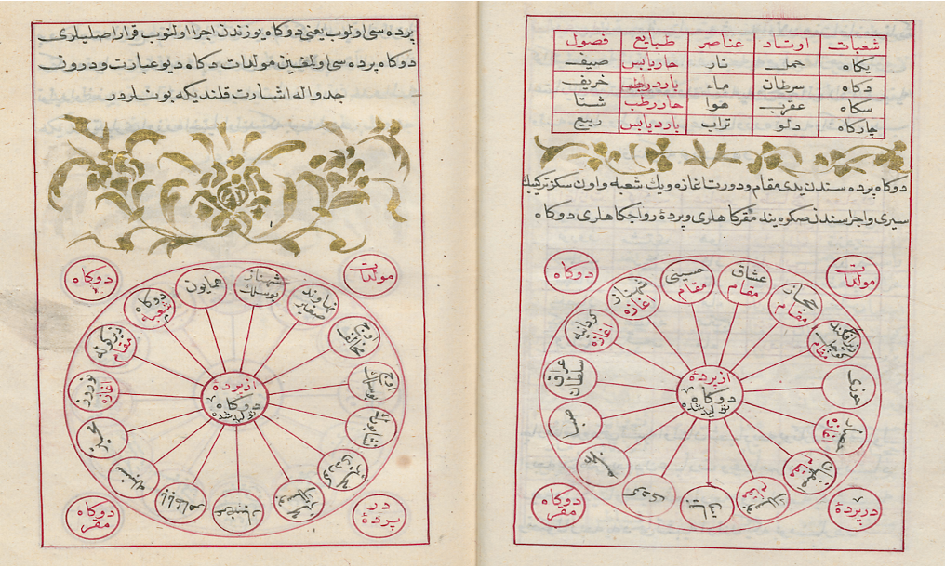
Turkish Makam Music
Turkish makam music also utilizes similar representations of pitch-set relationships.
Kemani Hızır Ağa's treatise 'Tefhimü’l Makâmât fi Tevlidi’n Nagâmât’ (Explanation of Makams in the Generation of Melodies - 18th cent.) explores the linking of perde and makam structures.
The treatise reveals inter-relationships with other systems.

Slide 6
Our Model and Assumptions
What is Makam?
Description of Perde/Pitch, Çeşni/Flavor and their role in Turkish Makam Music
Transformations and Relations
Transition to Superstructures from Substructures

Slide 7

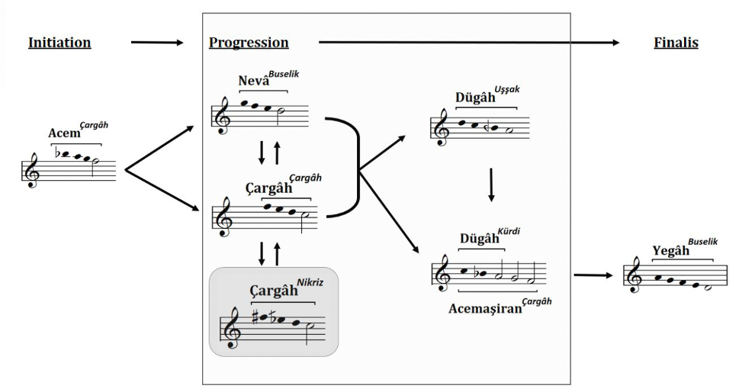
What is Makam
A Makam is a progression of small melodic structures called “Çeşni/Flavor”. To that end, It does not correspond to a scale but rather is characterized by the ways in which these melodic units unfold in time. Many makams can share similar pitch content. However, if the content and progression of melodic units change makams change, as well
It generally has three main formal units called the Initiation (“agaze”), the progression (“seyir”) and “finalis” (karar)

Slide 8
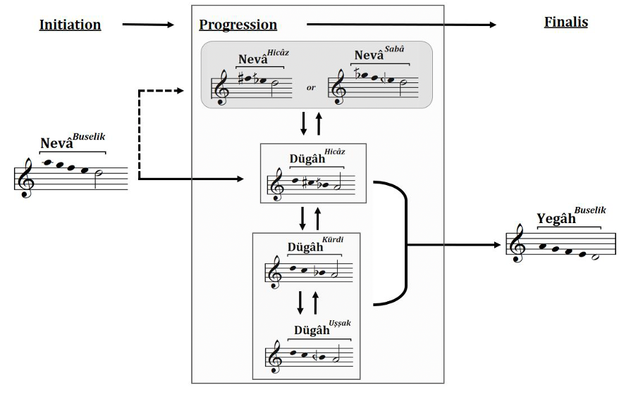
2) Description of Çeşni (Flavor or Melodic Unit) and Perde (Pitch Unit)
A Çeşni (Flavor) is a small melodic unit frequently structured as a tetrachord or pentachord. It can occasionally be encountered as a trichord or hexachord, as well.
Çeşni is described by the following qualities:
The pitch it leads to (Its local tonic or principal axis)
The intervallic content
Each çeşni has a principal axis and one or more secondary axis pitches which function as stationery. These can function as reference points for transformations
Çeşni is composed of Perde’s - pitch units which may correspond to a specific frequency or a bandwidth of frequencies depending on the context. In Turkish music each Perde (Pitch) and Çeşni (Flavor) has a textual label. Customarily, Perde is written first and Çeşni is written second. Our model utilizes the following notation: Dügah^{Uşşak} Rast^{Rast} meaning Uşşak Çeşni is built upon Dügah Perde.

Slide 9
3) Transition to Superstructures and our Questions
How are makams connected through different melodic units?
How are these melodic units related?
What kind of pitch relations do the melodic units utilize in order to progress from one to another?
What paths do they follow in order to progress?
How do makams compose larger structures via common melodic units?
Without the existence of stable frequency and measurement option how can we form relations?
Level:
Perde
Çeşni
Makam
Terkib

Slide 10
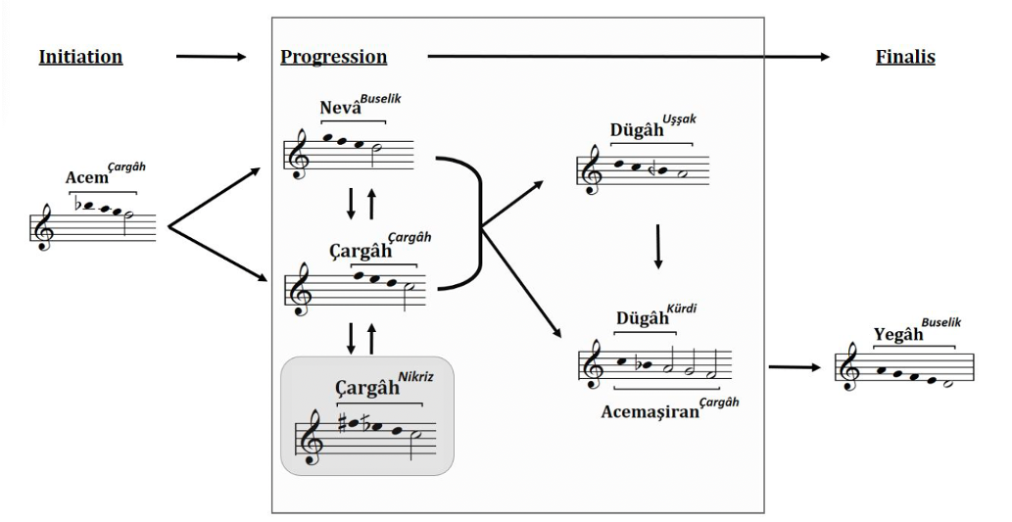
Transformations and Relations
Axis Related Transformations
refers to transformations in melodic structures wherein one or both of the axis pitches remain constant while the others undergoing changes.
Transference
The principal axis is transferred to the secondary axis or vica versa while the melodic flavor is preserved. It is a form of contextual transposition wherein the transposition level depends on the structure itself
“Girift” (Intricate) Relations
relations between intricate formations typically observed within complex arrangements. Alterations or expansions/contractions of the melodic structure occur due to the displacement of axis(es), resulting in associations with neighboring structures.

Slide 11
Technology and the App
Demonstration of the App
Data Structures and the database
Front-end: React and React-Force-Graph 2D and 3D
Backend: Python and Django framework

Slide 12
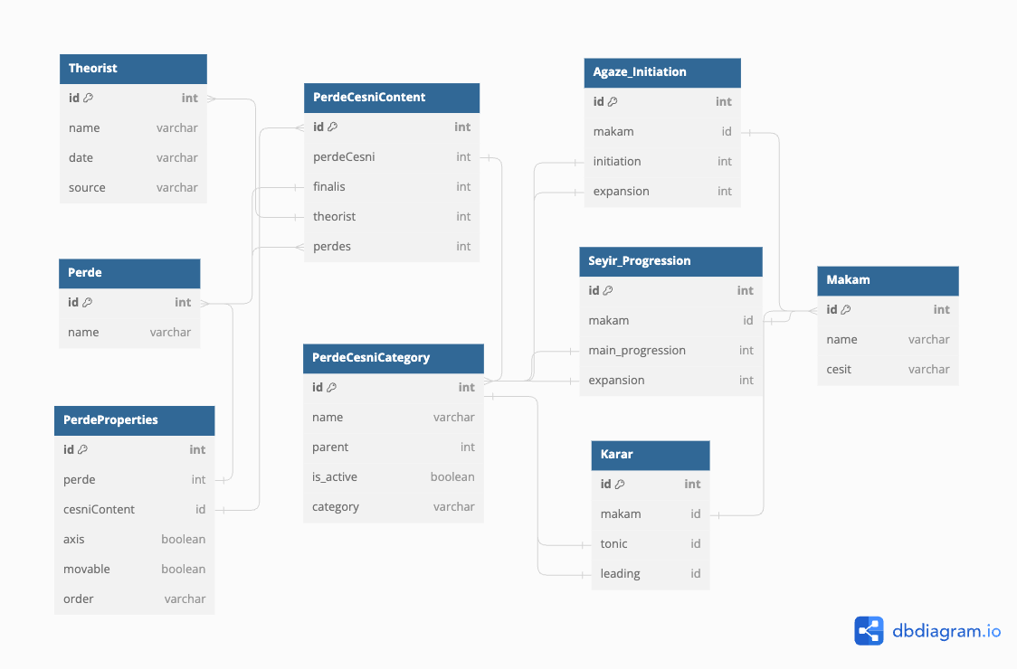
Data Structures and the Database
Notes:
Our data model for pitch and intervallic content in music uses a textual approach to account for the variability of makam systems, with a focus on capturing trajectories and pathways between melodic units and makam structures.
2. We leverage a relational database and Django framework to effectively represent and analyze the intricate textual data structures, revealing the topological properties inherent in the makam universe.
3. The model's fundamental building block is "Perde," linking melodic units, while incorporating essential melodic components ("Cesnis") establishes connections within the makam network, providing insights into the evolution and complexity of the makam universe across different historical periods.

Slide 13
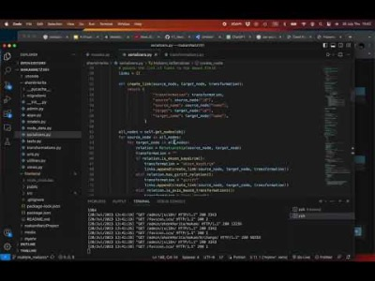
Backend: Python and Django Framework
Notes:
- Python, along with the Django framework, was chosen as the backend technology for our application due to Django's ability to establish a secure and efficient environment for managing large volumes of data. The built-in admin panel provided by Django facilitates seamless data administration and handling.
- The foundation of our data structures relies on Django "models," a prominent feature that empowers us to create intricate and well-defined data abstractions. This enables us to design and manage complex relationships between various entities in the system effectively.
- The Python "rest framework" complements our backend infrastructure, providing practical tools to formulate queries for data filtering, establish connections between nodes, implement code transformations, and execute relation algorithms. This feature-rich framework enhances the overall functionality and performance of our application.
- As part of the data processing pipeline, the acquired information undergoes transformation into the "json" format through a process known as "serialization." This preparation allows for efficient rendering operations at the frontend, facilitating smooth user interactions and presentation of data.

Slide 14
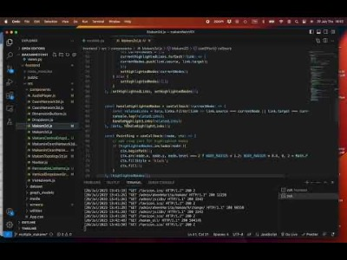
Front-end: React and React-Force-Graph 2D and 3D
Notes:
For the frontend framework, we opted for React, a widely-used open-source framework designed for constructing single-page web applications. React's modular structure revolves around components, which are reusable building blocks. This feature facilitates the development of scalable and maintainable web applications. Additionally, React boasts efficient rendering capabilities, contributing to the creation of fast and responsive web experiences.
• At the core of our application lies a graphical interface known as "react-force-graph." Leveraging the power of Three.js, a JavaScript module for rendering 3D graphics on the web, this interface enables the creation of visually appealing 3D and 2D force-directed graphs. The combination of React and Three.js provides a robust platform for generating captivating visual representations of complex data structures.
• By harnessing the data generated through Django, we were able to craft an engaging user interface, providing users with a seamless experience in exploring and constructing the universe. The current version of the application framework exhibits versatility in handling diverse data models and generating distinct networks in accordance with our theoretical framework.

Slide 15

Demonstration of the App - MakamNetzV1.0
Notes:
**1) ENTIRE ÇEŞNİ NETWORK**
Our app showcases the Çeşni Network, offering a 3D visualization of melodic units, or "çeşnis," and their connections. The small nodes represent individual çeşnis, while the larger ones symbolize the fundamental Pitch-perde upon which they are built. Nodes with the same color are derived from the same Perde. This visualization, known as the "Çeşni Universe," enables users to freely explore various pathways within the network, gaining insights into the complex relationships between melodic units.
For a more accessible experience, we have also created a 2D version of the Çeşni Universe. By hovering over a node, users can highlight all connected nodes and links, allowing for an in-depth analysis of transformations and relationships between melodic units, thus aiding the study of pathways in makams.
**2) MAKAMS**
In the Makams section, users can delve into the melodic progressions within a single makam. The formal sections are color-coded, and a designated blue node serves as the starting point. Both 3D and 2D representations are available for a comprehensive view.
Within the 2D model, clicking on a node provides an example of the melodic unit in both score and audio formats. This interactive feature fosters a deeper understanding of how makams are heard and represented in musical notation.
(audio and score demo)
Additionally, our app examines how the melodic units of a single makam are distributed within the topology of the Çeşni Universe. In certain cases, nodes representing closely related progressions cluster together, while other makams exhibit distant relations. We are actively refining this representation to better elucidate such phenomena.
Furthermore, we are exploring the transformation and relationships within individual makams. Our model shows promise in constructing frequently used makams, but we recognize the need to expand its capabilities by incorporating additional relations, such as 5th and octave pitches, as well as all secondary axis functioning pitches.
**3) MAKAM NETWORK**
Our app's final feature involves creating networks from multiple selected makams. Presently, we are testing this feature with 17 makams. Although Turkish music boasts over 400 makams, this subset allows us to observe and analyze relations between different makams and their sub-spaces.
In summary, our app aims to provide a humble and insightful exploration of Turkish music's melodic structures. Through 3D and 2D visualizations, interactive elements, and a wide range of makams, we hope to foster a deeper appreciation and understanding of this rich musical tradition. Thank you for joining us on this journey through the intriguing world of the Makam Network.

Slide 16
Bibliography
Aydemir, M. 2022. Türk Müziği Çeşni Rehberi. Pan Yayıncılık, İstanbul.
Bayraktarkatal, E., ve Güray, C. 2021. “Makamın Yapıtaşı.” Anadolu ve Komşu Coğrafyalarda Makam Müziği Atlası (eş editörler Güray C., Tokaç M. S.), s. 943-981, AKM Yayınları, Ankara.
Baysal, O. 2018. “Zaman Makam Analiz Modeli”. Ç.Adar (Ed). 9. Uluslararası Hisarlı Ahmet Sempozyumu: 11-12-13 Mayıs 2018- Müzik Teorileri Tam Metin Kitabı, (s.298-313) Afyonkarahisar: Matbaa-i Beka.Kütahya.
Cohn, R. 1998. Introduction to Neo-Riemannian Theory: A Survey and a Historical Perspective. Journal of Music Theory, 42(2), 167–180. https://doi.org/10.2307/843871
Cohn, R. 2011. “Tonal Pitch Space and the (neo-) Riemannian Tonnetz,” in Oxford Handbook of Neo-Riemannian Music Theories, Edward Gollin and Alexander Rehding, ed., forthcoming Oxford University Press
Kemânî Hızır Ağa. 1761. “Tefhîmü’l-Makâmât fî Tevlîdi’n-Nagamât”.
Kutluğ, Y. F. 2000. "Türk Musikisinde Makamlar." İstanbul: YKY.
Şeftali, Y.C. 2022. Abdülbaki Nasır Dede’nin Tedkik ü Tahkik Adlı Eserindeki Makam ve Terkiblerin Ahenk İlişkilerinin Belirlenmesi. Yüksek Lisans Tezi, İstanbul Teknik Üniversitesi
Programming Resources
Official Django documentation - https://docs.djangoproject.com/en/4.2/
Official React.js documentation - https://react.dev/reference/react
Official Python documentation - https://docs.python.org/3/
React Force Graph - https://github.com/vasturiano/react-force-graph
Three.js - https://threejs.org/docs/index.html#manual/en/introduction/Creating-a-scene
Dbdiagram.io

Slide 17
A Virtual Guide to the Makam Universe
Thank You
Dr. Ozan Baysal, Dr.Recep Gül, Yusuf Can Şeftali
HCI – New Technologies for Analysing and Visualizing Musical Structure
23.08.2023 – Copenhagen
This work is supported by the Scientific and Technological Research Council of Turkey, TUBITAK, Grant #122K923

